Slide 1

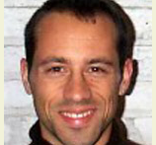

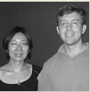

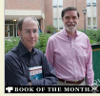
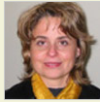
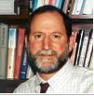
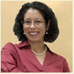
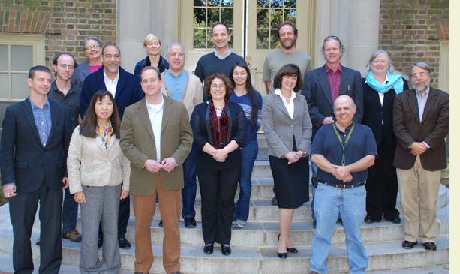
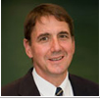
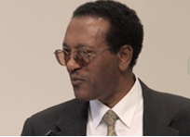



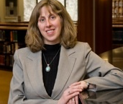
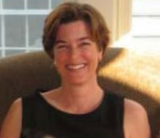
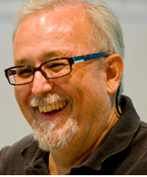

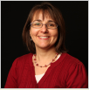
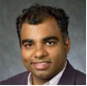

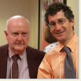
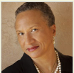
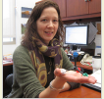

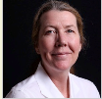
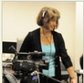

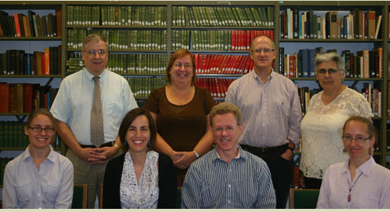




Who
Are We?
Some Facts
About the
Faculty

Slide 2
Number and Percent of Faculty and Other Employees, 2010-11
 | Number | %
Full-time Tenured and Tenure Eligible | 512 | 19.8%
Full-time Non-Tenure Eligible | 106 | 4.1%
Research and Public Service Faculty | 40 | 1.5%
Part-time (adjunct) Instructional and Research Faculty | 173 | 6.7%
All other employees | 1,753 | 67.8%
Total Full-time and Part-time Employees (excluding Instructional and Research Assistants) | 2,584
Source: IPEDS, Human Resource Component. Prepared by Office of Institutional Analysis, January 2012

Slide 3
Number of Full-time Faculty (T/TE and NTE) and All Other Employees, 1991-2010
Over the period, Full-time faculty increased by 31% while all other
Full-time employees increased by 67%.
Source: IPEDS, Human Resource Component. Prepared by Office of Institutional Analysis, January 2012

Slide 4
Salaries and Benefits of Full-time and Part-time Faculty, FY '12
As percent of Total Operating Costs
As percent of E&G
Source: Office of VP for Finance

Slide 5
2011: projection based on fall enrollments

Slide 6
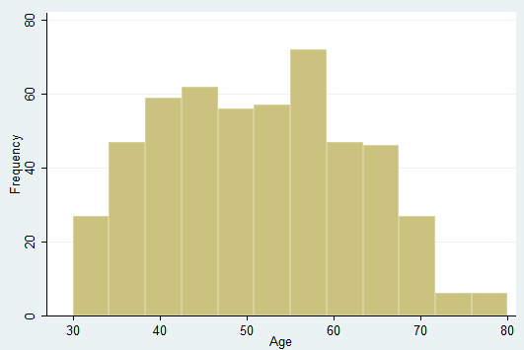
Age Distribution of Tenured and Tenure-Eligible (T/TE) Faculty
mean age = 51
132 faculty members (26%) of T/TE faculty are 60 or older.
73 faculty members (14%) of T/TE faculty are 65 or older.
Potential Problem or Opportunity?

Slide 7
More than a quarter of the faculty have been hired in the past 5 years.
Gender and Ethnic Breakdown of all
512 T/TE Faculty
Gender and Ethnic Breakdown of 131
T/TE Faculty Hired in Last Five Years
(26% of the Faculty)
 | Number | Percent
Female | 181 | 35%
Male | 331 | 65%
White Non-Hispanic | 436 | 85%
Asian/Pacific Islander | 34 | 7%
Black Non-Hispanic | 19 | 4%
Hispanic | 8 | 1.5%
Native American | 1 | .2%
Multi-ethnic | 1 | .2%
Unknown | 13 | 2.5%
 | Number | Percent
Female | 50 | 38%
Male | 81 | 62%
White Non-Hispanic | 98 | 81%
Asian/Pacific Islander | 12 | 10%
Black Non-Hispanic | 7 | 6%
Hispanic | 3 | 2%
Multi-ethnic | 1 | 1%
 |  | 100%
Unknown | 10
With normal retirements and faculty leaving for other reasons, we can anticipate
hiring another quarter of the faculty in the next five years. (51% of the faculty
have been hired within the past twelve years.)

