Slide 1
We Spent What?!
Budgeting, Reimbursements, & More!

Slide 2
Types of Budgets (3)
Club Development Account
Sport Club Checking Account (BB&T)
Campus Recreation Allocation

Slide 3
Club Development Account
This is money your club receives from alumni, parents, or other forms of donations.
Checks should be made payable to “College of William and Mary” and place “your club name” in the memo section of the check.
Donations carry over from year to year
Notes:
- Checks should be mailed or submitted directly to the Sport Club dept, who will ensure that the check goes to the development office under the proper account.
-If any check goes to the development office but is not clearly marked for your club, your club will not receive the funds.

Slide 4
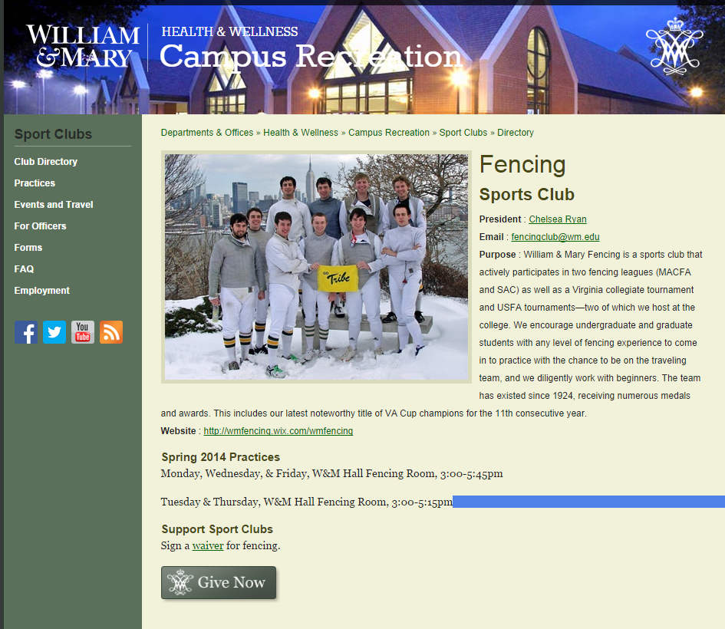
Donate online
Go to your club page on the Sport Club directory, and choose Give Now!

Slide 5
Sport Club Checking Account
This is your club’s personal checking account
Money that you would deposit in this account:
Dues, fundraisers, contracts, or any other method of acceptable revenue generation.
Carries over from year to year
Change the name of club officers
HOW? For BB&T come see me and I will generate a letter for you!
Notes:
You should change the names of club officers who have access to the checking accounts when new officers are elected.

Slide 6
Campus Recreation Allocation
A limited budget that you may use to pay for transportation costs, entry fees, lodging, equipment, or any special, preapproved purpose.
Anything you do not spend by the end of the Spring Semester (end of April) does NOT carry over to the next academic year.

Slide 7
Approved Campus Rec Budget Expenditures
Transportation costs Gas/vehicle rental
Lodging
League or Conference Membership Dues
Equipment for games and practices
Tournament Entry fees
Notes:
For more examples check out the sport clubs manual online

Slide 8
Non-Approved Expenditures
Payments for coaches/instructors
Socks, undergarments, t-shirts
Awards, prizes, gifts
Food
Any item not authorized by Sport Club Office prior to purchase

Slide 9
Quiz?!?!
FACT or FICTION?
Campus Rec funds are directly deposited to my club’s BB&T account for us to use.

Slide 10
FICTION
There are three ways to access your Campus Rec Budget
Reimbursement after an approved purchase or travel
Direct payments for club registrations, tournament fees, etc.
Invoice payments for approved purchases

Slide 11
Things you need to KNOW
Changing names on checking accounts, equipment purchases policies, & reimbursements

Slide 12
Names on Checking Accounts
Step 1
Request a letter from the Sport Club Office
Step 2
Get the letter signed by the Sport Club Office
Step 3
Step 4
Return the letter to the Sport Club Office so we can verify the change
Bring the letter to the bank

Slide 13
Equipment Purchased Policies
Equipment purchased with Campus Rec Budget
Must be inventoried and returned to the Rec Center at the end of the each academic year.
Equipment will be placed in storage, and sign it back to your club when the school year starts again in the fall.
Equipment purchased with Club Checking Account
Does not have to be turned in since the funds are self-generated
Many clubs return this equipment at the end of the year anyway, since it serves to benefit the club in the future.

Slide 14
Reimbursements
1. Complete a reimbursement request form within 5 days of purchase or travel
2. Include original receipts and ALL relevant information (Student ID#, travel dates, hotel room occupants)
3. For travel, you must sign 2 travel vouchers (Form P and Q)
4. Submit the request to the Sport Club Office
5.You should receive payment in approximately 4-6 weeks

Slide 15
Reimbursements Reminders
Requests related to travel/trips are due 7 days following your trip
Non-travel related expenses can be reimbursed directly to your club, for deposit in your club’s BB&T Account or to the individual. If you would like for the check to be made out to your club, be sure to note this on Appendix R.
Names on receipts must match those specified on Appendix R

Slide 16
Reimbursements: What NOT to do
Reimbursement requests will NOT BE ACCEPTED if:
You do not include a receipt, hotel folio, or other relevant information
You do not include your Student ID#
You do not sign and attach Appendix P&Q for request related to travel
Names don’t match
Common mistakes to watch out for:
Leaving Section C blank on Appendix R
Forms submitted without the signature of Club President of Treasurer
Names on receipts do not match those on Appendix R

Slide 17
Thank You!
Any questions?
Let me know!
Kelly Mathiesen
Graduate Assistant for Sport Clubs
Campus Recreation
rsclub@wm.edu
(757) 221-7413

