Slide 1

2024 Open Enrollment for Health Benefits and Flexible Spending Accounts
Commonwealth of Virginia Health Benefits Program

Slide 2
2024 Open Enrollment
May 1 – May 15
It’s time to make annual decisions on health plans
and flexible spending accounts (FSAs)
Nothing is required if you are:
Not changing your health plan or dependents
Not enrolling in an FSA
Not participating in Premium Rewards
Changes made during Open Enrollment become effective in the new plan year beginning July 1, 2024

Slide 3
Health Plans
Enroll in or change your health plan
Elect or remove optional buy-ups
Waive coverage
Add or remove family members

Slide 4
Flexible Spending Accounts
Enroll in a Health or Dependent Care
FSA or both
You must submit an enrollment each year you wish to have an FSA

Slide 5
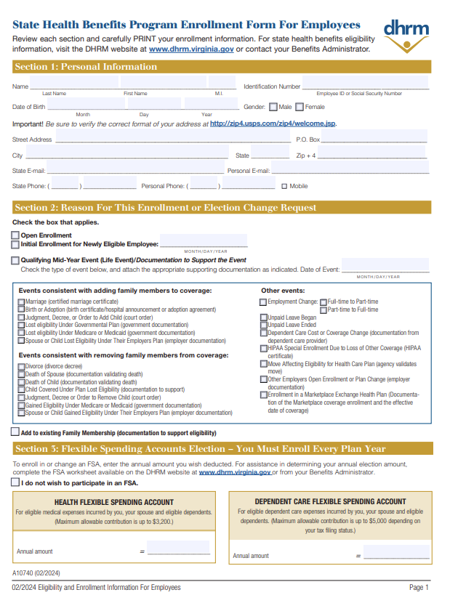

Make Your Elections
Online by visiting my.cardinal.virginia.gov
OR
Submit an Enrollment Form to your agency Benefits Administrator securely via this box link
The deadline is 11:59 pm Wednesday, May 15

Slide 6
New to Cardinal?
You will be required to register before you can log into Cardinal for the first time.
Not sure if you need to register? Visit https://www.cardinalproject.virginia.gov/portal for guidance.

Slide 7
Visit Cardinal Online to Prepare
Register as a new user with your Cardinal ID if this is your first time accessing the system
Your 11-digit Cardinal ID # can be found by visiting https://my.wm.edu/ and logging in to Banner Self-Service. Once in Banner, select:
1. "Personal Information"
2. "View/Update Personal Information."
3. Your 93# and Cardinal ID will be displayed in the top right corner of this page

Slide 8

Cardinal New User Registration Quick Start Guide
CLICK HERE TO ACCESS PDF
Please ensure your login works and confirm your contact information
Phone Number
Email Address
Home Address

Slide 9

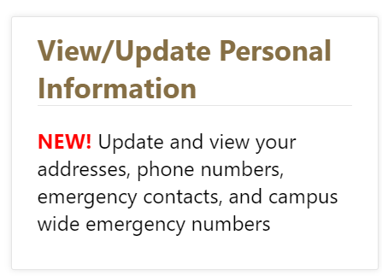
Contact Info Updates
Do you need to update your phone number, email, and/or home address?
You can do so under the Personal Information tab in Banner Self Service (go to my.WM.edu and click the Banner button.)
Please also send a message to askHR@wm.edu if any contact information is incorrect in Cardinal.

Slide 10
Accessed Cardinal before?
Simply login at my.cardinal.virginia.gov.
If you forgot your password and you registered for Cardinal previously (it’s a long process, you wouldn’t forget it!), use these steps:
Go to my.cardinal.virginia.gov
Use the “Forgot Password” link, which will send an automated email.
TIP! This automated email may take up to 20 minutes to deliver, make
sure to check your spam!
Need more support? Go to: https://www.cardinalproject.virginia.gov/portal

Slide 11

Online Open Enrollment in Cardinal
Log into Cardinal at my.cardinal.virginia.gov
Open Enrollment help:
Spotlight, pages 4-5 or
Cardinal Support materials at www.cardinalproject.virginia.gov/oe

Slide 12

Cardinal Christy is here to help!
This tutorial video provides an overview on how you can make benefit elections during open enrollment using Cardinal HCM

Slide 13
Unable to Complete and Submit Enrollment Online?
Complete fillable form which can be found here.
Print, sign, and submit to University Human Resources using the secure box upload link.
All supporting documentation for dependents can be submitted via box as well.
Be sure paper enrollment forms are uploaded to box, postmarked, or faxed by 11:59 pm on May 15, 2024

Slide 14
Health Plan Options
Plans Offered | Available
Anthem COVA Care | Statewide & elsewhere
Anthem HDHP | Statewide & elsewhere
Aetna COVA HealthAware | Statewide & elsewhere
Kaiser Permanente HMO | Regional, Northern Virginia
Sentara Health Vantage HMO | Regional, Hampton Roads
TRICARE Supplement | Statewide & elsewhere
Employee premiums depend on approval of the state budget by the General Assembly and are subject to change. Current premiums can be found in the DHRM Spotlight.

Slide 15

Verify Plan Choice With ALEX

Slide 16
What’s New for 2024
COVA Care without Optional Vision & Hearing: The $1,500 benefit for a minor will pay every 24 months and there is no additional benefit.
COVA Care with Optional Vision & Hearing:
The $1,500 benefit will pay first for a minor every 24 months, if the benefit doesn’t cover the hearing aid, the minor can utilize the optional benefit of $1,200 every 48
months.
Adults only have the optional benefit of $1,200 every 48 months.
COVA HealthAware: The $1,500 benefit for a minor will not be subject to the deductible and paid at $0 coinsurance every 24 months.
COVA HDHP: The $1,500 benefit for a minor will be subject to the deductible and paid at $0 coinsurance every 24 months.
Sentara Health Plans HMO: The $1,500 benefit for a minor will pay every 24 months. There is no additional benefit.
The adult hearing aid benefit is $1,200 every 48 months.
Hearing Aid Benefit for Children
Coverage for hearing aids and related services for minor children age 18 and younger.
Coverage includes the cost of one hearing aid, per hearing-impaired ear, every 24 months, up to $1,500.

Slide 17

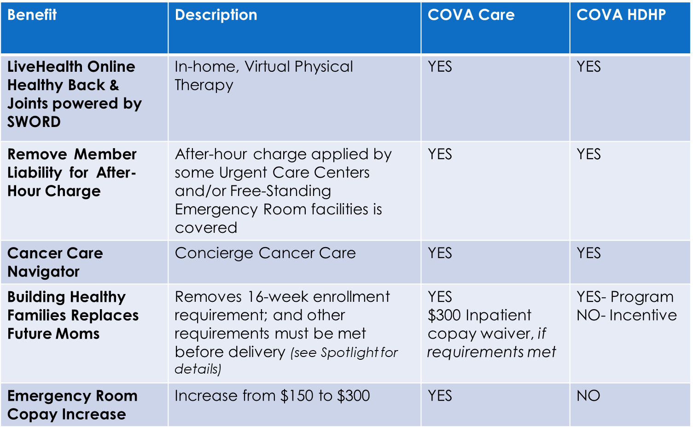
What’s New for 2024

Slide 18
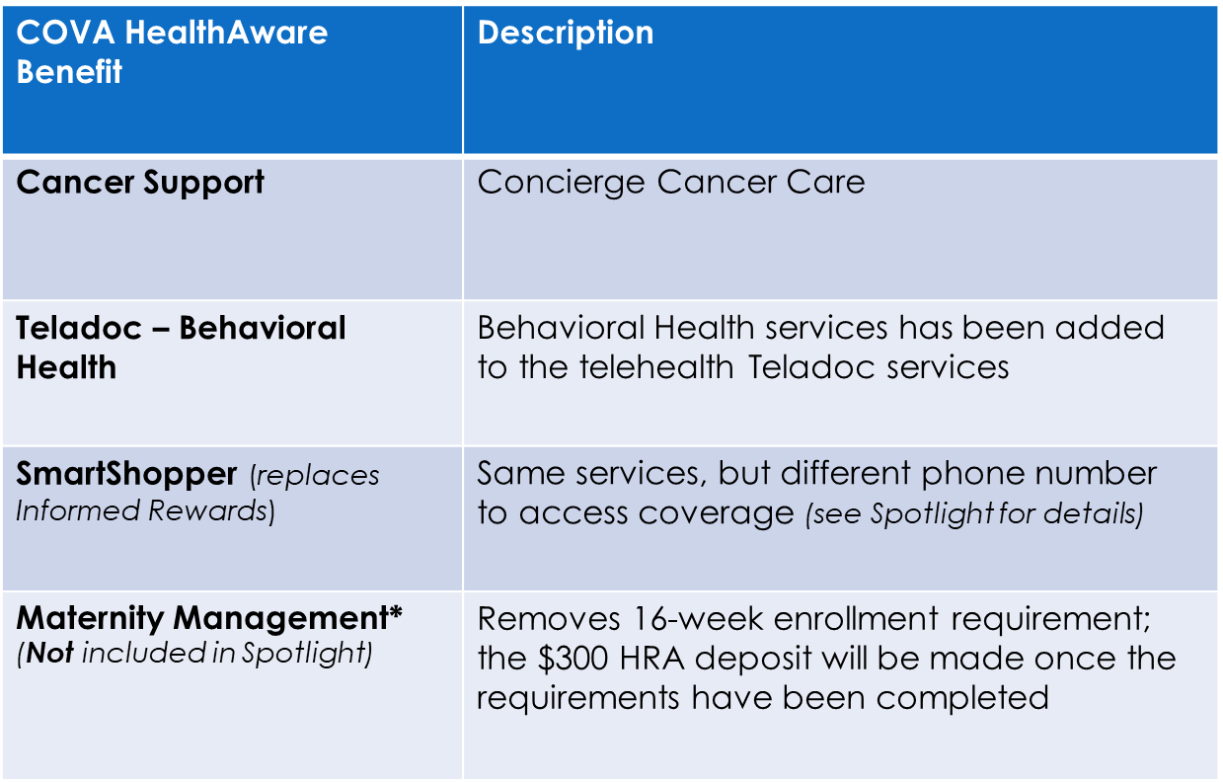
What’s New for 2024

Slide 19


Earn Premium Rewards!
For employee and/or spouse enrolled in:
COVA Care or COVA HealthAware
Employee or spouse can earn $17/month
Together can earn $34/month

Slide 20
How Do I Receive a Premium Reward?
Employee must be enrolled in COVA Care or COVA HealthAware
For a Reward Starting July 1
Complete your health assessment between May 1 and May 15
For a Reward After July 1
Earn a reward any time during the plan year as long as the requirements are met
See Premium Reward requirements chart here

Slide 21
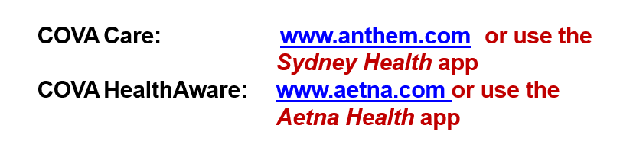
Where Do I Submit My Health Assessment?
Log in to the COVA Care or COVA HealthAware plan website or app
**Additional instructions are provided in Spotlight**

Slide 22
Statewide Plans
COVA Care | Administered by Anthem, Delta Dental and Anthem Pharmacy delivered by CarelonRx | www.anthem.com/cova COVA Care Brochure
COVA HDHP | Administered by Anthem, Delta Dental and Anthem Pharmacy delivered by CarelonRx | www.anthem.com/cova COVA HDHP Brochure
COVA HealthAware | Administered by Aetna, Delta Dental and Anthem Pharmacy delivered by CarelonRx | www.covahealthaware.com COVA HealthAware Brochure
TRICARE Supplement for Eligible Military Retirees | Administered by Selman & Company | https://info.selmanco.com/cova 800-638-2610, press Option 1
Regional Plans
Sentara Health Vantage HMO | Available only in Hampton Roads (see website for specific zip codes) | https://www.sentarahealthplans.com/group-pages/cova Sentara Health Plans HMO Brochure
Kaiser Permanente HMO | Available primarily in Northern Virginia (see website for specific zip codes) | https://my.kp.org/commonwealthofvirginia/ Kaiser Permanente HMO Brochure
Additional contact information and resources available on the last page of Spotlight

Slide 23


STATEWIDE plans

Slide 24
Administered by Anthem
Basic Plan Includes:
Medical
Behavioral Health
Prescription Drug
Diagnostic & Preventative Dental
Routine Eye Exam & Vision Discounts

Slide 25
Optional Benefits
Expanded Dental
Primary Care - such as fillings, extractions, root canals
Complex Restorative - crowns, dentures,
bridges and implants
Orthodontic services

Slide 26
Optional Benefits
Expanded Hearing
Routine hearing exam once per plan year
Hearing aids and related supplies up to $1,200 every 48 months
Expanded Vision
Eyeglasses
Contact lenses
Includes allowances for non-Blue View provider services

Slide 27
Basic Plan Includes:
Medical
Behavioral Health
Prescription Drug
Diagnostic & Preventative Dental
Routine Eye & Hearing Exams
Health Reimbursement Arrangement (HRA)
Out-of-Network Coverage

Slide 28
Optional Benefits
Expanded Dental
Primary Care - such as fillings, extractions, root canals
Complex Restorative - crowns, dentures, bridges and implants
Orthodontic services
Expanded Vision
Eyeglasses
Contact lenses
Discounts for eyewear and
accessories
Network includes private practice providers plus participating national chains

Slide 29
What is a Health Reimbursement Arrangement (HRA)?
Account that automatically pays eligible out-of-pocket expenses as long as funds are available
Medical
Behavioral Health
Pharmacy
Funds paid from HRA toward any eligible expenses for any covered member
Unused HRA funds roll-over into future plan years with no limit if enrollment in the plan continues

Slide 30
HRA Contribution
Initial HRA contribution for 7/1/2024:
Employee/Early Retiree - $600
Employee/Early Retiree + Enrolled Spouse - $1200
HRA contribution is prorated for new enrollments or
QME changes during the plan year.
The HRA proration chart may be found here

Slide 31
Additional HRA funds can be earned by completing “Do-Rights”
$50 HRA contribution for up to three “do-rights”
Up to $150 per
employee/early retiree
Up to $150 per enrolled spouse
“Do-Rights” Include
Annual routine physical exam
Routine dental exam
Annual routine vision exam
Annual flu shot
Physical activity tracker
Digital coaching

Slide 32
Regional plans

Slide 33

Sentara Health Plans Vantage HMO
You must live or work in Hampton Roads area zip
codes to enroll
No referrals required to see a specialist
Out-of-area coverage for dependent children
No out-of-network coverage except for emergencies

Slide 34
Sentara Health Plans Vantage HMO
Medical, prescription drug, dental, vision and hearing benefits
Preventive care covered at 100%
100% of hospitals in Hampton Roads are in-network
Employee Assistance Program (EAP)
Dedicated member services unit
https://www.sentarahealthplans.com/group-pages/cova

Slide 35
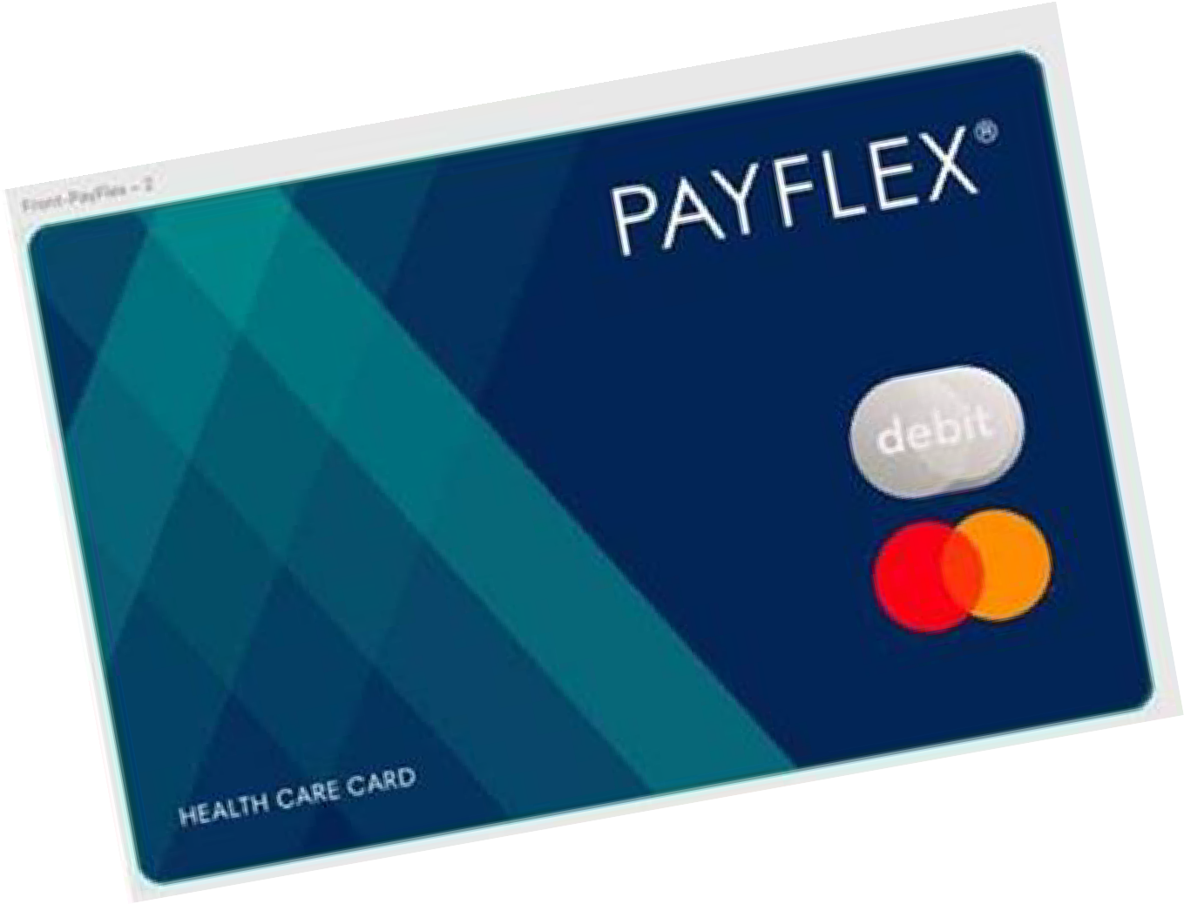
Flexible Spending Accounts (FSA)
Administered by PayFlex for all employees eligible for health benefits
Health Care FSA
Set aside up to $3,200 per year, pre-tax, for eligible health care expenses
Dependent Care FSA
Set aside up to $5,000 per year, pre-tax, for eligible expenses for the care of your dependent

Slide 36
Flexible Spending Accounts (FSA)
You must enroll each plan year to participate in an FSA
“Use it or lose it” rule:
Use all the funds by the end of your coverage period (June 30)
File for reimbursement by your filing
deadline or forfeit your FSA funds

Slide 37
Useful Links & Resources
Questions about changes in the upcoming health plan year? | Review Important 2024-2025 Health Plan Information and Premiums in the Spotlight on Your Benefits newsletter
Looking for paper enrollment form, important healthcare notices and other helpful DHRM resources? | Visit the DHRM Open Enrollment page
Questions on Cardinal HCM Employee Self Service (ESS)? | Review the Cardinal Quick Guide to Open Enrollment or email askHR@wm.edu
Questions on Open Enrollment in general? | Check out these FAQ’s or email openenrollment@dhrm.virginia.gov
Questions on which plan is best for you? | Consult with ALEX Virtual Benefits Counselor

Slide 38
Open Enrollment Support Sessions
Wednesday May 1, 2024 Open Enrollment Begins! In-Person Support Session for W&M Employees Jones Hall Room 203 8:30 to 12:30 pm
Friday May 3, 2024 In-Person Support Session for VIMS Employees Watermen’s Hall Technology Classroom (VIMS) 9:00 am to 1:00 pm
Monday May 6, 2024 In-Person Support Session for W&M Employees Jones Hall Room 203 12:30 pm to 4:30 pm
Tuesday May 7, 2024 In-Person Support Session for VIMS Employees Watermen’s Hall Technology Classroom (VIMS) 12:30 pm to 4:30 pm
Wednesday May 8, 2024 In-Person Support Session for W&M Employees Jones Hall Room 203 8:30 am to 12:30 pm
Tuesday May 14, 2024 In-Person Support Session for W&M Employees Jones Hall Room 203 12:30 pm to 4:30 pm
UHR is offering in-person support sessions where the team will be available to assist with questions concerning coverage levels, costs, differences in the programs, etc., and assist employees with making selections and changes in Cardinal
Please note: We are unable to advise on health plan elections based on individual circumstances
No Appointment Necessary

Slide 39
Contact Us
William & Mary
University Human Resources
Email: askhr@wm.edu
Phone: 757-221-3169
Fax: 757-221-7724

