Slide 1
2023 Open Enrollment for Health Benefits and Flexible Spending Accounts (FSAs)
Commonwealth of Virginia Health Benefits Program

Slide 2
2023 Open Enrollment
May 1 – May 15
It’s time to make annual decisions on health plans
and flexible spending accounts (FSAs)
Nothing is required if you are:
Not changing your health plan or dependents,
Not enrolling in an FSA, and
Not participating in Premium Rewards
Changes made during Open Enrollment become effective in the new plan year beginning July 1, 2023

Slide 3
Health Plans
Enroll in or change your health plan
Elect or remove optional buy-ups for COVA Care, COVA HDHP, COVA HealthAware
Waive coverage (elect not to participate in Commonwealth health coverage)
Add or remove family members

Slide 4
Flexible Spending Accounts (FSA’s)
Enroll in a Health or Dependent Care
FSA or both
You must submit an enrollment request each year you wish to have an FSA

Slide 5
Welcome to
You can make your Open Enrollment Elections either:
Online by visiting my.cardinal.virginia.gov
or
Submit an Enrollment Form to your agency Benefits Administrator at askHR@wm.edu
The deadline is 11:59 Monday, May 15, 2023!

Slide 6
Cardinal ESS
Employees can make elections online related to:
Health plan
Flexible Spending Accounts (FSA)
When?
During the Open Enrollment period from Monday, May 1, 2023 to Monday, May 15, 2023 no later than11:59 p.m.

Slide 7
New to Cardinal?
You will be required to register before you can log into Cardinal for the first time.
Not sure if you need to register?
Go to https://www.cardinalproject.virginia.gov/portal for guidance on who needs to register for Cardinal.

Slide 8
Visit Cardinal Online Before May 1 to Prepare
Register as a new user with your Cardinal ID if this is your first time accessing the system
Your 11-digit Cardinal ID # can be found by visiting https://my.wm.edu/ and logging in to Banner Self-Service. Once in Banner, select:
1. "Personal Information"
2. "View/Update Personal Information."
3. Your 93# and Cardinal ID will be displayed in the top right corner of this page

Slide 9
Cardinal New User Registration Quick Start Guide
CLICK HERE TO ACCESS PDF
Please ensure your login works and confirm your contact information
Phone Number
Email Address
Home Address

Slide 10
Accessed Cardinal before?
Simply login at my.cardinal.virginia.gov.
If you forgot your password and you registered for Cardinal previously (it’s a long process, you wouldn’t forget it!), use these steps:
Go to my.cardinal.virginia.gov
Use the “Forgot Password” link, which will send an automated email.
TIP! This automated email may take up to 20 minutes to deliver, make
sure to check your spam!
Need more support? Go to: https://www.cardinalproject.virginia.gov/portal

Slide 11
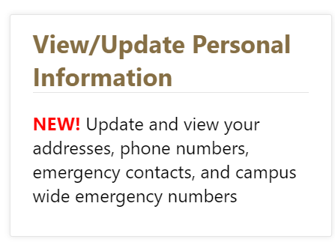
Moved Lately?
Do you need to update your phone number, email, and/or home address?
You can do so under the Personal Information tab in Banner Self Service (go to my.WM.edu and click the Banner button.)

Slide 12
How to Complete your Online Open Enrollment in Cardinal
Log into Cardinal at my.cardinal.virginia.gov
Follow the Open Enrollment directions by either using:
Mailed Spotlight, pages 4-5 or
Cardinal Support materials at www.cardinalproject.virginia.gov/oe

Slide 13
Cardinal Carl is here to help!
This tutorial video provides an overview on how you can make benefit elections during open enrollment using Cardinal HCM

Slide 14
Visit Cardinal Online Starting May 1 to Submit Elections
1. Select Human Capital Management under Cardinal Applications
2. Click on the Benefits Detail tile
3. Click the Benefits Enrollment list item on the left-hand side of the screen
4. When on this page, click the Start button
5. The Open Enrollment page displays, follow instructions
Submit your elections early starting May 1 and no later than 11:59 p.m. on May 15, 2023

Slide 15
Unable to Complete and Submit Enrollment Online?
Complete fillable form which can be found here
Print, sign, and submit to University Human Resources using the secure Box upload link
All supporting documentation for dependents can be submitted via Box as well
Be sure paper enrollment forms are uploaded to Box, postmarked, or faxed by 11:59 on May 15, 2023

Slide 16
Health Plan Options
Plans Offered | Available
Anthem COVA Care | Statewide & elsewhere
Anthem HDHP | Statewide & elsewhere
Aetna COVA HealthAware | Statewide & elsewhere
Kaiser Permanente HMO | Regional, Northern Virginia
Optima Health Vantage HMO | Regional, Hampton Roads
TRICARE Supplement (eligible military retirees) | Statewide & elsewhere
Employee premiums depend on approval of the state budget by the General Assembly and are subject to change. Current premiums can be found in the DHRM Spotlight.

Slide 17
Verify Plan Choice With ALEX
Find the best health plan options with ALEX, your online benefits counselor.
ALEX evaluates your input and recommends a plan tailored just for you!
https://www.myalex.com/cova/2023

Slide 18
Open Enrollment Highlights
COVA Care and COVA HDHP
Diabetes Prevention Program: Digital health coaching to reduce risk for type 2 diabetes at no cost to the member.
Expanded Virtual Care: Virtual primary care and preventive care through the Sydney Health mobile app at no cost to the member.
LiveHealth Online Dermatology: Consult with a dermatologist virtually.
In-Home Addiction Treatment/I-HAT: In-home drug and alcohol
addiction treatment program.

Slide 19
Open Enrollment Highlights
COVA HealthAware
Teladoc Dermatology: Consult with a dermatologist virtually.
MinuteClinic: In-person and virtual visits at no cost to the member.
Health Flexible Spending Account
Contribution maximum increases to $3,050 per plan year.
Open Enrollment packet mailed to home address on record
Packet includes Spotlight, Language Assistance, CHIP Notice along with other Important Notices.

Slide 20
Earn Premium Rewards!
For employee and/or spouse enrolled in:
COVA Care or COVA HealthAware
Employee or spouse can earn $17/month
Together can earn $34/month

Slide 21
How Do I Receive a Premium Reward?
Employee must be enrolled in COVA Care or COVA HealthAware
For a Reward Starting July 1
Complete your health assessment between May 1 and May 15
For a Reward After July 1
Earn a reward any time during the plan year as long as the requirements are met
See Premium Reward requirements chart:
https://www.dhrm.virginia.gov/employeebenefits/open-enrollment2023-24

Slide 22
Where Do I Submit My Health Assessment?
Log in to the COVA Care or COVA HealthAware plan website or app
**Additional instructions are provided in Spotlight**

Slide 23
Shared Savings Programs
Incentive programs to reduce healthcare costs and reward you for making informed, cost-effective decisions about your health care
Voluntary and available to you and your enrolled dependents
COVA HealthAware: Informed Rewards www.aetna.com
COVA Care & COVA HDHP: Smart Shopper https://cova.smartshopper.com

Slide 24
Statewide Plans
COVA Care | Administered by Anthem, Delta Dental and Anthem Pharmacy delivered by CarelonRx | www.anthem.com/cova 800-552-2682 Plan Summary
COVA HDHP | Administered by Anthem, Delta Dental and Anthem Pharmacy delivered by CarelonRx | www.anthem.com/cova 800-552-2682 Plan Summary
COVA HealthAware | Administered by Aetna, Delta Dental and Anthem Pharmacy delivered by CarelonRx | www.covahealthaware.com 855-414-1901 Plan Summary
TRICARE Supplement for Eligible Military Retirees | Administered by Selman & Company | https://info.selmanco.com/cova 800-638-2610, press Option 1
Regional Plans
Optima Health Vantage HMO | Available only in Hampton Roads (see website for specific zip codes) | www.optimahealth.com/cova 866-846-2682 Plan Summary
Kaiser Permanente HMO | Available primarily in Northern Virginia (see website for specific zip codes) | https://my.kp.org/commonwealthofvirginia/ 800-777-7902 Plan Summary
Additional contact information and resources available on the last page of Spotlight

Slide 25
STATEWIDE plans

Slide 26
Administered by Anthem
Basic Plan Includes:
Medical
Behavioral Health
Prescription Drug
Diagnostic & Preventative Dental
Routine Eye Exam & Vision Discounts

Slide 27
Optional Benefits
Expanded Dental
Primary Care - such as fillings, extractions, root canals
Complex Restorative - crowns, dentures,
bridges and implants
Orthodontic services

Slide 28
Optional Benefits
Expanded Hearing
Routine hearing exam once per plan year
Hearing aids and related supplies up to $1,200 every 48 months
Expanded Vision
Eyeglasses
Contact lenses
Includes allowances for non-Blue View provider services

Slide 29
Administered by Aetna
Basic Plan Includes:
Medical
Behavioral Health
Prescription Drug
Diagnostic & Preventative Dental
Routine Eye & Hearing Exams
Health Reimbursement Arrangement (HRA)
Out-of-Network Coverage

Slide 30
Optional Benefits
Expanded Dental
Primary Care - such as fillings, extractions, root canals
Complex Restorative - crowns, dentures, bridges and implants
Orthodontic services
Expanded Vision
Eyeglasses
Contact lenses
Discounts for eyewear and
accessories
Network includes private practice providers plus participating national chains

Slide 31
What is a Health Reimbursement Arrangement (HRA)?
Account that automatically pays eligible out-of-pocket expenses as long as funds are available
Medical
Behavioral Health
Pharmacy
Funds paid from HRA toward any eligible expenses for any covered member
Unused HRA funds roll-over into future plan years with no limit if enrollment in the plan continues

Slide 32
HRA Contribution
Initial HRA contribution for 7/1/2023:
Employee/Early Retiree - $600
Employee/Early Retiree + Enrolled Spouse - $1200
HRA contribution is prorated for new enrollments or
QME changes during the plan year.
The HRA proration chart may be found at
www.COVAHealthAware.com

Slide 33
Additional HRA funds can be earned by completing “Do-Rights”
$50 HRA contribution for up to three “do-rights”
Up to $150 per
employee/early retiree
Up to $150 per enrolled spouse
“Do-Rights” Include
Annual routine physical exam
Routine dental exam
Annual routine vision exam
Annual flu shot
Physical activity tracker
Digital coaching

Slide 34
TRICARE Supplement
Open to state employees and early retirees who are military retirees, or the spouse of a military retiree
Must be eligible for:
TRICARE, the military health benefits program, and
the State Health Benefits Program
https://info.selmanco.com/cova

Slide 35
Regional plans

Slide 36
O ptima Health Vantage HMO
You must live or work in Hampton Roads area zip
codes to enroll
You choose a primary care physician (PCP) to coordinate your care
No referrals required to see a specialist
Out-of-area coverage for dependent children
No out-of-network coverage except for emergencies

Slide 37
O ptima Health Vantage HMO
Medical, prescription drug, dental, vision and hearing benefits
Preventive care covered at 100%
100% of hospitals in Hampton Roads are in-network
Employee Assistance Program (EAP)
Dedicated member services unit
www.optimahealth.com/cova

Slide 38
Kaiser Permanente HMO
You must live or work in primarily Northern Virginia zip codes to enroll
Medical, prescription drug, dental, vision and hearing benefits
Preventive care covered at 100%
You choose a primary care physician (PCP) to coordinate your care
Employee Assistance Program (EAP)
Plan service area extends to Fauquier County
www.myhealthkp.org/commonwealthofvirginia

Slide 39
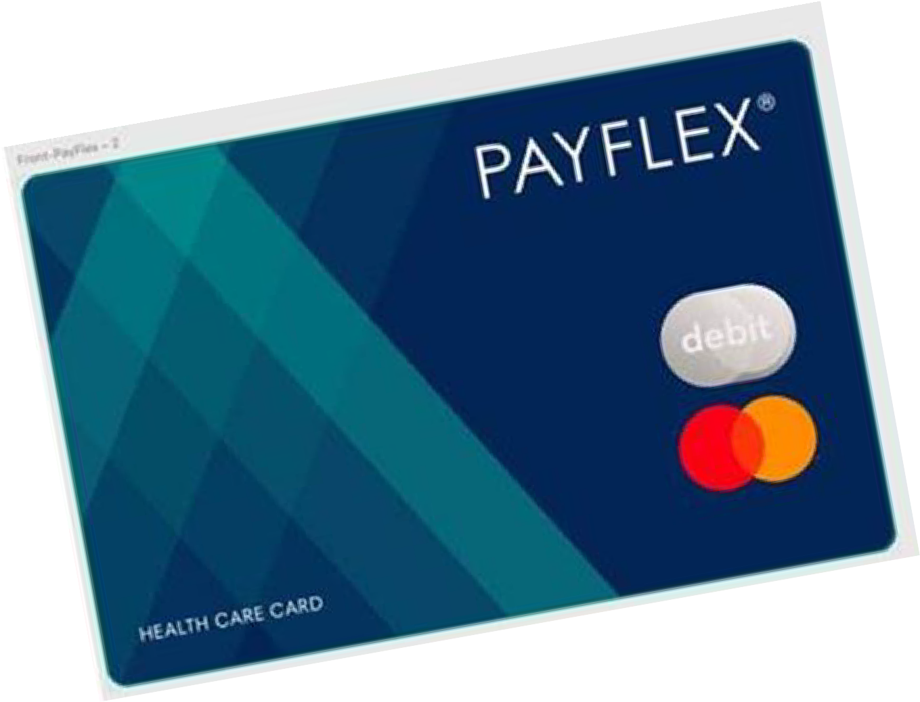
Flexible Spending Accounts (FSAs)
Administered by PayFlex for all employees eligible for health benefits
Health Care FSA
Set aside up to $3,050 per year, pre-tax, for eligible health care expenses
Dependent Care FSA
Set aside up to $5,000 per year, pre-tax, for eligible expenses for the care of your dependent

Slide 40
Flexible Spending Accounts (FSAs)
You must enroll each plan year to participate in an FSA
“Use it or lose it” rule:
Use all of your funds by the end of your coverage period (June 30)
File for reimbursement by your filing
deadline or forfeit your FSA funds

Slide 41
Useful Links & Resources
Questions about changes in the upcoming health plan year? | Review Important 2023-2024 Health Plan Information and Premiums in the Spotlight on Your Benefits newsletter
Looking for paper enrollment form, important healthcare notices and other helpful DHRM resources? | Visit the DHRM Open Enrollment page
Questions on Cardinal HCM Employee Self Service (ESS)? | Review the Cardinal Quick Guide to Open Enrollment or email askHR@wm.edu
Questions on Open Enrollment in general? | Check out these FAQ’s or email openenrollment@dhrm.virginia.gov
Questions on which plan is best for you? | Consult with ALEX Virtual Benefits Counselor
Questions on individual plan details? | Review individual Plan Brochures here

Slide 42
Open Enrollment Support Sessions
Monday May 1, 2023 Open Enrollment Begins! In-Person Support Session for W&M Employees Jones Hall Room 203 8:30 to 12:30 pm
Tuesday May 2, 2023 In-Person Support Session for VIMS Employees Davis Conference Room (VIMS) 12:00 pm to 4:00 pm
Wednesday May 3, 2023 In-Person Support Session for W&M Employees Jones Hall Room 203 12:30 pm to 4:30 pm
Thursday May 4, 2023 In-Person Support Session for VIMS Employees Davis Conference Room (VIMS) 12:00 pm to 4:00 pm
Friday May 12, 2023 In-Person Support Session for W&M Employees Jones Hall Room 203 8:30 am to 12:30 pm
UHR is offering in-person support sessions where the team will be available to assist with questions concerning coverage levels, costs, differences in the programs, etc., and assist employees with making selections and changes in Cardinal
Please note: We are unable to advise on health plan elections based on individual circumstances
No Appointment Necessary

Slide 43
Contact Us
William & Mary
University Human Resources
Email: askhr@wm.edu
Phone: 757-221-3169
Fax: 757-221-7724
UHR is here to help!

