Slide 1

PAYMENTS TO STUDENTS GUIDE
Effective April 1st, 2023

Slide 2

Notes:
Poll Title: Do not modify the notes in this section to avoid tampering with the Poll Everywhere activity.
More info at polleverywhere.com/support
Provide 3 Words that describe how are you feeling today!
https://www.polleverywhere.com/free_text_polls/EvpFiYOicqumoSi6DZWpr

Slide 3
Agenda
Administration
Types of Student Payments
Procedures
Tools & Resources
Examples
Announcements

Slide 4

Introduction
William and Mary makes various payments to students for tuition and fees, research, other education-related activities and employment.
In awarding and processing such payments, care must be taken to classify these payments correctly for tax purposes.
This document addresses types of payments made to both graduate and undergraduate students, including scholarships, fellowships, stipends, prizes and awards, compensation for services and reimbursements.

Slide 5
Tax Law (IRC Section 117)
The taxation of scholarships and fellowships is important to colleges and universities
Processing Teams need to know whether the award is taxable and, if so, whether it must withhold income tax on the payment and file any reports with the IRS.
For the most part, all student payments are taxable and reportable.
There is also the tax impact on the student who receives the scholarship or fellowship payments. We need to ensure our students are aware of and follow compliance with the applicable tax laws.

Slide 6
Student Definition
To be considered a W&M Student
Must be enrolled in an approved degree seeking program
Student is approved for Study Abroad
Enrollment can be FT or PT
Must be Accepted for Admissions

Slide 7
WM Employee - Student
WM employees may have a student status because they are taking classes under the Employee Educational Assistance Policy and are limited to an annual maximum benefit of $5,250.
WM employees can NOT receive any additional institutional payments toward their educational benefits.

Slide 8
Payment Timing
Payment to the student must be made as soon as possible.
Do not “hold” payment to try to time the process.
Methodology for payment processing is directly related to the timing of the activity.

Slide 9
Processing a Student Payment
There are 3 components for each Student Payment.
What Payment Type is the Student Receiving?
Is the Student Enrolled at W&M?
What is the student tax status? (US Citizen vs Foreign National)

Slide 10

Payment Types

Slide 11
Types of Student Payments
Qualified
Scholarship/Fellowship
An amount provided for the benefit of a student to aid in the pursuit of studies
These Include: (1) Tuition and fees required for enrollment or attendance at the educational institution; (2) fees, books, supplies, or equipment required for courses of instruction at the institution
Non-Qualified
Scholarship/Fellowship
An amount provided to student that can be used for expenses that are not qualified tuition or related expenses.
These Includes: Expenses such as room, board, travel and personal expenses. Research Awards Prizes Stipends Grants Others
Employment
Paid for Work Agreements
Student Employment program provides opportunities to students to help finance their education and gain educational benefit.
These includes: Part-Time Job Graduate Assistant Teaching Assistant Resident Assistant Internships @W&M Payment in support of external internships
Reimbursements
Reimbursements are not reportable to the IRS as income to the student ONLY if: Directly Supports a faculty member project or research (this EXCLUDES) student research. Is related to presenting at a conference Is official University Business
Any reimbursement to an undergraduate or graduate student which has not met one of the criteria above for University student reimbursement must be processed as a Non-Qualified Scholarship.
W&M students do not qualify to be an Independent Contractor or Receive Honoraria

Slide 12
Qualified Payments
Only WM Students can receive Qualified Payment.
Student must be enrolled for classes
Rule application is the same for US Citizens and NRA students.
Qualified
Scholarship/Fellowship
An amount provided for the benefit of a student to aid in the pursuit of studies
These Includes: (1) Tuition and fees required for enrollment or attendance at the educational institution; (2) fees, books, supplies, or equipment required for courses of instruction at the institution
Qualified Scholarship/Fellowship
Treat as Financial Aid
Payment can ONLY be made to an enrolled student
If applicable Student Accounts will report on 1098-T Form
Student is enrolled
Yes

Slide 13
Non-Qualified Payments
Non-Qualified
Scholarship/Fellowship
An amount provided to student that can be use for expenses that are not qualified tuition or related expenses.
These Includes: Expenses such as room, board, travel and personal expenses. Research Academic Awards Academic Prizes Stipends (excludes internship support) Grants Others
Rule application is NOT the same for US Citizens and Foreign National students.
Non- Qualified Scholarship/Fellowship
Non- Qualified Scholarship/Fellowship
Student is Foreign National
Student is US Citizen
Contact the Payroll Office for TAX Analysis
Student is enrolled
Yes
No or Graduated
Student is enrolled
Treat as Financial Aid
Process through Accounts Payable
Yes
No
If applicable Student Accounts will report on 1098-T Form
If applicable, AP will report on a 1099-MISC.
Treat as Financial Aid
Process through Accounts Payable
Payroll will report on 1042-S

Slide 14
Employment
Employment
Paid for Work Agreements
Student Employment program provides opportunities to students to help finance their education and gain educational benefit. I-9 is required
These includes: Part-Time Job Graduate Assistant Teaching Assistant Resident Assistant Internships @W&M Support for external internships Employment Prizes and Awards
Rule application is the same for US Citizens and Foreign National students.
Employment
(a) Past, present, or future employment services
(b) Work performed by student in an activity under the control, direction and supervision of staff?
(c) Studies or research in which the primary beneficiary is the university or grantor?
Process through established Payroll Process
Payroll reports on W-2

Slide 15
Reimbursement
Reimbursements
Reimbursements are not reportable to the IRS as income to the student ONLY if: Directly Supports a faculty member project or research (this EXCLUDES) student research. Is related to presenting at a conference Is official University Business
Any reimbursement to an undergraduate or graduate student which has not met one of the criteria above for University student reimbursement must be processed as a Non-Qualified Scholarship.
Rule application is the same for US Citizens and Foreign National students.
Reimbursement
Treat as University Business Expense. Process reimbursement through BuyW&M
Non-Reportable

Slide 16


Slide 17
Financial Aid
Qualified and Non-Qualified Payments
Please use Student Payment Spreadsheet
Student Employment
Process I-9 timely
If payment is to Foreign National, then submit the Student Payment Spreadsheet when requesting the tax analysis.
Make sure you request the Tax Analysis with plenty of time for the payroll team to complete their tasks and for the student to complete their assessment.
You may use Position Numbers: Stipends S1SOFI and for Internships STINTL
Please use Student Employment Form

Slide 18
Accounts Payable
Non-Qualified Payments
Use Student Payment Request Form (BuyW&M Student Payment Request)
Travel is the most common type of reimbursement
Reimbursements
Any stipends, awards or prizes processed through AP for a US citizen require a W-9 to be on file:
If graduated, refer to the Vendor Request Guide to invite as a Fiscal vendor
If payment is to Foreign National, make sure you request the Tax Analysis with plenty of time for the payroll team to complete their tasks and for the student to complete the assessment.
Reimbursements must be supported by receipts and transactions must adhere to published policies.
List of allowable reimbursements: https://www.wm.edu/offices/supplychain/ap/typesofappayment/index.php
If not enrolled, refer to the Student Profile Change Request Form Guide

Slide 19
Human Resources
Non-W&M Students
(Selected for a program run by W&M, working either at W&M or at an external agency/company)
To determine process, send email to AskHR@wm.edu, Attn: Class/Comp
W&M Students
HR processes: graduate assistant, VIMS Workship, and W&M resident assistant “salaries”
Name of program
Where / with what organization
Duration (e.g., summer months; January –December)
What are we paying them for? (e.g, to offset living expenses, to work, etc.)
Financial Aid processes: student hourly jobs and supplemental payments to all W&M students (studentemploy@wm.edu)
Has program determined payment terms?

Slide 20

Tools available to help you

Slide 21
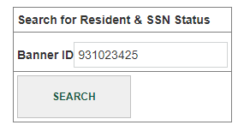
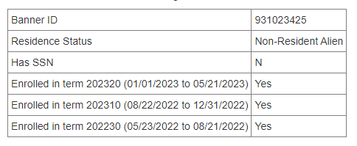
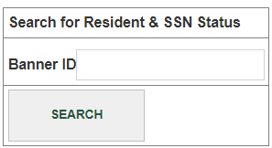
NEW: Find student-specific information
FinOps.wm.edu (Financial Operations Portal)
Step 1: Enter 93#
Step 2: Evaluate Output
Student Search (Residence, SSN & Enrollment)
The output provides you with residency status, SSN and whether enrolled)

Slide 22
NEW: Tax Analysis Status Report
It is the responsibility of the hiring department and/or employee to notify the Payroll Office if they are in the US on a qualifying visa to ensure they receive the proper tax treatment.
To facilitate this process the Payroll office is now making available a Tax Analysis Status Report. This report includes a list of all NRA payees and their Tax Analysis status in the tax system.

Slide 23
If your student status is:
Approved/Pending Approval
Do not submit a Request for Tax analysis
Email foreignnationals@wm.edu to inquiry about the status
Unprocessed
Do not submit a Request for Tax analysis
Contact your student directly to remind them that they must complete the tax analysis process before their payment can be processed.
Payee is not on the Tax Analysis Status Report
Submit the Request for Tax Analysis to initiate the process

Slide 24
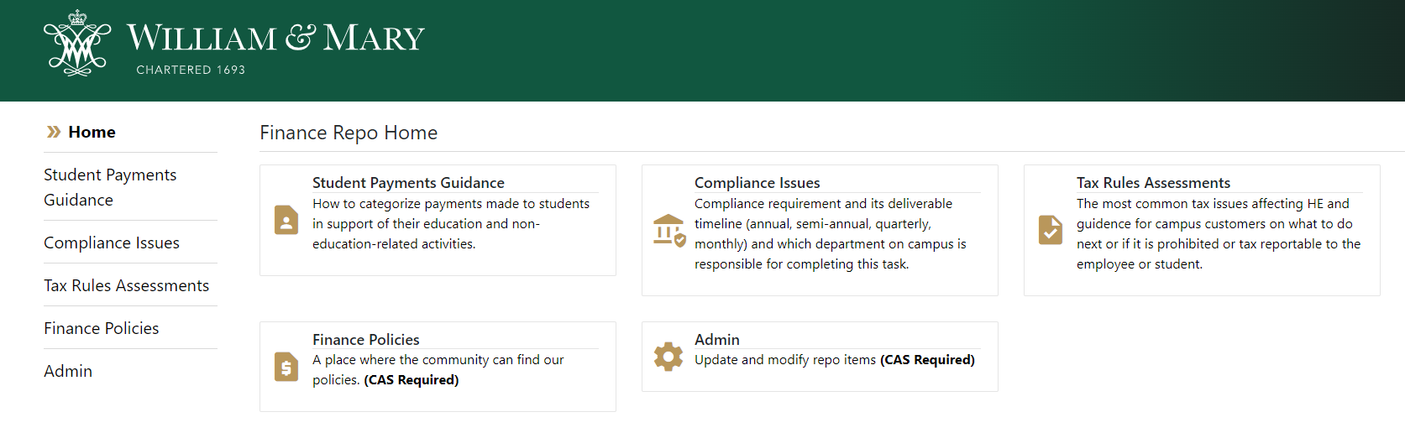
NEW: Student Programs Payment Guide
The Tax Office has compiled a list of the student programs. The information repository offer guidance on the process.
Visit: Student Programs Payment Repository

Slide 25
What happens if you don’t see your program listed in the portal
The Tax and Compliance office will help you determine how to pay the student.
Step 1: Review the repository of student payments to find your program and instructions.
Step 2: If your program is NOT listed, send an email to Tax@wm.edu to request review and guidance.
Step 3: Tax office will update the repository with the new programs.

Slide 26

Examples
Remember you are not alone in this process

Slide 27
Examples - Continued
The student is attending a conference in the summer that will benefit their research. The student is not enrolled.
The student is receiving a graduation award and is currently enrolled in classes
The student is being awarded a summer fellowship. The payment is being given to the student in advance and the student is currently enrolled in classes.
The student is being awarded a summer fellowship. The award is being paid to the student in the summer (5/23-8/21) and the student is not enrolled in Summer classes.
Stipend - AP
Non-Qualified- Financial Aid
Fellowship - AP
Fellowship- AP

Slide 28
Examples
Faculty invites a student to a conference. The student will present research findings.
The student is receiving a graduation award but has graduated.
The student attended a conference in July that benefited the student’s independent research. The student is asking to be reimbursed and he is enrolled.
A donor gift mandates that the university buys supplies and books for a student.
Reimbursement
Awards- AP
Non-Qualified Financial Aid
Non-Qualified Financial Aid

Slide 29


Slide 30
Announcement - Vision 2026
The Charles Center and the Office of Career Development & Professional Engagement are collaborating in a pilot program for summer 2023 as a first step toward providing barrier-free, academically grounded applied learning opportunities to W&M undergraduates.
A small cohort of students will be enrolled in either a 0-credit or 3-credit pilot course and will receive stipends disbursed through the Financial Aid Office, rather than through Payroll. Assessment of the pilot will guide the future of this disbursement method.

Slide 31
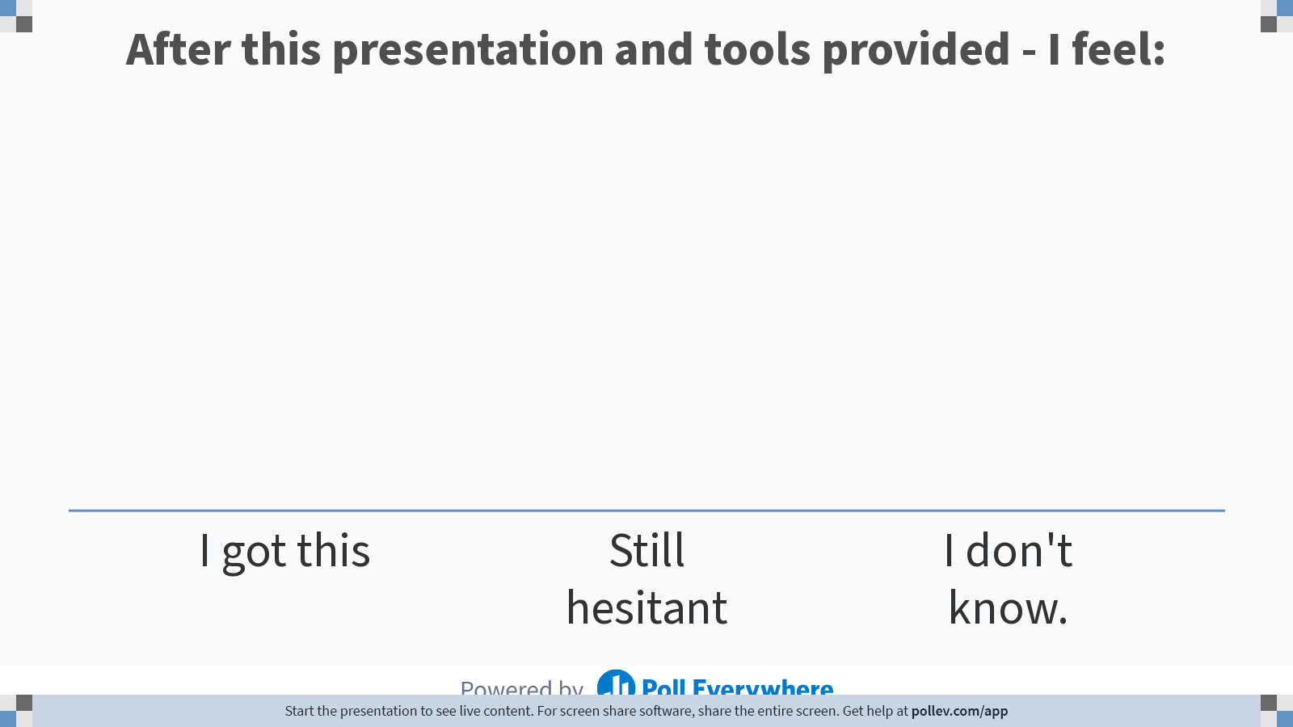
Notes:
Poll Title: Do not modify the notes in this section to avoid tampering with the Poll Everywhere activity.
More info at polleverywhere.com/support
After this presentation and tools provided - I feel:
https://www.polleverywhere.com/multiple_choice_polls/ldK3i1ptldMu9J2ceE3Yy?state=opened&flow=Default&onscreen=persist

Slide 32

Questions about this presentation:
Please send an email to tax@wm.edu

