Slide 1

PAYMENTS TO STUDENTS GUIDE
Effective March 2024

Slide 2
Agenda
Administration
Types of Student Payments
Procedures
Tools & Resources
Examples

Slide 3

Introduction
William and Mary makes various payments to students for tuition and fees, research, other education-related activities and employment.
In awarding and processing such payments, care must be taken to classify these payments correctly for tax purposes.
This document addresses types of payments made to both graduate and undergraduate students, including scholarships, fellowships, stipends, prizes and awards, compensation for services and reimbursements.

Slide 4
Tax Law (IRC Section 117)
The taxation of scholarships and fellowships is important to colleges and universities
Processing Teams need to know whether the award is taxable and, if so, whether it must withhold income tax on the payment and file any reports with the IRS.
For the most part, all student payments are taxable and reportable.
There is also the tax impact on the student who receives the scholarship or fellowship payments. We need to ensure our students are aware of and follow compliance with the applicable tax laws.

Slide 5
Student Definition
To be considered a W&M Student
Must be enrolled in an approved degree seeking program
Student is approved for Study Abroad
Enrollment can be FT or PT
Must be Accepted for Admissions

Slide 6
WM Employee - Student
WM employees may have a student status because they are taking classes under the Employee Educational Assistance Policy and are limited to an annual maximum benefit of $5,250.
Under IRS rules, WM employees can NOT receive any additional institutional payments toward their educational benefits not included in the policy.

Slide 7
Payment Timing
Payment to the student must be made as soon as possible.
Do not “hold” payment to try to time the process.
Methodology for payment processing is directly related to the timing of the activity.

Slide 8
Processing a Student Payment
There are 3 components for each Student Payment.
What Payment Type is the Student Receiving?
Is the Student Enrolled at W&M?
What is the student tax status? (US Citizen vs Foreign National)

Slide 9

Payment Types

Slide 10
Types of Student Payments
Qualified
Scholarship/Fellowship
An amount provided for the benefit of a student to aid in the pursuit of studies
These Include: (1) Tuition and fees required for enrollment or attendance at the educational institution; (2) fees, books, supplies, or equipment required for courses of instruction at the institution
Non-Qualified
Scholarship/Fellowship
An amount provided to student that can be used for expenses that are not qualified tuition or related expenses.
These Includes: Expenses such as room, board, travel and personal expenses. Research Awards Prizes Stipends Grants Others
Employment
Paid for Work Agreements
Student Employment program provides opportunities to students to help finance their education and gain educational benefit.
These includes: Part-Time Job Graduate Assistant Teaching Assistant Resident Assistant Internships @W&M Payment in support of external internships
Reimbursements
Reimbursements are not reportable to the IRS as income to the student ONLY if: Directly Supports a faculty member project or research (this EXCLUDES) student research. Is related to presenting at a conference Is official University Business There is a documented business purpose
Any reimbursement to an undergraduate or graduate student which has not met one of the criteria above for University student reimbursement must be processed as a Non-Qualified Scholarship.
W&M students do not qualify to be an Independent Contractor or Receive Honoraria

Slide 11
Qualified Payments
Only WM Students can receive Qualified Payment.
Student must be enrolled for classes
Rule application is the same for US Citizens and NRA students.
Qualified
Scholarship/Fellowship
An amount provided for the benefit of a student to aid in the pursuit of studies
These Includes: (1) Tuition and fees required for enrollment or attendance at the educational institution; (2) fees, books, supplies, or equipment required for courses of instruction at the institution
Qualified Scholarship/Fellowship
Treat as Financial Aid
Payment can ONLY be made to an enrolled student
If applicable Student Accounts will report on 1098-T Form
Student is enrolled
Yes

Slide 12
Non-Qualified Payments
Non-Qualified
Scholarship/Fellowship
An amount provided to student that can be use for expenses that are not qualified tuition or related expenses.
These Includes: Expenses such as room, board, travel and personal expenses. Research Support Academic Awards Academic Prizes Stipends (excludes internship support) Grants Others
Rule application is NOT the same for US Citizens and Foreign National students.
Non- Qualified Scholarship/Fellowship
Non- Qualified Scholarship/Fellowship
Student is Foreign National
Student is US Citizen
Contact the Payroll Office for TAX Analysis
Student is enrolled
Yes
No or Graduated
Student is enrolled
Treat as Financial Aid
Process through Accounts Payable
Yes
No
If applicable Student Accounts will report on 1098-T Form
If applicable, AP will report on a 1099 form.
Treat as Financial Aid
Process through Accounts Payable
Payroll will report on 1042-S

Slide 13
Employment
Employment
Paid for Work Agreements
Student Employment program provides opportunities to students to help finance their education and gain educational benefit. I-9 is required
These includes: Part-Time Job Graduate Assistant Teaching Assistant Resident Assistant Internships @W&M Support for external internships Employment Prizes and Awards
Rule application is the same for US Citizens and Foreign National students.
Employment
(a) Past, present, or future employment services
(b) Work performed by student in an activity under the control, direction and supervision of staff?
(c) Studies or research in which the primary beneficiary is the university or grantor?
Process through established Payroll Process
Payroll reports on W-2

Slide 14
Reimbursement
Reimbursements
Reimbursements are not reportable to the IRS as income to the student ONLY if: Directly Supports a faculty member project or research (this EXCLUDES) student research. Is related to presenting at a conference Is official University Business
Any reimbursement to an undergraduate or graduate student which has not met one of the criteria above for University student reimbursement must be processed as a Non-Qualified Scholarship.
Rule application is the same for US Citizens and Foreign National students.
Reimbursement
Treat as University Business Expense. Process reimbursement through BuyW&M
Non-Reportable

Slide 15


Slide 16
Financial Aid
Qualified and Non-Qualified Payments
Please use Student Payment Spreadsheet
Student Employment
Process I-9 timely
If payment is to Foreign National, then submit the Student Payment Spreadsheet when requesting the tax analysis.
Make sure you request the Tax Analysis with plenty of time for the payroll team to complete their tasks and for the student to complete their assessment.
You may use Position Numbers: Stipends S1SOFI and for Internships STINTL
Please use Student Employment Form

Slide 17
Accounts Payable
Non-Qualified Payments
Use Student Payment Request Form (BuyW&M Student Payment Request)
Travel is the most common type of reimbursement
Reimbursements
Any stipends, awards or prizes processed through AP for a US citizen require a W-9 to be on file:
If graduated, refer to the Vendor Request Guide to invite as a Fiscal vendor
If payment is to Foreign National, make sure you request the Tax Analysis with plenty of time for the payroll team to complete their tasks and for the student to complete the assessment.
Reimbursements must be supported by receipts and transactions must adhere to published policies.
List of allowable reimbursements: https://www.wm.edu/offices/supplychain/ap/typesofappayment/index.php
If not enrolled, refer to the Student Profile Change Request Form Guide

Slide 18
Human Resources
Non-W&M Students
(Selected for a program run by W&M, working either at W&M or at an external agency/company)
To determine process, send email to AskHR@wm.edu, Attn: Class/Comp
W&M Students
HR processes: graduate assistant, VIMS Workship, and W&M resident assistant “salaries”
Name of program
Where / with what organization
Duration (e.g., summer months; January –December)
What are we paying them for? (e.g, to offset living expenses, to work, etc.)
Financial Aid processes: student hourly jobs and supplemental payments to all W&M students (studentemploy@wm.edu)
Has program determined payment terms?

Slide 19

Tools available to help you

Slide 20
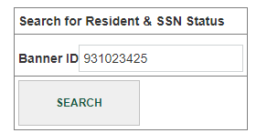
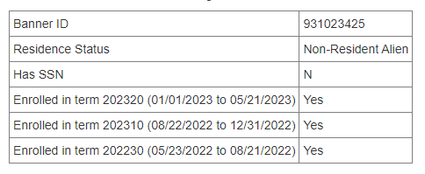
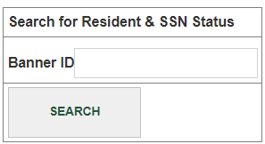
Find student-specific information
FinOps.wm.edu (Financial Operations Portal)
Step 1: Enter 93#
Step 2: Evaluate Output
Student Search (Residence, SSN & Enrollment)
The output provides you with residency status, SSN and whether enrolled)
Announcement: Student Tool will be enhanced to indicate whether enrollment is for credit

Slide 21
Tax Analysis Status Report
It is the responsibility of the hiring department and/or employee to notify the Payroll Office if they are in the US on a qualifying visa to ensure they receive the proper tax treatment.
To facilitate this process the Payroll office is now making available a Tax Analysis Status Report. This report includes a list of all NRA payees and their Tax Analysis status in the tax system.

Slide 22
If your student status is:
Approved/Pending Approval
Do not submit a Request for Tax analysis
Email foreignnationals@wm.edu to inquiry about the status
Unprocessed
Do not submit a Request for Tax analysis
Contact your student directly to remind them that they must complete the tax analysis process before their payment can be processed.
Payee is not on the Tax Analysis Status Report
Submit the Request for Tax Analysis to initiate the process

Slide 23
New! NRA Tax Analysis Request Forms
Starting in March 2024, the Payroll Office will be using the new NRA Tax Analysis Request forms submitted through DocuSign. Depending on the type of payment, it is the responsibility of a department initiating a payment to submit one of the following requests for tax analysis:
NRA PR (payroll/wages/employment): when hiring foreign nationals -students, staff, and faculty as a part-time or full-time employees (including Graduate Assistants, Teaching Assistants, Resident Assistants, Internship Payments) and payments are processed through the Payroll Department. Please submit a request for tax analysis after submitting a PAF/ePAF.
NRA SFA (scholarships/fellowships/other): when payments are processed through the Financial Aid Office. Please include the Student Payment Spreadsheet/award letter when requesting a tax analysis as it will be routed directly to deptaward@wm.edu through DocuSign after tax analysis is completed.
NRA AP (awards/honorariums/services/payments to students awarded summer scholarships/fellowships)- when payments are processed through the Accounts Payable Department/buyW&M. Please include a detailed explanation of the payment including if the payment is for an individual or a foreign entity and where the services will be performed (US Source vs Foreign Source income) when requesting a tax analysis.
Prior to submitting the request for tax analysis, please check the Tax Analysis Status Report, updated weekly, to verify NRA payees (VIMS and WM) current analysis status. If the tax analysis has been previously completed, the departments are not required to submit another tax analysis request during the same calendar year. Instead, departments should send us payment information by email to foreignnationals@wm.edu.

Slide 24
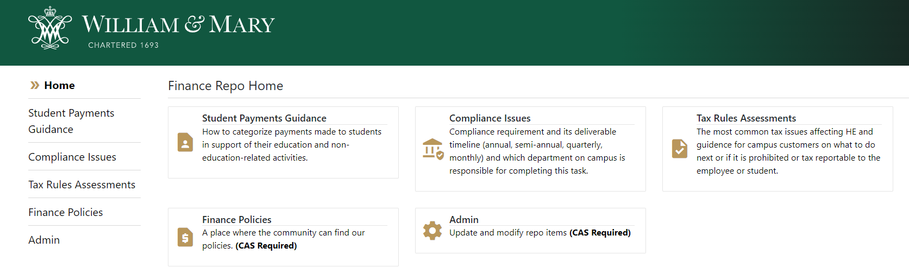
Student Programs Payment Guide
The Tax Office has compiled a list of the student programs. The information repository offer guidance on the process.
Visit: Student Programs Payment Repository (financepolicies.wm.edu)

Slide 25
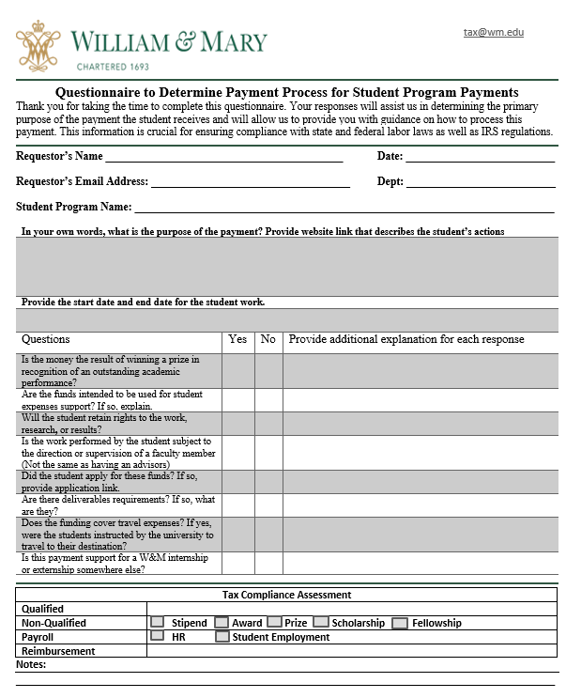
NEW: Questionnaire
What if your program is NOT in finops.wm.edu? Complete this questionnaire and send it to tax@wm.edu.

Slide 26
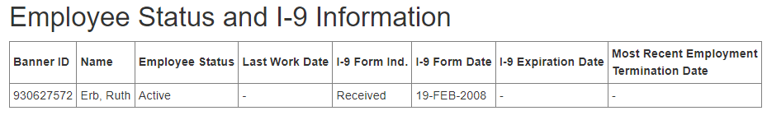
Verification of Student I-9 Status
You may see if a student has an I-9 on record by going to the Timesheets Approver/Employee Job Status Search in finops.wm.edu.
You will need to have your student 93#.
In general, if an I-9 has been received AND the Most Recent Employment Termination Date is Blank OR the I-9 has been received since the Most Recent Employment Termination Date, then no I-9 is needed.
If the I-9 Expiration Date displays a date, then the I-9 must be updated with the current work authorization information.

Slide 27
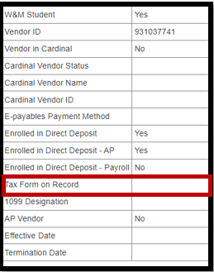
Verification of Student W-9 Status
There are two ways of verifying whether a student has a W-9 on record.
You may see if a student has an active W-9 by going to Vendor Search. You will need to have your student 93#.
If the W-9 is on record it will say YES in the Tax Form on the Record field.

Slide 28
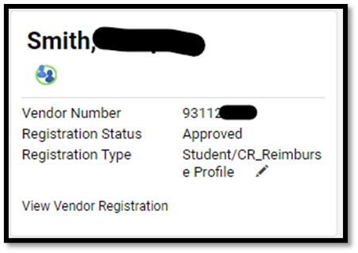
Verification of Student W-9 Status
You may also see the W-9 under the student profile in BuyW&M.
If the profile shows approved and the registration type is a Fiscal Vendor or Student/CR Reimbursement profile, that means they have fully registered and provided the necessary tax document.

Slide 29

Examples
Remember you are not alone in this process

Slide 30
Examples - Continued
The student is attending a conference in the summer that will benefit their research. The student is not enrolled.
The student is receiving a graduation award and is currently enrolled in classes
The student is being awarded a summer fellowship. The payment is being given to the student in advance and the student is currently enrolled in classes.
The student is being awarded a summer fellowship. The award is being paid to the student in the summer (5/23-8/21) and the student is not enrolled in Summer classes.
Non-Qualified- Financial Aid
Non-Qualified- AP
Non-Qualified - AP
Non-Qualified- AP

Slide 31
Examples
A faculty is scheduled to present a paper/poster at a conference. As a result of unexpected scheduling conflict the faculty is not able to attend the conference and present the paper. To avoid cancelling the session, the faculty asks one of his graduate students to present for him.
The student is receiving a graduation award but has graduated.
Student is attending a conference. The student is not presenting a paper. The conference is related to student’s field of education and will provide the student an opportunity to network with peers and faculty from other institutions.
A donor gift mandates that the university buys supplies and books for a student.
Non-Qualified- AP
Non-Qualified Financial Aid
Non-Qualified Financial Aid
Reimbursement

Slide 32

Questions about this presentation:
Please send email to tax@wm.edu

