Slide 1

Employee Educational Benefits Policy

Slide 2
Types of Educational Assistance
1 Tuition Waiver
2 Tuition Assistance
3 Tuition Reimbursement

Slide 3
Definitions of Programs
Tuition Waiver – Undergraduate-level tuition waived by the university for an approved academic credit course at William & Mary.
Tuition Assistance – Graduate-level tuition paid for by the university for an approved academic credit course taken at William & Mary.
Tuition Reimbursement – Any tuition reimbursed by the university for an approved, work-related, academic credit course at an institution other than William & Mary.

Slide 4
Who is Eligible
Employees must be employed and actively working at the time of registration.
  Who is eligible?
    Eligible Employees – Faculty and staff participating in the VRS or ORP retirement program. Hourly employees who are eligible for paid time off may also be eligible. Contact Human Resources for further guidance.
    Ineligible Employees – Adjunct faculty, temporary hourly employees, student employees, or employees on leave without pay for personal reasons, and employees with active disciplinary action on file.
Educational assistance is not available retroactively.
Eligible employees must continue employment eligibility during the duration of the semester.

Slide 5
How to use the Waiver & Assistance Programs
Eligible employees must complete the Employee Educational Assistance Form (located in Self-Service).
  Form must accurately reflect the courses the employee will be taking. (Form cannot contain errors)
  Form must be completed and approved before registration. Completing the form after registration can result in benefits being denied.
  If the Student Accounts office does not receive the approved Employee Educational Assistance Form OR the employee drops the class by the Last Day to Add/Drop Classes, then the employee will be responsible for paying the full tuition of those courses.

Slide 6
How to use the Reimbursement Program
The university does not have a central fund to cover employee educational benefits.
  Departments will cover any reimbursements for their employees with their departmental funds.
To qualify for reimbursement, all of the following must be met:
  Department approval is received before registering, taking, and paying for a course.
  Course is directly related to the employees’ jobs at W&M.
  Course is not offered or cannot be taken at W&M.
  Employee must receive a grade of C or better.
Approvals for reimbursement are approved in very rare occasions.

Slide 7
Other important points
W&M Courses
A maximum of 6 credit hours in educational assistance is allowed for each semester to include all summer sessions combined.
The employee will be responsible for repaying the total amount of tuition originally paid for or waived by the university, or the employee is not eligible for reimbursement if the following occurs:
  Does not complete the course with a grade of “C” or “Pass.”
  Withdraws from the course at any time during the semester or session,
  Separates from the university before completing the course

Slide 8
Taxation
Type | Tax Rule
Tuition Waiver & Reimbursement | Undergraduate educational assistance benefits are not subject to tax reporting or withholdings.
Tuition Assistance & Reimbursement | Graduate educational assistance benefits are excludable from tax reporting and withholding up to $5,250 annually. Amounts over $5,250 are subject to tax reporting and withholdings and will be included in the employee’s reportable taxable income with appropriate taxes withheld.
The amount credited to the employee’s annual educational assistance benefit will be based on the calendar tax year in which the educational assistance (waiver) was applied.

Slide 9
Excluded Programs
Online Master Business Administration
Master of Science in Business Analytics
Counseling Education M.Ed. Programs
Geographic Information Science Certificate Program (GIS)
Executive Master Business Administration
Executive EdD program (limited to one fall and spring semester course and two summer term courses).
Concentrations in K-12 and Gifted Administration of the Executive EdD program
All online courses managed by a 3rd party offered by Mason School of Business and School of Education are ineligible for employee educational assistance.
Employee family members are not eligible under this policy

Slide 10
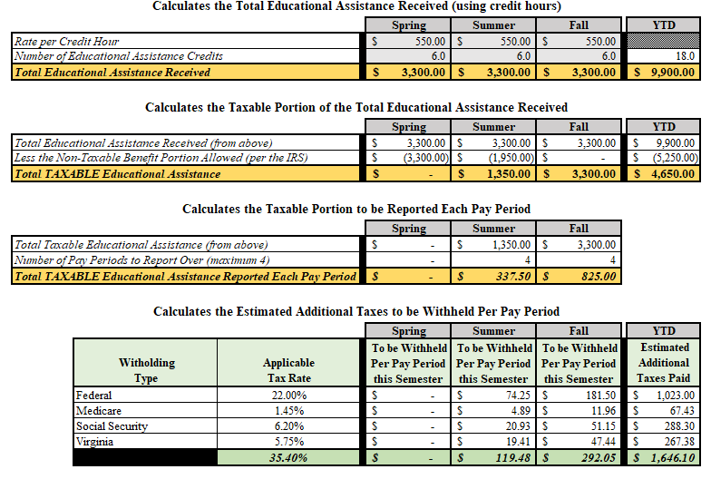
Graduate Program Taxation
William & Mary - Employee Educational Assistance (wm.edu)
Forms
  Tax Calculator (Estimated Taxation for planning purposes)
  Future Policy Page: financepolicies.wm.edu

Slide 11
Take Aways
Enrolling in courses at W&M represents the most straightforward avenue for leveraging educational benefits.
Currently, centralized funding to enhance educational benefits for employees is unavailable. In the event of pursuing courses externally, approval is necessary and granted only in rare instances.
The university is actively exploring avenues to establish a fund aimed at augmenting supplementary educational benefits – specifics to be determined.
Self-Sustaining programs and online programs are excluded from this benefit due to internal costs.
Compliance with IRS guidelines mandates the imposition of taxation on this benefit on graduate programs. Employees are advised to acquaint themselves with the potential impact on their paychecks and make necessary preparations accordingly.
The university provides a wide array of programs for you to explore. If you can't find your desired program, don't hesitate to reach out to the counselors and admissions departments. They are here to help you in discovering comparable options that align with your educational goals. Don't give up on your aspirations—let W&M support you in reaching them.

Slide 12


