Slide 1
Approving Timesheets

Slide 2
Agenda
Policy Statement
Proxy Designation
Timesheet Approval Procedures
Self-Service Timesheet Challenges
Return For Correction
Hourly/Student Timesheet Approval
Responsibilities
Additional Information –
Hiring Out of State Employees
Off-Cycle Check Requests
Resources & Contact Information

Slide 3
Policy Statement
The College requires that all employees complete their timesheets accurately and timely as an integral component of the payroll process. Supervisors, identified as “timesheet approver”, have the responsibility to approve timesheets by the established deadlines.
All employees and their designated Approvers are responsible for ensuring timesheets are submitted and approved via Banner Self-Service no later than the published due dates in order to accurately record all hours paid, and for the proper accounting of work and leave time.

Slide 4
Proxy Designation
There may be times when you are unavailable to approve time. In those instances, Approvers must set up a Proxy to act on their behalf and to approve the timesheets assigned. Approvers should set up one or more proxies in advance.
A proxy assumes your approval power.
A proxy can only see the employee’s timesheet and reported hours.
A proxy should ONLY approve time when requested to do so by you.
An employee can be made a proxy for more than one approver.
A proxy should never be a direct report.

Slide 5
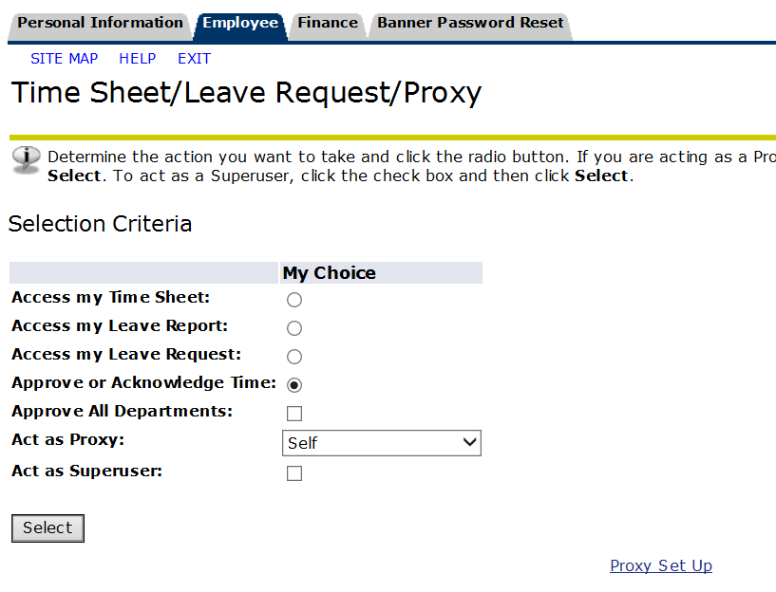
Using drop down menu, select proxy and then click on check box and save your changes. Available proxies are listed alphabetically by last name.
Always confirm that your designted proxy has ORG access prior to selection. Contact your HR team for assistance.

Slide 6
Timesheet Approval Procedures
Employees submit timesheet by the established published deadlines.
Approvers have until 10AM of the following day to approve submitted timesheets.
After 10AM, Unapproved timesheets are Administratively Approved.
Payroll runs the process that moves Self-Service Timesheets to Banner.

Slide 7
Self-Service: Timesheet Challenges
Selecting Correct Department
Selecting Correct Pay Period
Timesheet Errors
Missing Employee Timesheet

Slide 8
Selecting Correct Department and Pay Period
Issue 1:
Approver has not selected the correct Department and Description. Approver need to click the radio button under My Choice.
Issue 2:
Approver does not have the correct pay period selected. Approver to click on drop down arrow and pick the correct pay period.

Slide 9
Return For Correction
Issue 3:
An employee has submitted an incorrect timesheet, and it must be corrected prior to the submission deadline.
As an approver, you are responsible for ensuring that timesheets are also submitted accurately. In the event that you determine an error has been made on a timesheet, you should return the timesheet for correction. You may enter comments in the “Comment” field, prior to returning the timesheet.
The employee will receive an automated email notifying them that corrections are required. After the employee re-submits the timesheet, it can be approved as previously outlined.

Slide 10
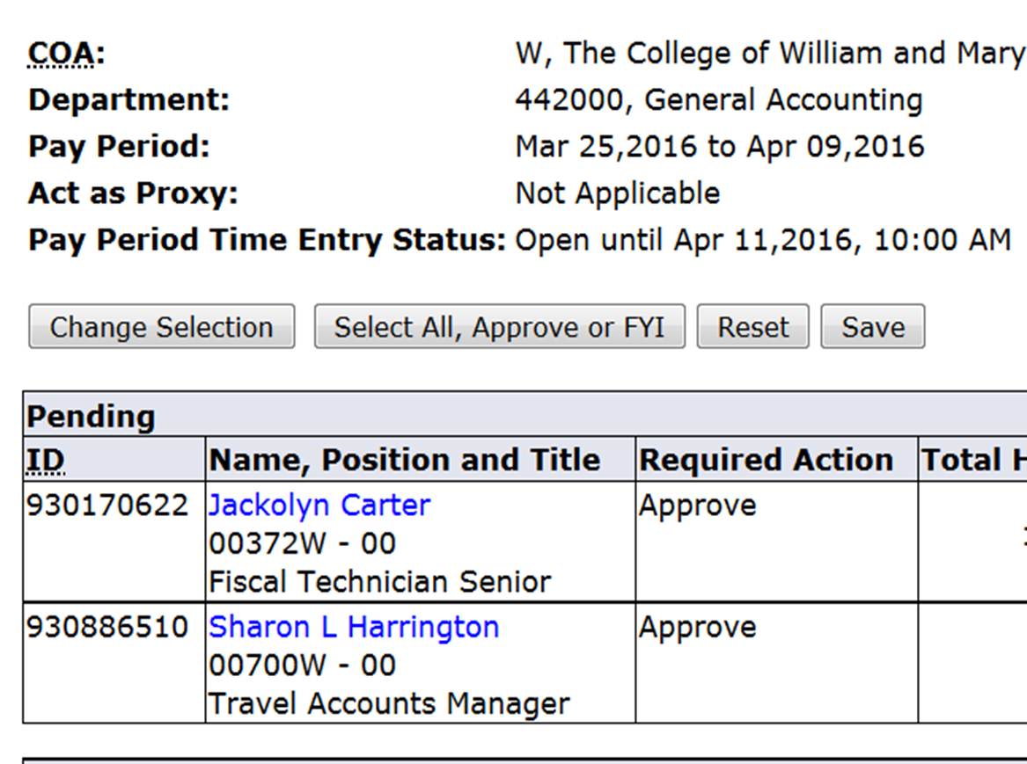
Missing Employee Timesheet
After selecting (1) correct Department and (2) Pay Period, Approver still cannot see the Employee listed.
Designated Approver Set Up
Employee Job Set Up
For Undergraduate Student Employees –Call Financial Aid Office
For all other employee types - Call your HR Team Representative (Osprey, Wren or Griffin)

Slide 11
Hourly/Student Employee
Hourly/Student Pay Periods:
1-15 Email to Approvers sent the 24th
16-31 Email to Approvers sent 9th
Pay Periods Overlap
When selecting a pay period Approvers may see several open pay periods.
Approvers must be aware which pay period requires approval.

Slide 12
Administratively Approved Timesheets
Supervisor is copied on email.
Each Employee whose timesheet was administratively approved would be listed on letter.
Approver is now required to verify the hours paid to each employee.
An email detailing each employee hours approved is required.
(timesheets@wm.edu)

Slide 13
Responsibilities - Approver
Approvers are required to review and verify all timesheets via Banner Self-Service that were administratively approved in the payroll process.
If a correction is necessary, the Approver and the impacted employee must complete a manual timesheet and submit it to the Payroll Department immediately and notify Payroll staff via email that a corrective manual timesheet is being submitted.
If no corrections are required, respond to the email certifying that the time paid for each affected employee is correct.

Slide 14
Responsibilities: Approver’s Supervisor
Approver’s supervisor must ensure the approver understands his/her responsibility to approve timesheets in a timely manner.
The Approver’s supervisor must ensure the Approver reviews all administratively approved timesheets and sends certifying email within 7 days of receiving the email from the Payroll Department.

Slide 15
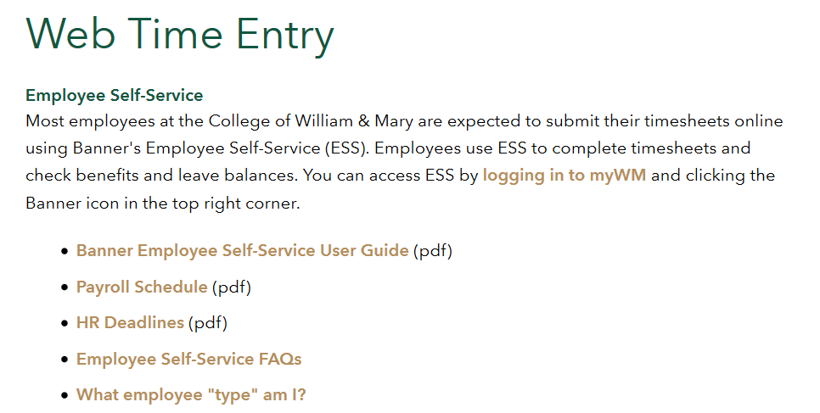
Resources
Human Resources Website
Timesheet Approver and Proxy Guide
https://www.wm.edu/offices/it/documents/training/TimeApprvr_r1.pdf

Slide 16
Additional Information

Slide 17
Out-of-State Hires
Departments wishing to hire/reassign employees to work, or telecommute, out-of-state must seek prior approval by following procedures outlined in the Out of State Employees Hiring Policy
No employee can be hired, begin employment, or telecommute, outside of Virginia until this approval is received
Additional information is available via the Payroll website or by contacting:
employees-outofstate-request@lists.wm.edu

Slide 18
Off-Cycle Check Requests
Manual check requests are to be used for those individuals who will suffer financial hardship if not paid, otherwise they will receive back-pay in the next payroll cycle. The Payroll Office reserves the right to approve a manual check.
If a manual check has been approved by the Payroll Office, it will be processed per the schedule outlined on the Payroll Processing Calendar, available via the HR website
There is a minimum requirement of 32 hours on the manual timesheet for an off-cycle check to be processed
Timesheet errors or missed deadlines will not be approved for off-cycle checks and will be processed in the next pay period, as a retro-active payment.
Fillable forms can be found on the website via this link: Manual Timesheet

Slide 19
Contact Information
Online: www.wm.edu/offices/financialoperations/payroll
Phone: 757-221-2848
Email: payofc@wm.edu – general questions
timesheets@wm.edu –timesheet confirmation only

