Slide 1
Your Right to Know
New Information!
Global Harmonization Systems (GHS)
Notes:
Hello and welcome to the Global Harmonization Training.
The following training will detail the changes that have occurred regarding OSHAs Right to Know standard with the implementation of the Global Harmonization System otherwise known as GHS.

Slide 2
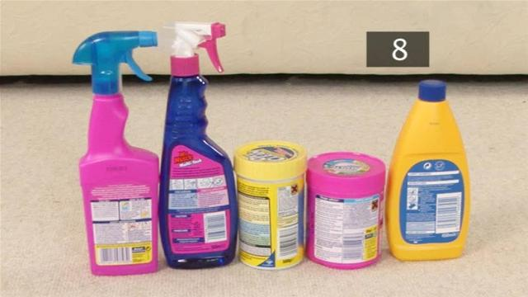
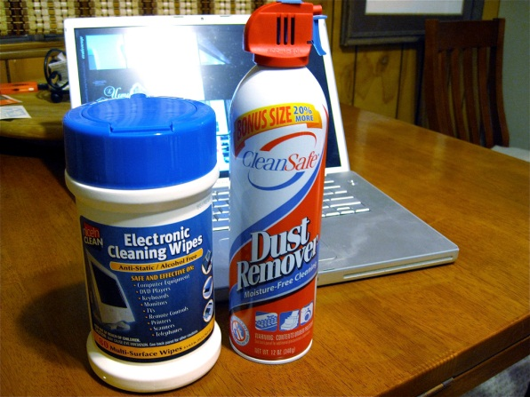
Your Right to Know: Global Harmonization System
What is it?
Why do I need to know about GHS?
What are the changes?
What if I have questions?
Notes:
The items that will be discussed in detail include What is the Global Harmonization System? Why do I need to know about the Global Harmonization System as a College of William and Mary employee, What are the changes to the current system with regards to Global Harmonization, and who can you contact if you have further questions or would like further information.

Slide 3
GHS – What is it?
The Global Harmonization Standard (GHS) is an international agreement among nations to use a common classification and labeling system for chemicals
New Labels will be on products
Online information about chemicals will become consistent
GHS is part of OSHA’s Hazard Communication Standard (HCS) Law.
Notes:
The GHS includes criteria for the classification of health, physical and environmental hazards, as well as specifying what information should be included on labels of hazardous chemicals as well as safety data sheets formally know as Material Safety Data sheets or MSDSs
GHS is part of the Occupational Safety and Health Administrations Hazard Communication Standard.

Slide 4

Why do I need to Know?
Chemicals are located throughout every building of the College
One of your rights as an employee is to know what chemicals –including cleaning supplies – are being used the in the buildings where you work.
Notes:
All employers with hazardous chemicals in their workplaces such as William and Mary, are required to have a hazard communication program, including container labels, safety data sheets, and employee training. This is a requirement of OSHAs hazard communication standard.
Every College building contains some extent of chemicals. These can range from basic housekeeping chemicals to chemicals found in a chemistry research laboratory.

Slide 5
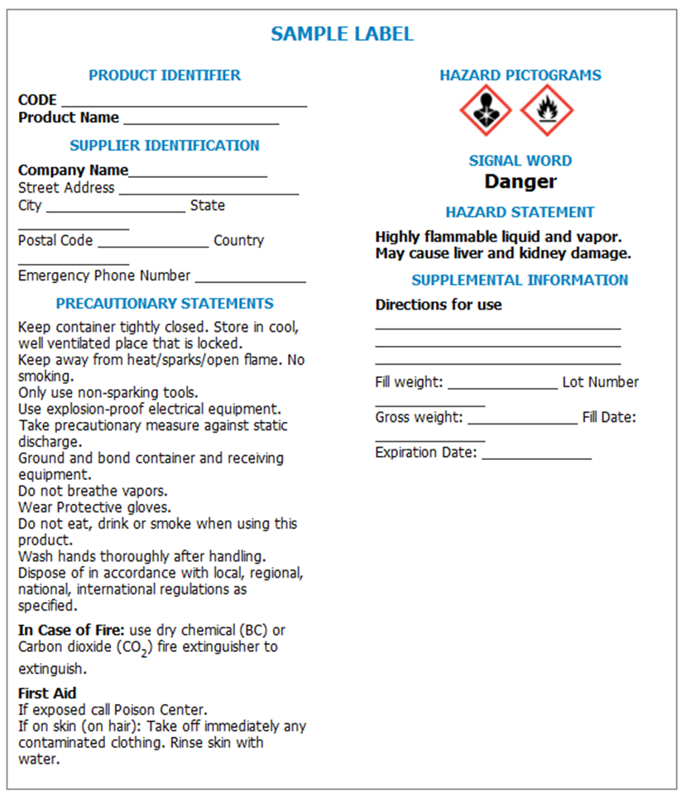

What are the Changes?
New labeling system
New product information sheets
Hazard Communication Safety Data Sheets
Notes:
The Global Harmonization System implements several changes to the existing OSHA hazard communication system. These include a new labeling system and new product information sheets. The updates are intended to create a unified system worldwide and create clarity for the employee.

Slide 6
Changes: Labeling System
All labels on chemical containers will have the same information.
The key components are:
Product Identifier
Pictogram
Signal Word
Hazard Statement
Precautionary Statement(s)
Notes:
Labels on containers will contain the same layout for information regardless of the chemical or the manufacturer. The key components will include the product identifier otherwise known as the name of the chemical. A pictogram will be included that helps to visually indicate the hazard. A signal word is meant to be a simple written communication to quickly and readily identify the severity of the hazard. The hazard statement will specify the greatest concerns regarding the chemical from a safety and employee exposure standpoint. The precautionary statement will give further detail to possibly include proper storage and use, steps to take in the case of a fire, and recommended first aid measures.

Slide 7




Changes: Labeling System – What is a “Pictogram?”
Picture-based communication, similar in concept to traffic signs
Each pictogram consists of a diamond shaped symbol, with a white background and a red border
Notes:
The pictogram utilizes a visual picture to communicate a hazard related to the chemical. You can think of these pictograms as the traffic signs for the chemical. Every pictogram will be in the shape of a diamond with a white background and red border.

Slide 8



Changes: Labeling - Pictograms
Health Hazard
Carcinogen
Toxicity
Respiratory Sensitizer
Exclamation Mark
Irritant
Skull & Crossbones
Acute Toxicity
Notes:
The specific pictograms relate to the potential hazard of the chemical. The health hazard pictogram communicates hazards such as a possible carcinogen, toxicity, or respiratory sensitizer. The skull and crossbones pictogram indicates the chemical is acutely toxic and the exclamation mark indicates the chemical is an irritant

Slide 9



Changes: Labeling – Pictograms 2
Flame
Flammables
Pyrophorics
Organic Peroxides
Flame over Circle
Oxidizers
Corrosives
Skin burns
Eye damage
Corrosive to metals
Notes:
The flammable, corrosive and oxidizer pictograms are similar to the department of transportation pictograms. The difference is that these pictograms are again specific to the global harmonization system with the pictogram, white background, and red borders.

Slide 10



Changes: Labeling – Pictograms 3
Gas Cylinder
Gases under pressure
Bomb Exploding
Explosives
Environmental Hazard
Aquatic toxicity
Notes:
The last three pictograms includes the gas cylinder, environmental hazard, and explosive.

Slide 11
Changes: Labeling System – Signal Word
A signal word is a single word that indicates the severity level of the hazard.
The new system has two signal words:
Danger – more severe hazards
Warning – less severe hazards
Notes:
One word is used to indicate the relative severity of hazard and alert the reader to a potential hazard on the label and safety data sheet. The GHS includes two signal words: “Warning” for less severe hazard categories and; “Danger” for more severe hazard categories.
Lower categories of classification and unclassified products would not require pictograms or signal words under GHS.

Slide 12
Changes: Labeling System – Hazard Statement
Describes the nature of the chemical hazard, and sometimes includes the degree (i.e., “highly flammable liquid” instead of “flammable liquid”)
Warning
Harmful if swallowed
Danger
May cause fire or explosion; strong oxidizer
Causes severe skin burns and eye damage
Hazard Statements:
• May cause fire or explosion; strong oxidizer
• Causes severe skin burns and eye damage
Notes:
Hazard statements are standardized and assigned phrases that describe the hazard(s) as determined by hazard classification. An appropriate statement for each GHS hazard should be included on the label for products possessing more than one hazard.

Slide 13
Changes: Labeling System – Precautionary Statements
Precautionary Statements describe recommended measures that should be taken to minimize or prevent adverse effects.
First aid:
IF ON SKIN (or hair) or clothing: Rinse immediately contaminated clothing and skin with plenty of water before removing clothes. Wash contaminated clothing before reuse.
IF IN EYES: Rinse cautiously with water for several minutes. Remove contact lenses, if present and easy to do. Continue rinsing.
IF INHALED: Remove person to fresh air and keep comfortable for breathing.
IF SWALLOWED: Rinse mouth. Do NOT induce vomiting.
Immediately call poison center.
Specific Treatment: Treat with doctor-prescribed burn cream.
Notes:
Precautionary information supplements the hazard information by briefly providing measures to be taken to minimize or prevent adverse effects from physical, health or environmental hazards. First aid is included in precautionary information. The GHS label should include appropriate precautionary information.
At this time there are four types of precautionary statements defined by GHS covering: prevention, response in cases of accidental spillage or exposure, storage, and disposal. The precautionary statements have been linked to each GHS hazard statement and type of hazard. The goal is to promote consistent use of precautionary statements

Slide 14
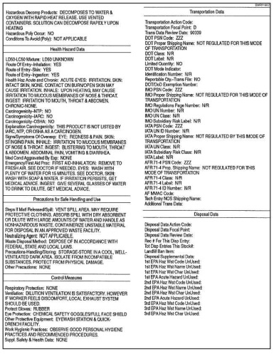
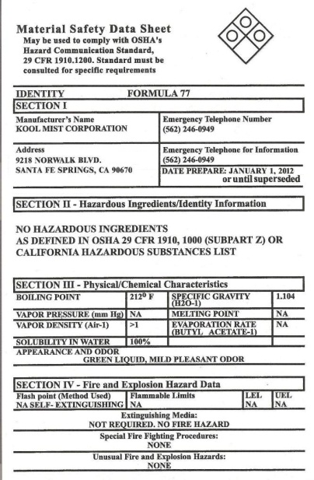
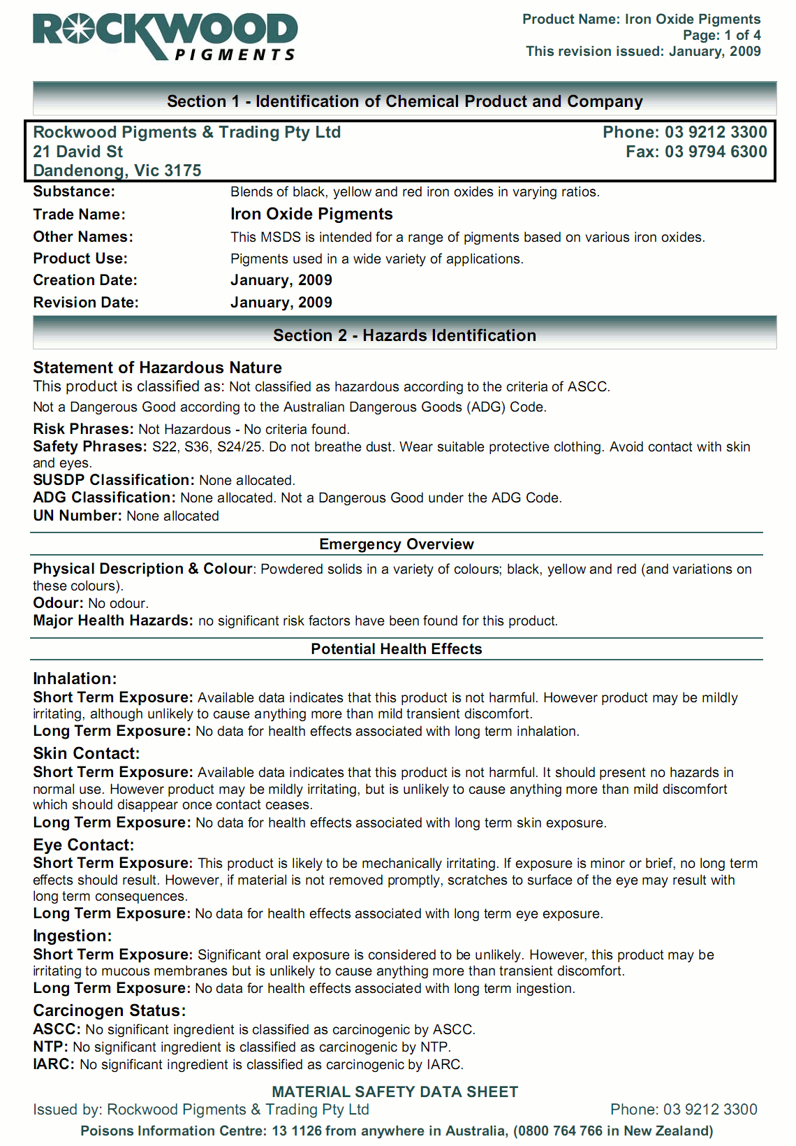
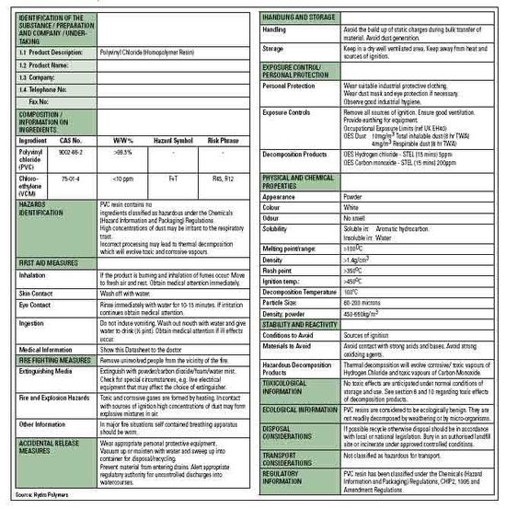
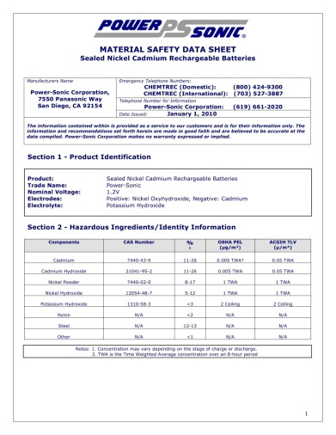
Changes: Safety Data Sheets
Under the current system, the Material Safety Data Sheets (MSDS) contain the important information, but manufacturers use different formats so it can be difficult to find the information you need quickly in an emergency.
Notes:
Another change under GHS is the renaming of material safety data sheets from MSDSs to simply safety data sheets, or SDSs.
Unfortunately, this dropping of the M has caused more confusion than is warranted. The truth is, an SDS is an MSDS, they are really the same thing, especially in terms of the role they play in the OSHA hazard communication standard. In fact, the GHS SDS format is nearly identical to the old 16 section MSDS – with a couple of modifications.

Slide 15
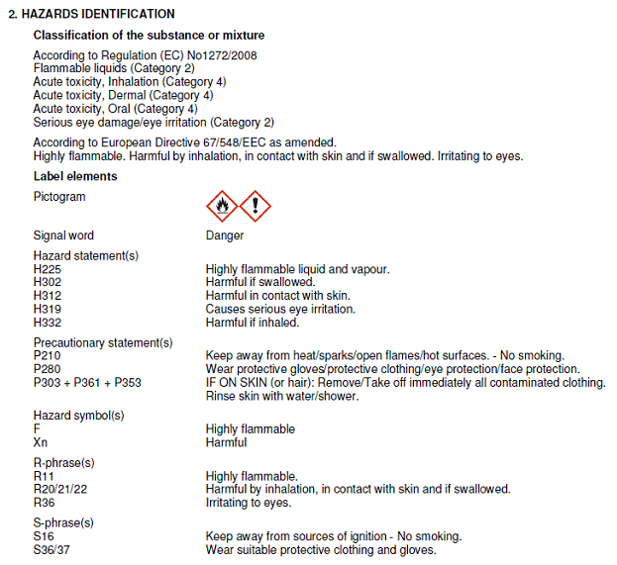
Changes: Safety Data Sheets 1
The GHS Safety Data Sheets (SDS) are standardized. The data sheets list the important information about each chemical:
by section
in the same order
using standardized language
no matter which country created the chemical
Notes:
Safety Data Sheets are an essential component of the GHS and are intended to provide comprehensive information about a substance or mixture for use in workplace chemical management. They are used as a source of info about hazards, including environmental hazards, and to obtain advice on safety precautions. The SDS contains sixteen standardized sections in a set order. This format is standard across the world with relation to GHS.

Slide 16
Changes: Safety Data Sheets 2
There are 16 sections –
Sections 1-5 state the same types of information found on the labels of chemical containers
Sections 6 -8 contain safe handling and storage types of information
Sections 9-16 are the more technical information about the chemical
Notes:
The SDS contains sixteen standardized sections in a set order. This format is standard across the world with relation to GHS. An SDS is produced for substances and mixtures which meet the harmonized criteria for physical, health, or environmental hazards under the GHS and for all mixtures which contain ingredients that meet the criteria for carcinogenic, toxic to reproduction or specific target organ toxicity.

Slide 17
SDS Library Access
The College’s SDS library can be accessed through the William and Mary website by searching for “Safety Data Sheets”
The first search result will take you to the College’s SDS website
The electronic library link is contained on this page.
Your College username and password will allow you access.
Once in the system you can search by chemical name, manufacturer, or building and room.

Slide 18

Video
Notes:
The following web clip gives directions on how to access the online Safety Data Sheet system maintained for the College. The College utilizes an online library for management of campus SDSs. The chemical inventories and SDSs indicated for a building are provided to the EH&S office to include in each individual building. If you notice your chemicals and the associated SDSs are not shown in your building, contact EH&S in order to have them included.

Slide 19

WAIT! There is an easier Way!
EHS has a QR Code
Notes:
The QR code will take you directly to the College’s electronic SDS database. Your William and Mary login and password will allow access to the system.

Slide 20
What if I have Questions?
Contact the Office of Environment, Health & Safety
http://www.wm.edu/offices/facilities/services/safety/index.php
phone: 221-2146
Watch this video:
http://www.youtube.com/watch?v=vCI7XXExs7s
Notes:
For questions regarding GHS, the OSHA hazard communication standard, or any other safety related issues contact the EH&S office. The video link will provide more in depth information regarding the changes taking place under GHS.

Slide 21
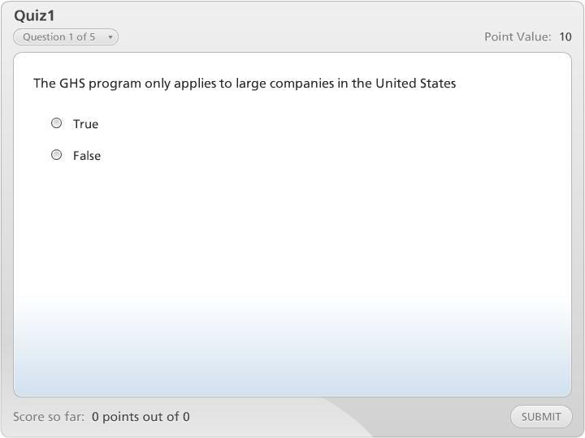



Quiz1

