Slide 1
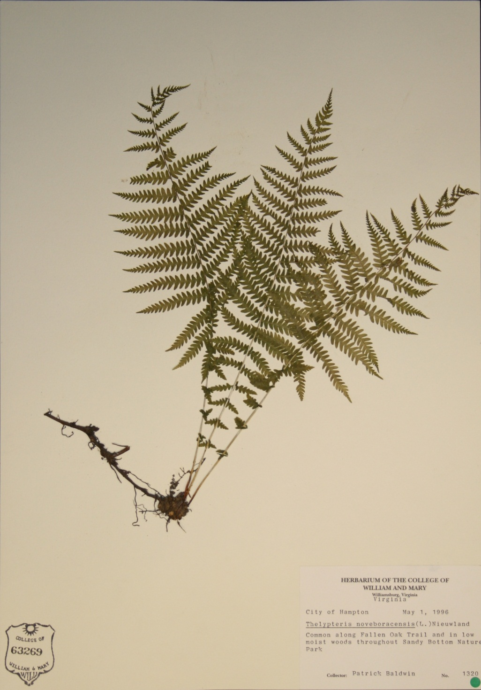
WILLI
Herbarium of the College of William and Mary
Martha Case, Director
Beth Chambers, Curator

Slide 2
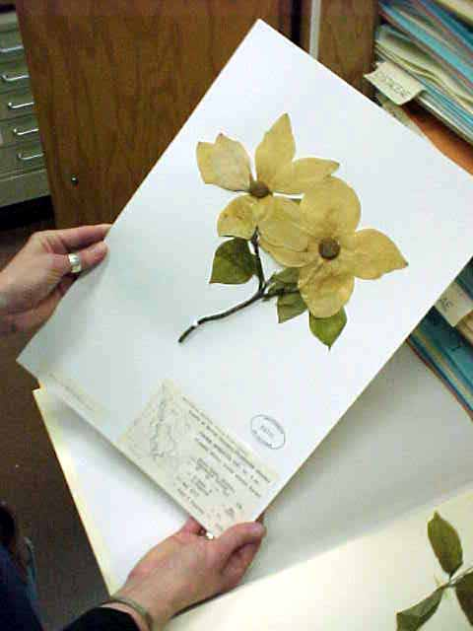
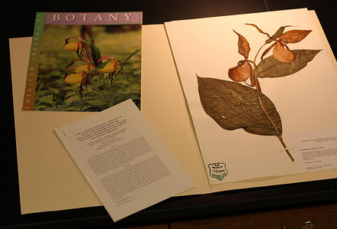
Herbaria are repositories of dried and pressed plant specimens, archivally maintained in a “library of plants
WILLI

Slide 3
History of Herbaria
WILLI
Due to nature of plant biochemistry (e.g., cell wall, lignin), dried, pressed plants can last for centuries (even millennia)
Plants (herbs) the earliest medicines
Plant collections the first PDR
Luca Ghini – Pisa Italy. Bound paper sheets with plant specimens mounted into book volumes
Linnaeus started storing the paper sheets with plants mounted on them in piles, a practice followed even today.

Slide 4
Oldest Herbaria
WILLI
Kassel, Germany – 1569
Universität Gesamthochschule Kassel
30,000 specimens
Bologna, Italy – 1570
University of Bologna
130,000 specimens
http://www.sma.unibo.it/erbario/descrizione.html

Slide 5
University of Bologna
WILLI

Slide 6
WILLI – Index Herbariorum Identifier
WILLI
Index Herbariorum
Started in 1935 in Netherlands, now New York Botanical Garden (NYBG)
Collections of dried reference specimens of plants
Collection large (usually 5,000 specimens minimum), accessible to scientists, and actively managed
Loan and exchange program (similar to Interlibrary Loan program for libraries)

Slide 7
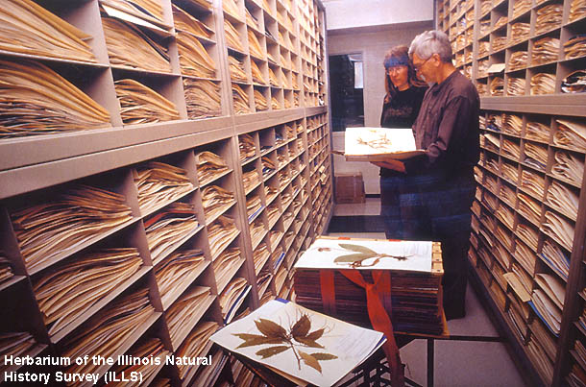
WILLI
~ 3,990 herbaria worldwide
~ 350,000,000 specimens worldwide
Document 400 years of world’s vegetation

Slide 8
Herbaria of note
WILLI
Biggest: National Herbarium of Paris (Herbier National de Paris) Established in 1635!
http://www.mnhn.fr/museum/foffice/transverse/transverse/accueil.xsp?cl=en

Slide 9
Clematis viticella collected by Lamarck – from P
WILLI

Slide 10
Herbaria of note - National
WILLI
NY New York Botanical Garden – Steere Herbarium - Largest in western hemisphere - 7.2 million
http://sciweb.nybg.org/science2/
GH Gray Herbarium at Harvard - 5 million specimens
http://www.huh.harvard.edu/
US – Smithsonian Herbarium – 4.3 million specimens
http://botany.si.edu/
Dates back to founding of Smithsonian, 1847
Washington DC collection

Slide 11
Herbaria of note - National
WILLI
MO Missouri Botanical Garden - 6 million specimens http://www.mobot.org/MOBOT/Research/herbarium.shtml
UC - University of California and Jepson Herbarium (Berkeley) – 2.1 million specimens
http://ucjeps.berkeley.edu/
FLAS – University of Florida – 470,000 specimens

Slide 12
Herbaria of note - Regional
WILLI
NCU – University of North Carolina at Chapel Hill – 665,000 specimens
Alan Weakley’s Manual of the Flora of the Southeastern US
http://www.herbarium.unc.edu/
BRIT - Botanical Research Institute of Texas - 1 million
http://www.brit.org/
Publishing upcoming Flora of Virginia
Southern Methodist University herbarium now non-profit org.
Took in 360,000 collection from Vanderbilt

Slide 13
Herbaria of Note- VA
WILLI
VIP – Massey Herbarium of the Virginia Polytechnical Institute 134,000 specimens
http://www.biol.vt.edu/herbarium/index.html
Curator W&M Grad (Tom Wieboldt)
Digital Atlas of Virginia through VPI (for now)
http://www.biol.vt.edu/digital_atlas/
VCU – Richmond – 17,700 specimens
URV – Richmond – 18,000 specimens
ODU – Norfolk – 28,000 specimens

Slide 14
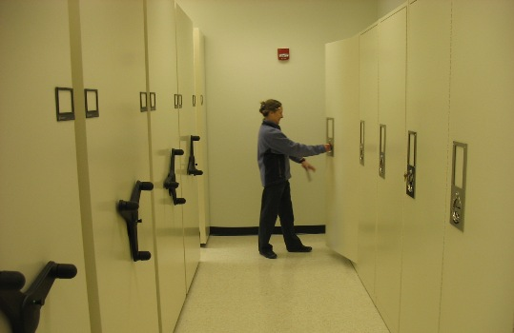
WILLI – College of William and Mary – 78,000 specimens
WILLI
http://www.wm.edu/herbarium

Slide 15
W&M Herbarium History
WILLI
Herbarium founded in 1968
First Director was Gus Hall
First Curator – Donna M E Ware
Began with gift of 3,000 specimens from NCU

Slide 16
Strong botanical history at W&M
WILLI
Second oldest college in the US, “reported to be the site of the first formal garden in the Colonies”
J T Baldwin W&M ’35
JT Baldwin – Vanderbilt PhD ‘39
Back to W&M Biology Department
World traveler for rubber (Hevea) in WWII
Brought dawn redwood (Metasquoia glyptostroboides) to campus
Many other trees on campus
Collaboration with Bernice Speese (Smilax)
Teaching collection started

Slide 17
WILLI
Use of herbarium specimens
Verifiable records supporting many kinds of research in plant science
Distributional data on plant species
Rare, threatened, endangered species
Invasive species
Basis for descriptions of species in manuals, monographs, and other publications
For construction of keys used in identification
To confirm determinations
Standards for consistent application of scientific names
Teaching

Slide 18
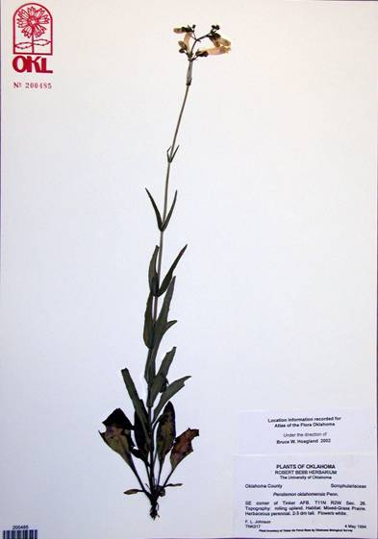
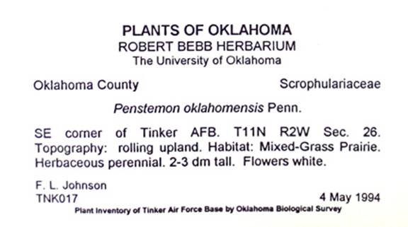
Herbarium specimens document where and when a plant grew
WILLI

Slide 19
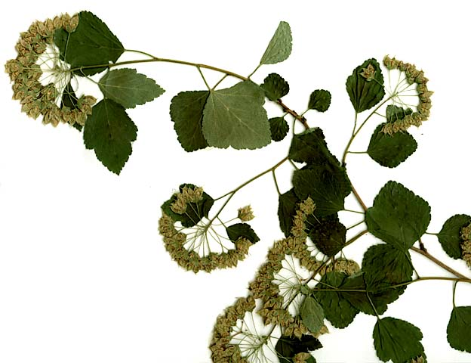
WILLI
Herbarium specimens also provide biological material for scientists to study such as:
External form and structure

Slide 20
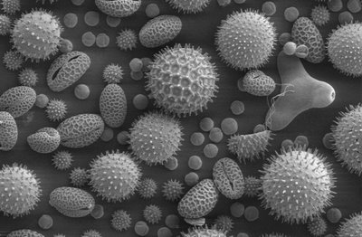
WILLI
Microscopic features like pollen

Slide 21
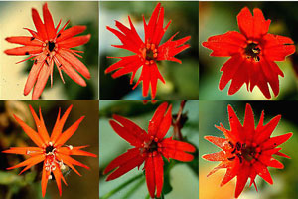
WILLI
Variation within a particular kind of plant

Slide 22
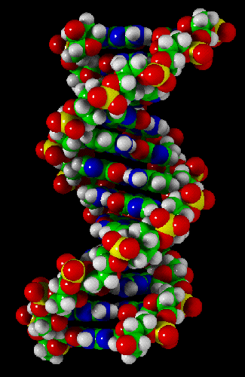
Even DNA itself!
WILLI

Slide 23
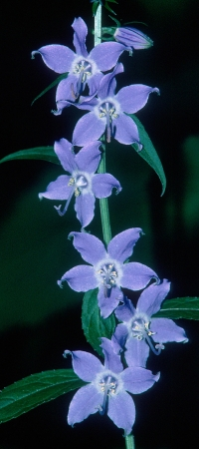
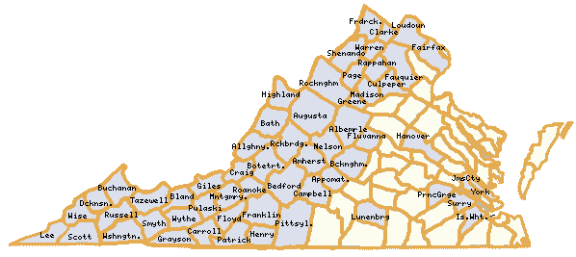
WILLI
This allows us to understand the ecology and geographic ranges of species
For example, the counties in VA where Campanulastrum americanum has been found

Slide 24
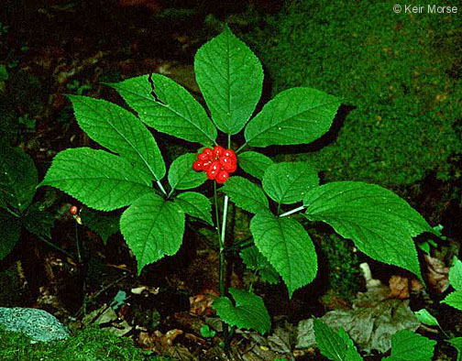
Herbaria are a vital resource for many kinds of research questions
WILLI
Have populations of American ginseng declined in the last 150 years?

Slide 25
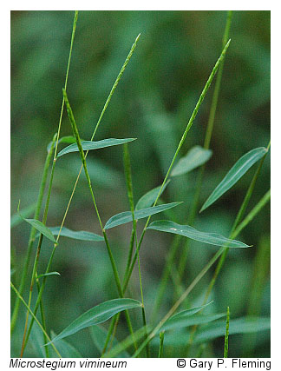
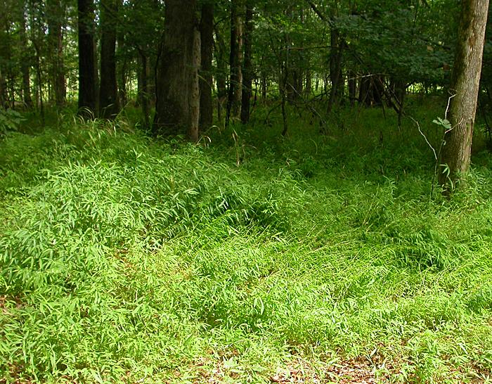
research questions…
WILLI
Are exotic and destructive species spreading?

Slide 26
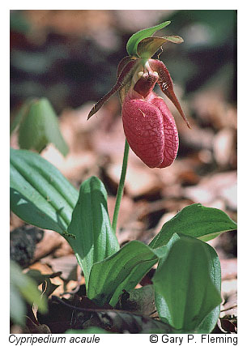
What species are found in the College Woods or other areas?
WILLI

Slide 27
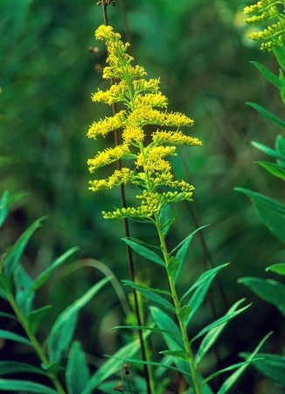
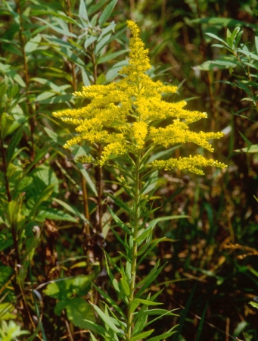
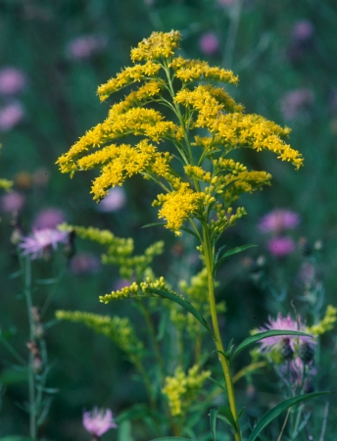
Herbaria are a vital resource for many kinds of research questions:
WILLI
Are these three goldenrods distinct species?

Slide 28
WILLI
Yes!
Solidago altissima
Solidago canadensis
Solidago juncea

Slide 29
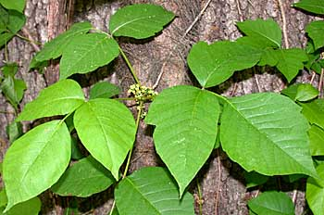
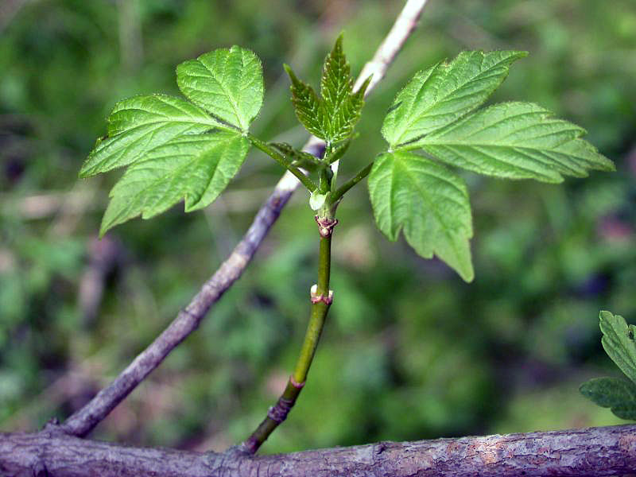
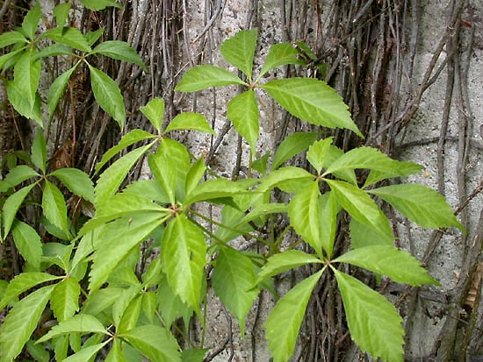
WILLI
How do you identify species?
Which one is poison ivy?

Slide 30
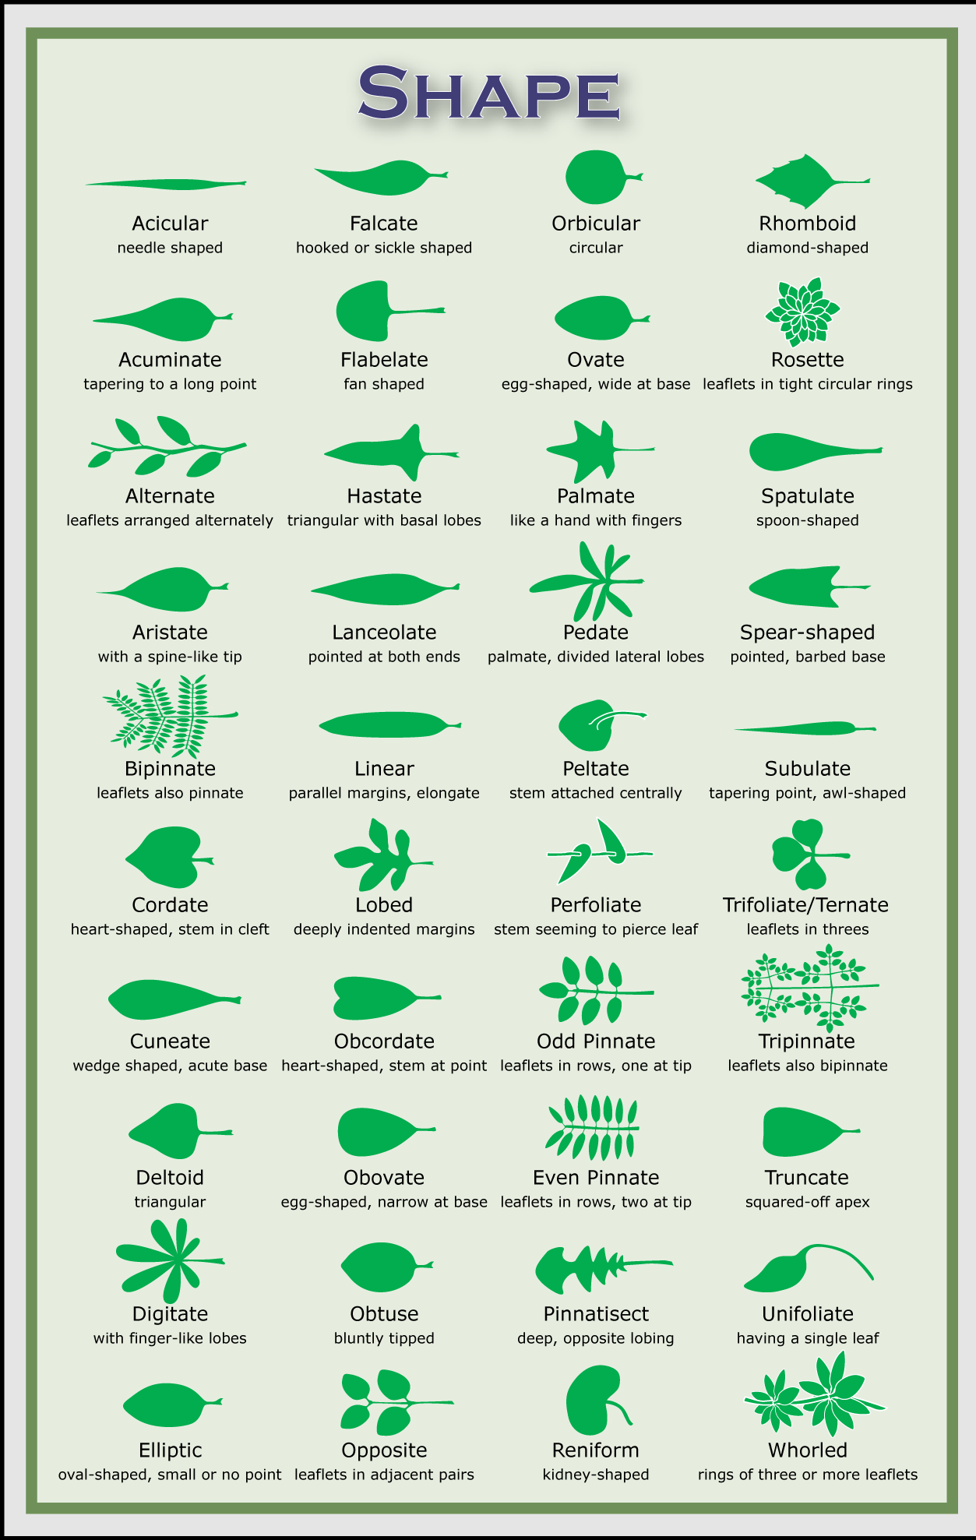
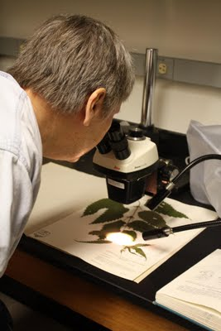
WILLI
Plant identification

Slide 31
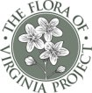
These specimens document species occurrences and provide material for other research projects -
WILLI
Such as the Flora of Virginia Project
“The Flora of Virginia, with publication targeted for 2012, will describe more than 3,500 plant species in 200 families and feature 1,400 captioned, scaled, and botanically accurate illustrations”

Slide 32
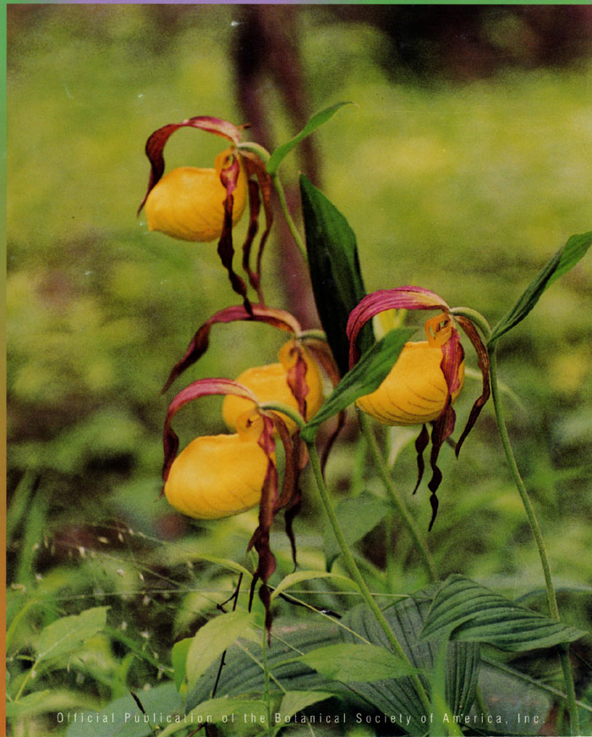
WILLI
Student research projects
Lady slipper pollination studies, e.g.

Slide 33
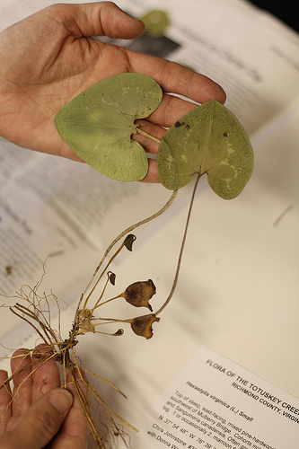
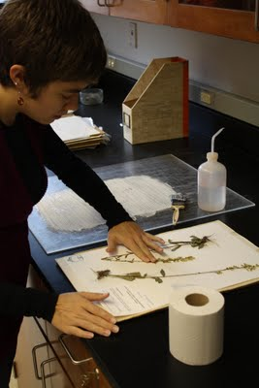
Specimen collecting & processing
WILLI
Specimen collecting & processing

Slide 34
WILLI
Link to specimen mounting demonstration
(5:30 minute long video)
http://www.wm.edu/as/biology/about/facilities/herbarium/volunteers/index.php

Slide 35
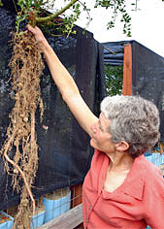
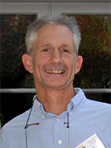
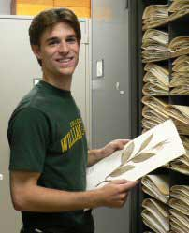
Over a hundred research students and herbarium associates have contributed over 30,000 specimens to the herbarium
WILLI
Dr. Gretchen North “Flora of E. Middlesex Co.” 1983
Dr. Amanda Ingram “Flora of Greensprings” 1998
Dr. Doug Soltis “Flora of the Davis Pond” 1974
Christopher Johnstone “Flora of Totuskey Creek” 2008

Slide 36
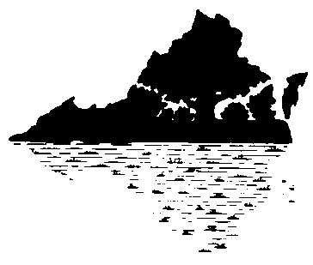
WILLI
Funding Acknowledgements
The College of William & Mary
National Science Foundation
Virginia Native Plant Society
Anonymous donors
Phlox nivalis

Slide 37
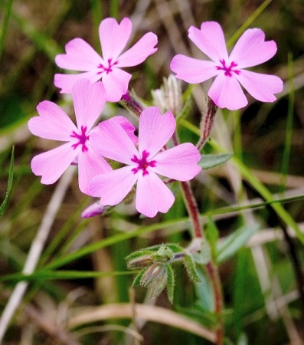
WILLI
Image credits:
Botanical Society of America
Illinois Natural History Survey (ILLS)
Michael Clayton, Wisconsin State Herbarium (WIS)
Robert Bebb Herbarium (OKL)
University of Victoria herbarium (UVIC)
VA Department of Conservation & Recreation
Gary Flemming
Hal Horwitz
Keir Morse
Phillip Merritt
Troy Weldy

