Slide 1
Mapping the Banks of the Crim Dell Pond
by Jesse Smyth & Kendall King

Slide 2
Intro to Invasion Ecology
Non-native invasive species
  Take over land and choke out native species
  Harmful to ecosystems
Crim Dell
  Full of many invasive species
    Bamboo, wisteria, English ivy
  Ongoing projects to restore ecological health of Crim Dell
Notes:
Harmful because alter the ecosystem structure and reducing biodiversity that other organisms rely on

Slide 3
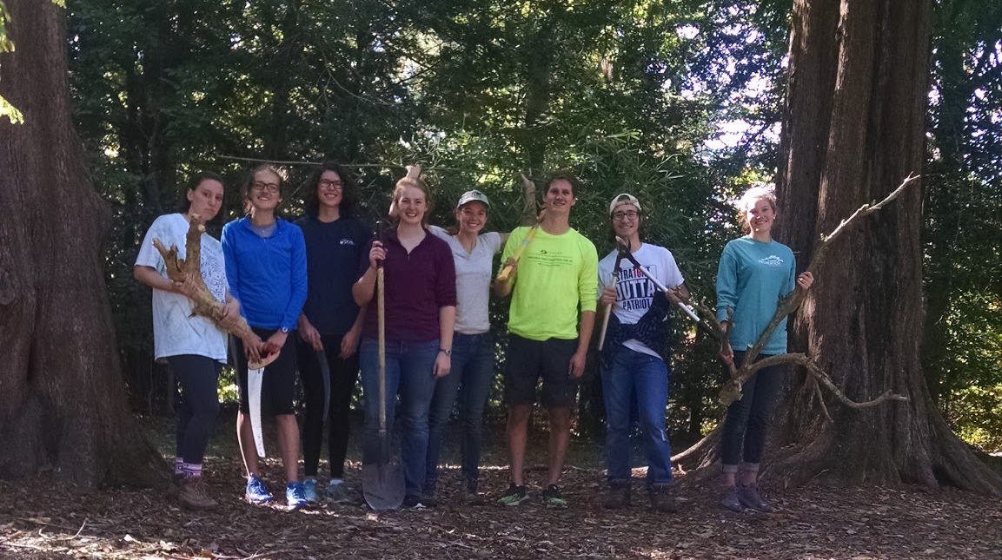
Background of Project
Notes:
No ivy day (Master Naturalists) → Make a Difference Day (Linda + Bird Club) → SEAC Restoration formed.
Restoration: 2-4 workdays per semester, removed nearly all the bamboo (over 300 large stalks), Significant amounts of wisteria/honeysuckle/ivy as well, planted well over 100 native plants

Slide 4
SEAC Restoration Video
https://www.youtube.com/watch?v=avp9GEo_-3o

Slide 5
Original Goals
Map and document dominant woody vegetation
Map and document invasive species of interest
Map and document sunny and shady slopes
Calculate the percent slopes around the pond
Create a planting plan using information gathered
Research options for planting on steep slopes
Notes:
Purpose of our project: To continue the work of SEAC Restoration and document it so that the project can continue past our graduation dates

Slide 6
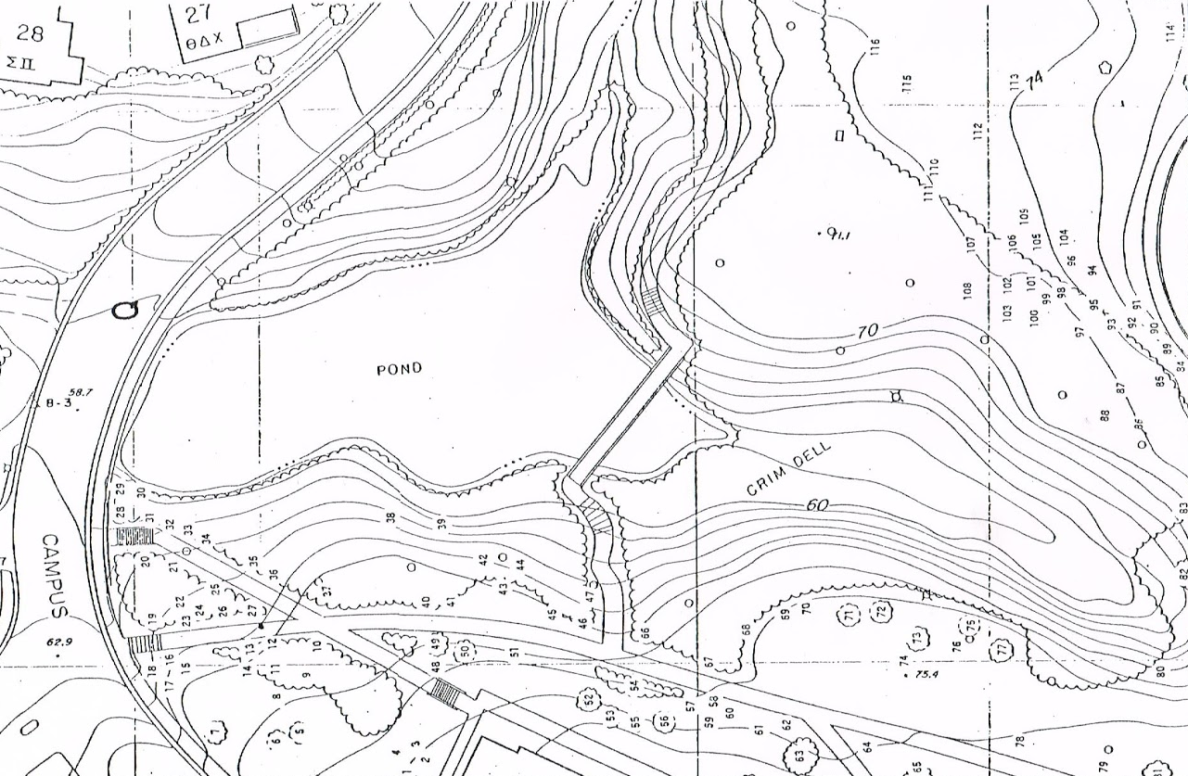
“Collection of Woody Species”Martin Mathes, 1980
Notes:
Map from larger work that mapped woody species of the entire campus

Slide 7
“Collection of Woody Species”Martin Mathes, 1980
Incorrect water feature
Outdated features
PROBLEMS
Unexplained symbols
Notes:
Many issues
Made in 1980
Doesn’t have McGlothlin, shows lodges as Greek housing
Inconsistent labeling of features
Southern arm of the Crim Dell is a different shape now.

Slide 8
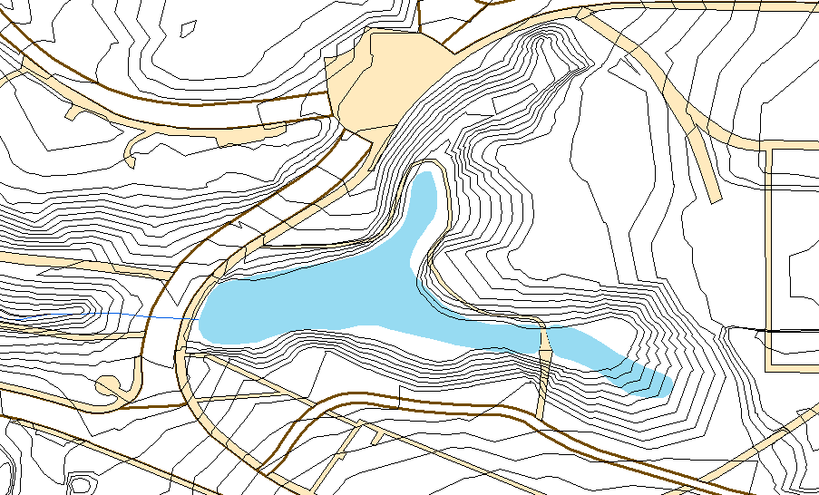
Layers from JCC GIS Database, W&M CGA, & Tim Russell
Notes:
Found layers from multiple sources
Layers from the CGA matched with layers from Tim Russell and the James City County GIS Database (but not with water features or our knowledge of the area)

Slide 9
Layers from JCC GIS Database, W&M CGA, & Tim Russell
PROBLEM
Contour intervals cross water feature

Slide 10
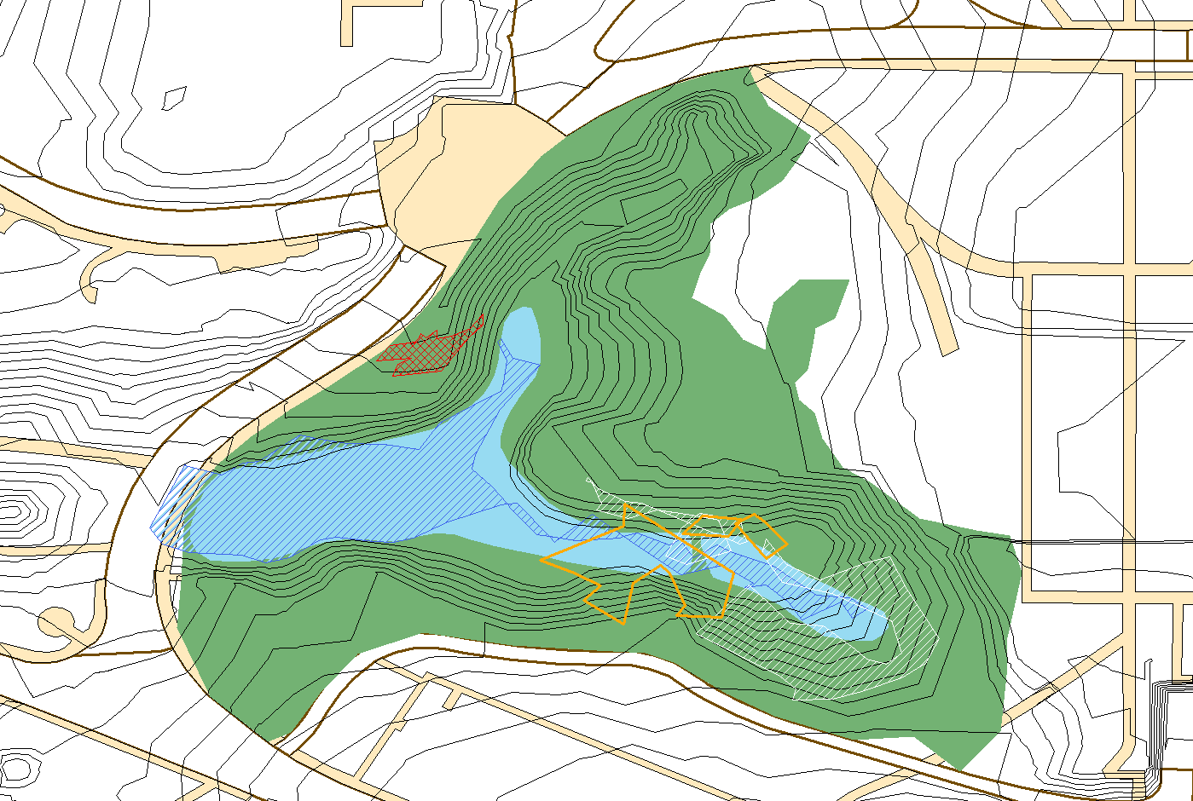
ArcMap and ArcCollector
Notes:
Tried two different types of GPS mapping
Handheld gps > take waypoints using a gps, upload them onto computer, extract data as shapefiles, overly onto existing shapefile features
ArcCollector> GIS app for phone, specify area working in, map features on site, connected to ArcGIS online

Slide 11
ArcMap and ArcCollector (GPS)
PROBLEMS
Patch of existing bamboo
Patch of wisteria
Crim Dell water feature
Patch of removed bamboo
Notes:
GPS inaccuracy
Working on such a small area
Two different types of gps mapping did not work out

Slide 12
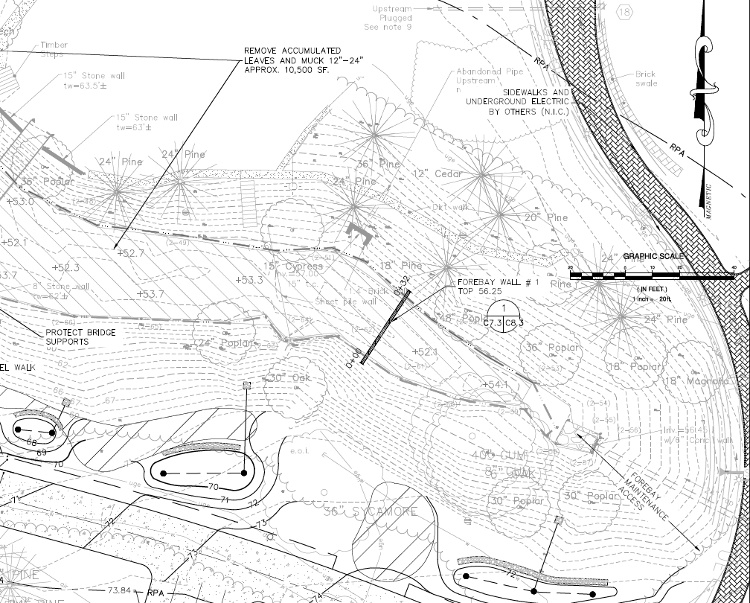
Draper Aden Associates Map
Notes:
Map created by DAA for facilities for stormwater infrastructure improvement plans
Very accurately drawn
Easy to use as a map reference

Slide 13
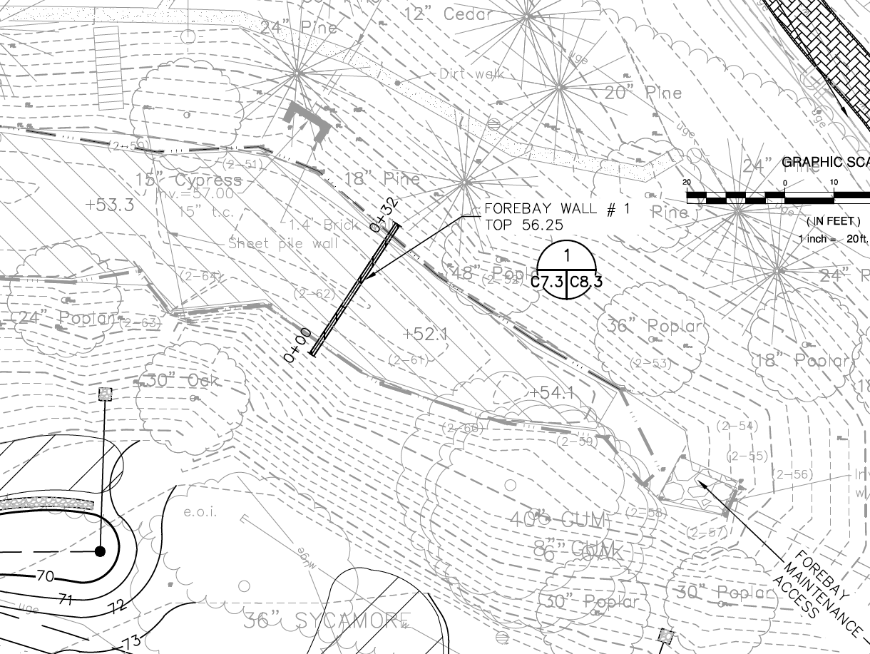
A Closer Look at the Map

Slide 14
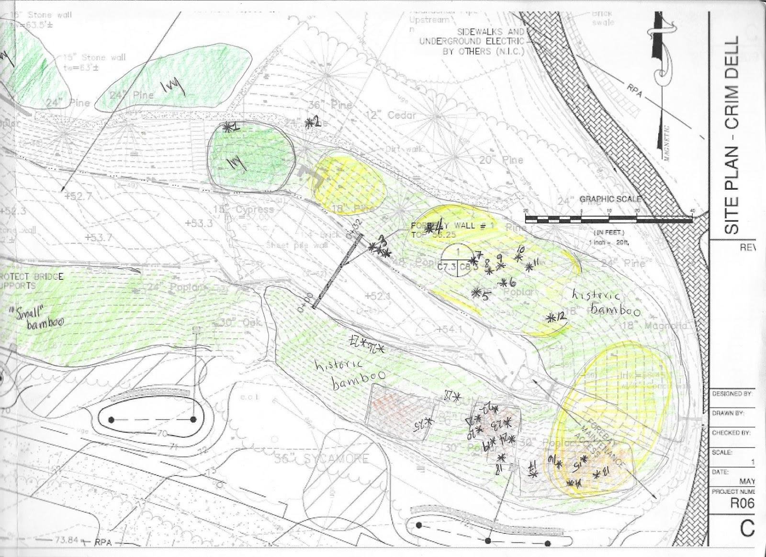
Hand Mapping the Crim Dell

Slide 15
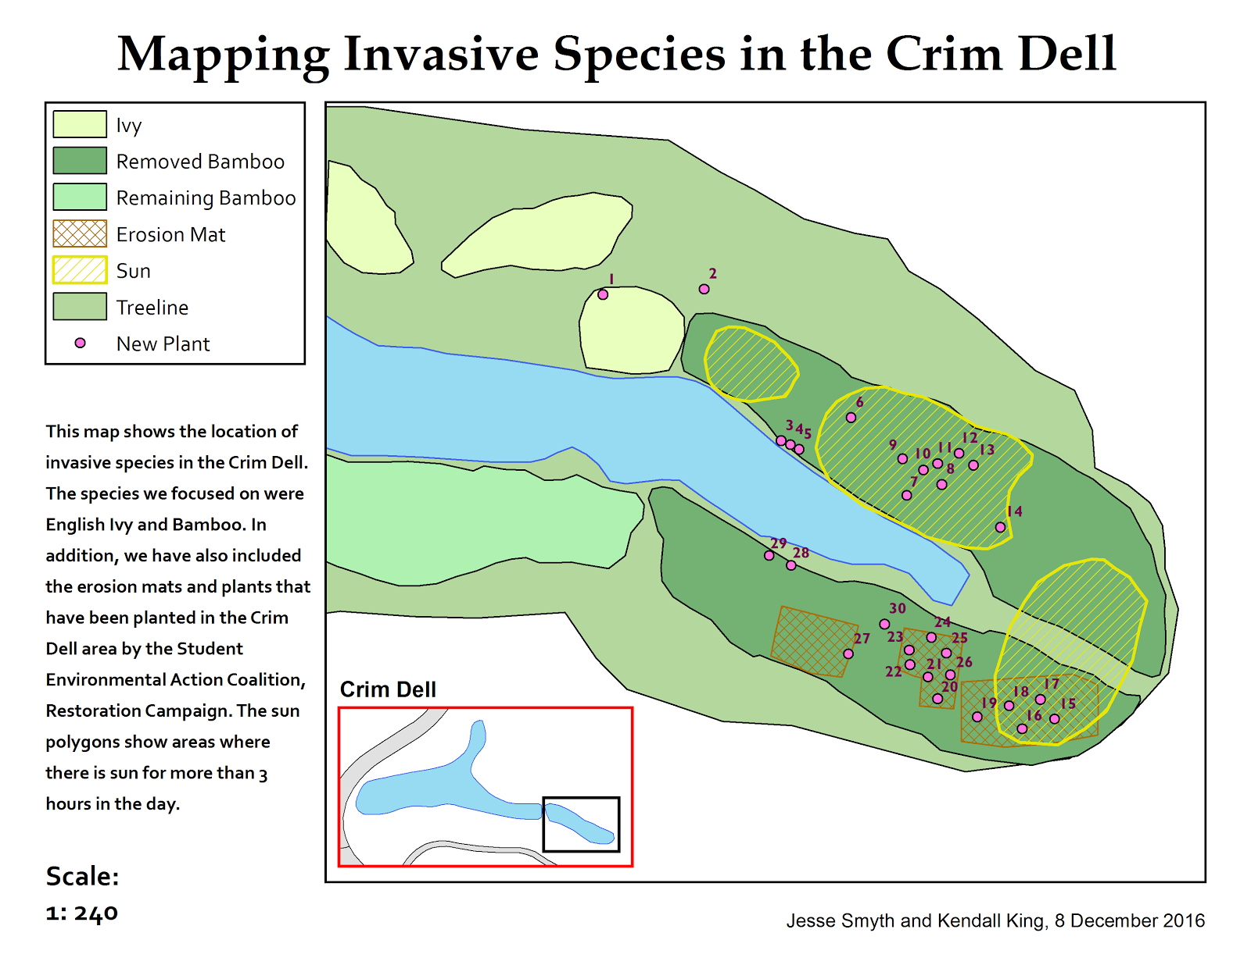
Invasives and New Plants

Slide 16
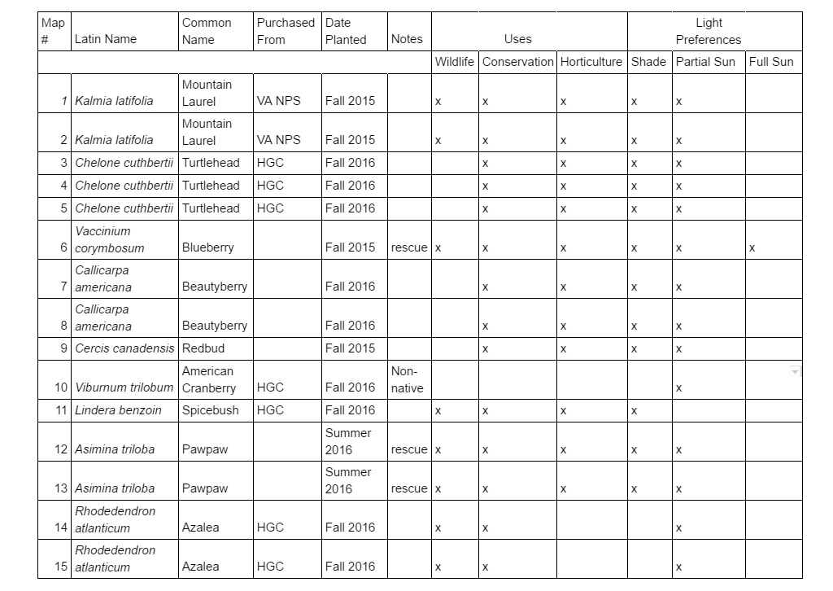

Slide 17
Homestead Garden Center
Virginia Native Plant Society
Rescued from construction site
Notes:
3 ways we get our plants
Donated from Virginia Native Plant Society
Bought from Homestead Garden Center
Rescued from areas that are set to be demolished

Slide 18
A Closer Look at the Trees

Slide 19
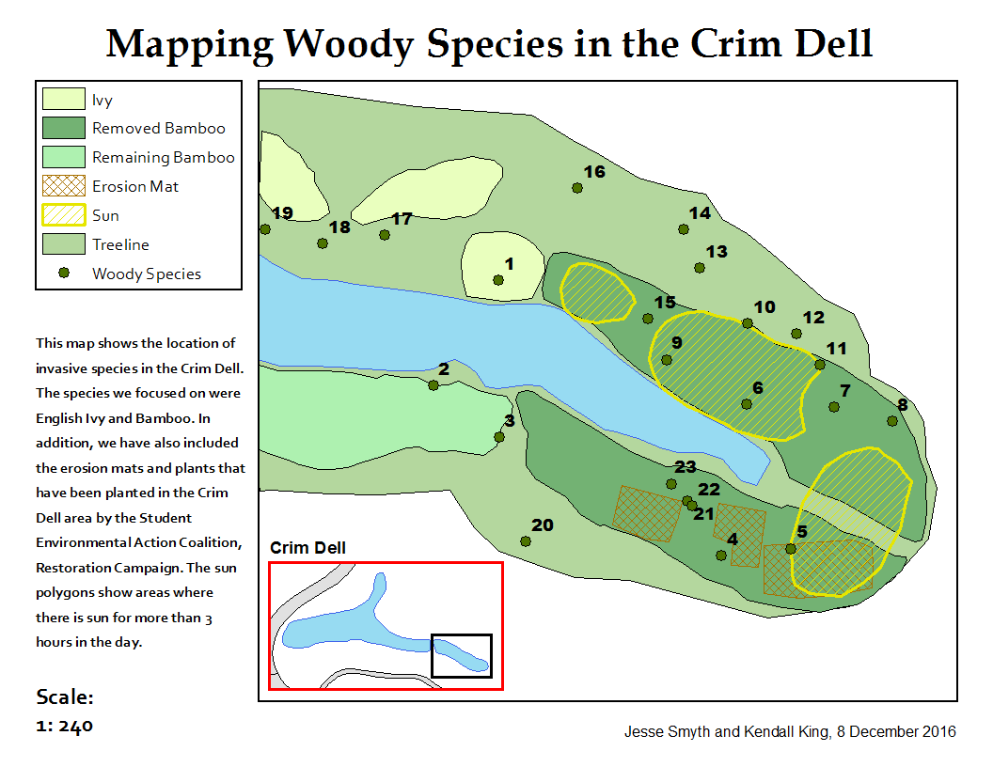
Invasives and Woody Species

Slide 20
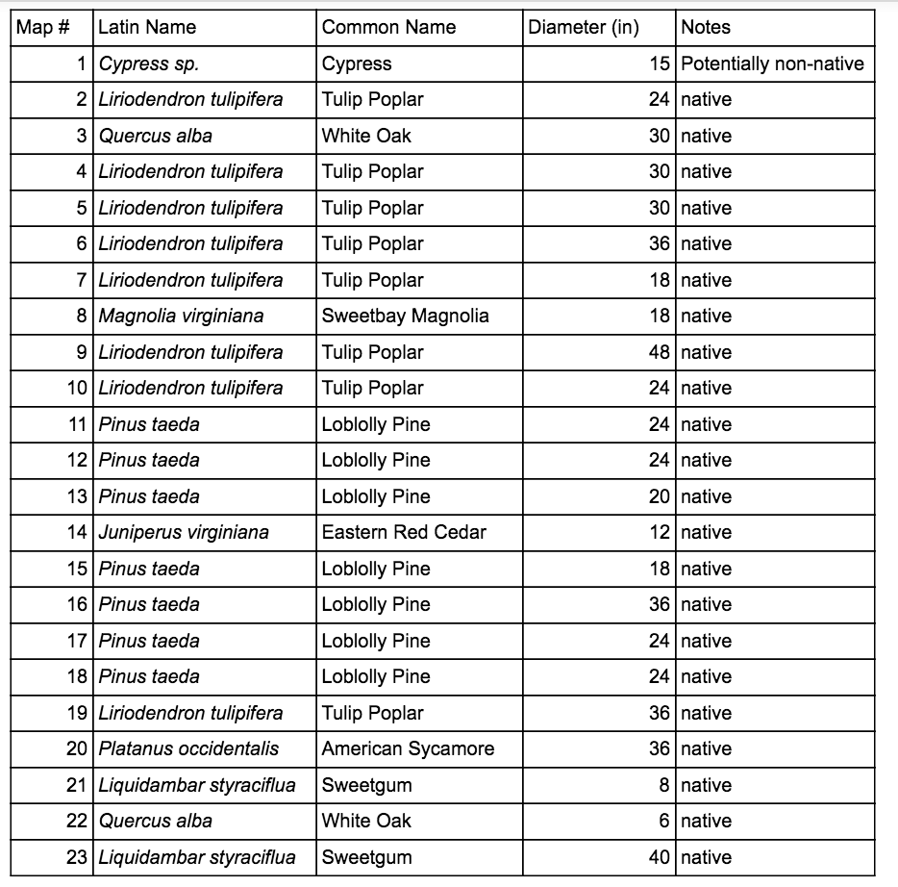

Slide 21
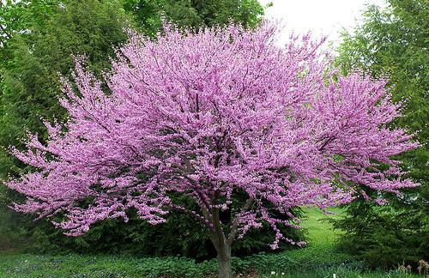
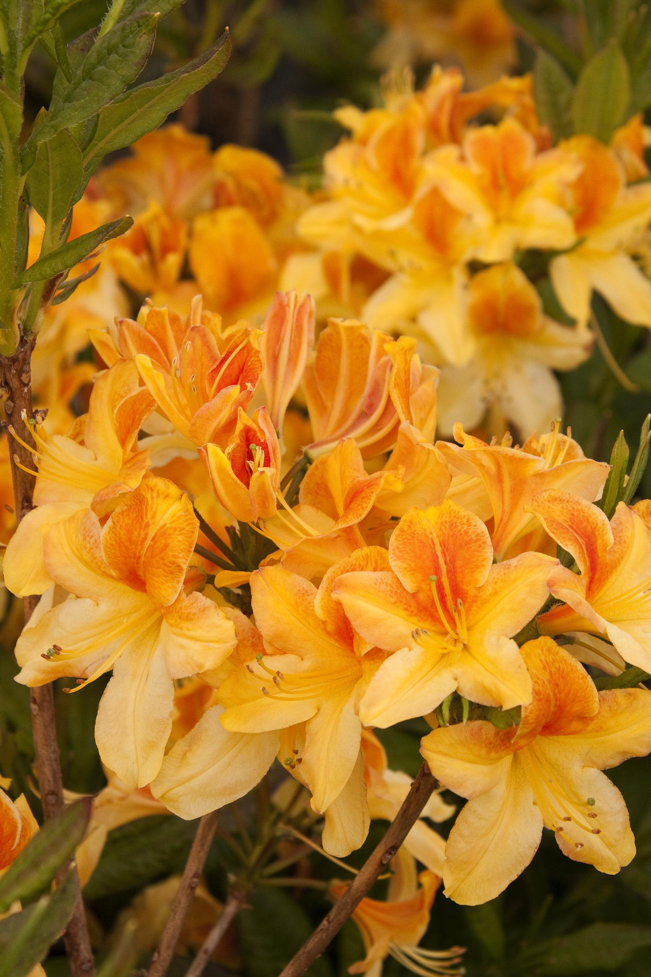
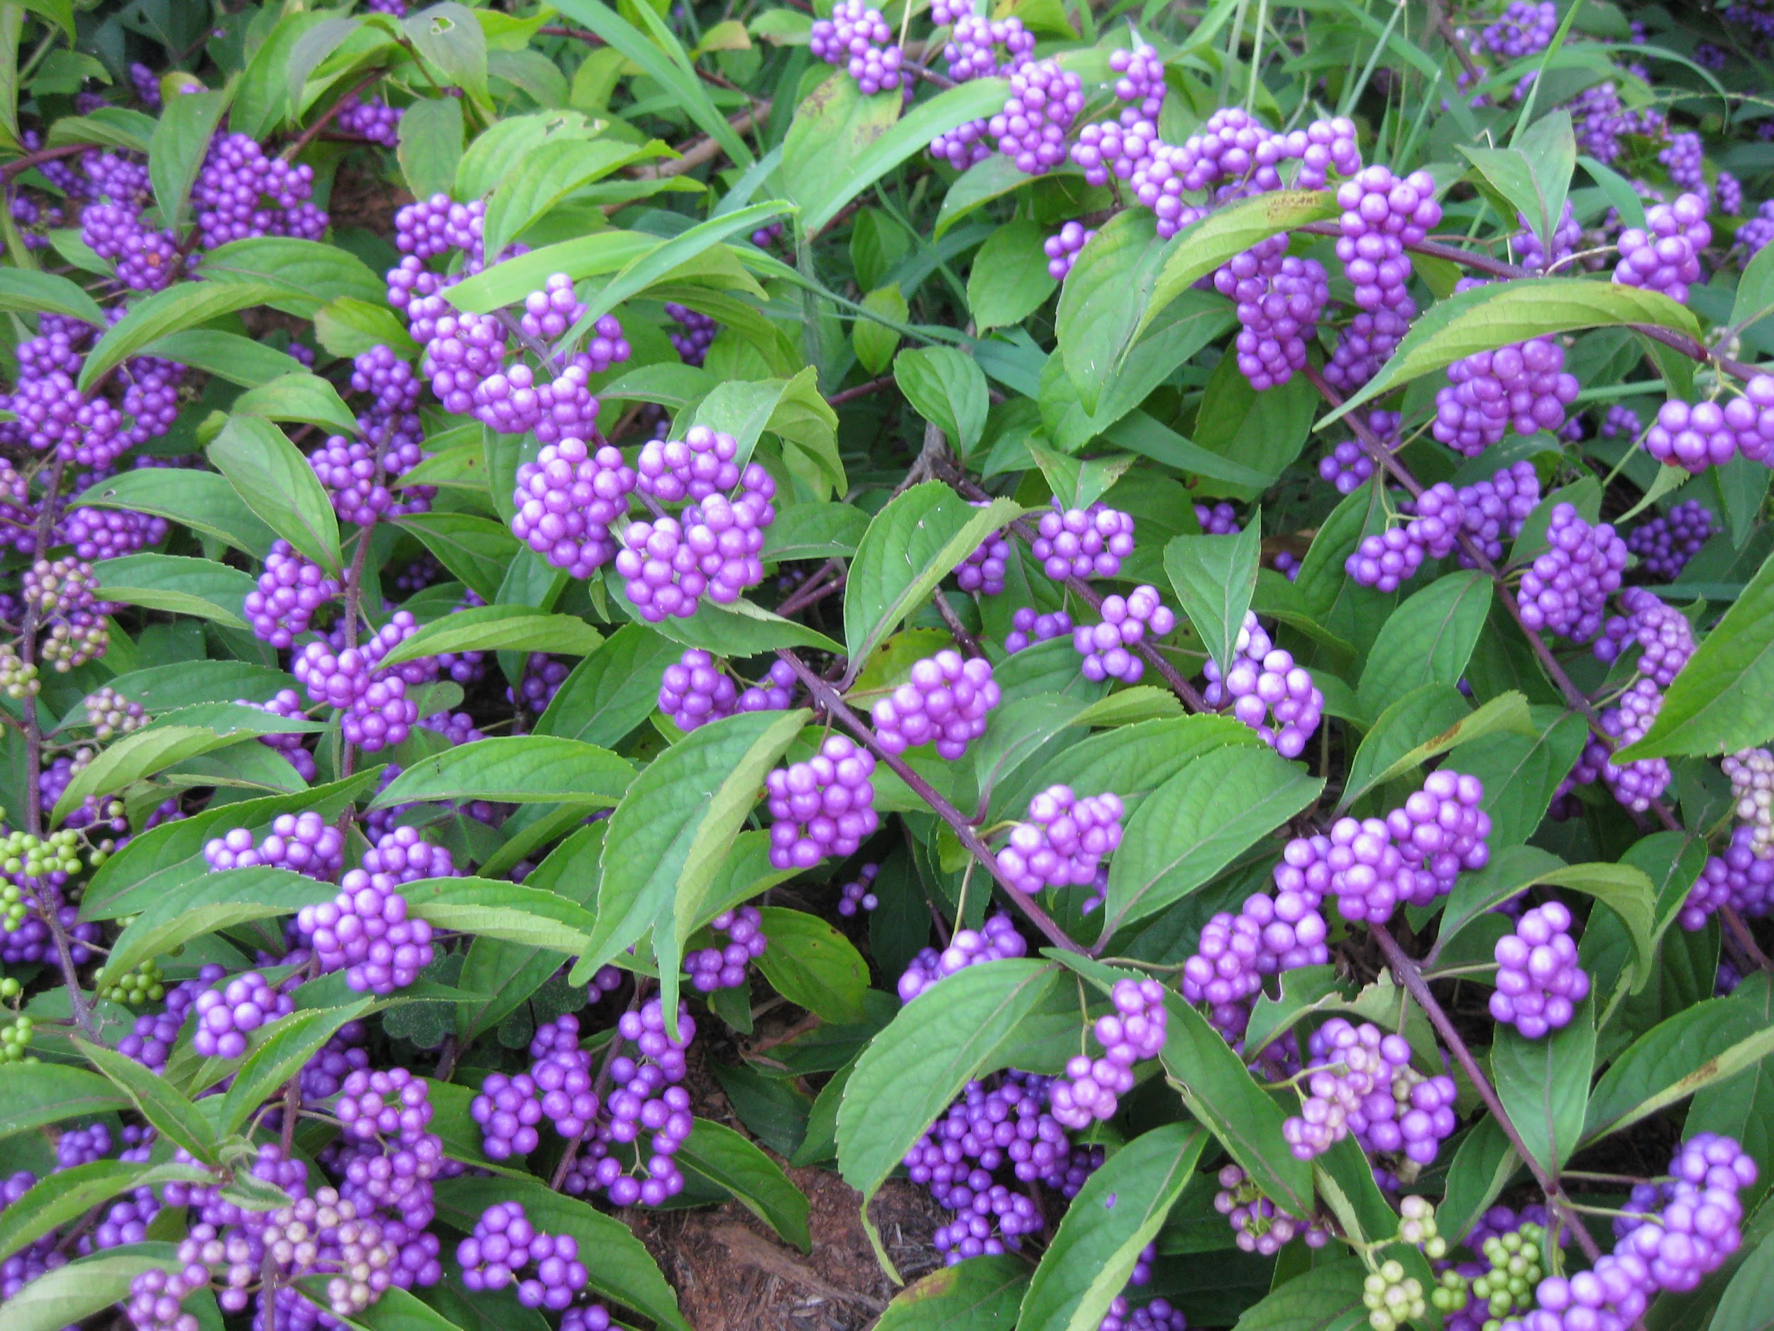
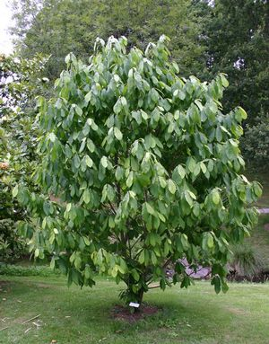
Plan for Replanting
Redbud
Golden Azalea
Beautyberry
Pawpaw
Notes:
What’s been done? (>100 plants, mix of herbaceous and woody. Most of the herbaceous ones have been forgotten, as they were planted a year ago and not mapped. Most woody ones still have pink tags for identification.
Future: More woody plants/trees: Dogwood, redbud, azalea, etc.

Slide 22
Conclusions
Improved ecological health
Greater accessibility for the campus community
Opportunities for mental health improvement
Continuation of the project
Mapping is hard.
Notes:
increased biodiversity, wildlife attractions (flowering plants), erosion control
without huge stands of bamboo, the Crim Dell and surrounding trails are more visible
some plant locations already lost due to lack of documentation/students graduating

Slide 23
Thank You!!
Linda and Beth!
Calandra!
Everyone else we talked to!
All of you for coming!

Slide 24
References
Mathes, Martin. (1980). Map Q. Collection of Woody Species, 45-47.
Petrides, G. A. & Wehr, J. (1998). Eastern Trees. China: Houghton Mifflin Company.
Pimentel, D., Zuniga, R., & Morrison, D. (2005). Update on the environmental and economic costs
associated with alien-invasive species in the united states. Ecological Economics, 52(3),
273-288. doi:http://dx.doi.org/10.1016/j.ecolecon.2004.10.002
Restoration Ecology Class. (2016). Dr. Doug DeBerry, College of William & Mary. BIOL/ENSP.
Royal Horticultural Society. (2016). Bamboo Control. The Royal Horticultural Society.
doi:https://www.rhs.org.uk/advice/profile?PID=210

Slide 25
Van Den Berg, A. E., Maas, J., Verheij, R. A., & Groenewegen, P. P. (2010). Green space as a buffer between stressful life events and health. Social Science & Medicine, 70(8), 1203-1210. doi:10.1016/j.socscimed.2010.01.002
Virginia Department of Forestry (2001). Common Forest Trees of Virginia: How to Know Them A Pocket
Manual. Charlottesville, VA: Department of Forestry.
Virginia Department of Forestry. (2010). Common Native Trees of Virginia. Charlottesville, VA:
Department of Forestry.
Virginia Native Plant Society. (2011). Native plants for conservation, restoration, and landscaping.
Virginia Department of Conservation and Recreation.
Zavaleta, E. S., Hobbs, R. J., & Mooney, H. A. (2001). Viewing invasive species removal in a
whole-ecosystem context. Trends in Ecology & Evolution, 16(8), 454-459.
doi:http://dx.doi.org/10.1016/S0169-5347(01)02194-2

