Slide 1
New Faculty Benefits Orientation
William & Mary
University Human Resources

Slide 2
Orientation Agenda
Welcome Remarks
Part One – Getting Started
Part Two – Retirement and Related Plans
Part Three – Healthcare Plans
Part Four – Voluntary Benefits
Notes:
Parts 2, 3 & 4 will contain information you will need to assist you with making decisions that need to be made in a timely manner. Please note the state deadlines. Failure to turn in forms and make your elections by the deadlines can have irrevocable consequences.
Agenda for today – IT IS A LOT OF INFO AND WE GO THROUGH IT PRETTY QUICKLY – Feel free to ask any questions along the way in the meeting chat. Laura will be moderating the chat answering any questions you may have.

Slide 3
Getting Started – Online Tools
Notes:
William & Mary (W&M) offers many online tools for employees to use throughout their work experience. This is a screen shot is the center of the MyW&M Home Page (https://my.wm.edu). Two important online tools for you to know are Banner Self Service and Cornerstone.

Slide 4
Getting Started – Checklist
Checklist Item | Location | Deadline
Welcome letter from UHR | Online Cornerstone | 7 Days
Code of Ethics & Mandatory Reporting | Online Cornerstone | 7 Days
Virginia Drug Policy Acknowledgement | Online Cornerstone | 7 Days
Direct Deposit | Online Banner | Today
Clearance Deduction Policy Acknowledgement | Online Cornerstone | Today
Notes:
We have added a new hire curriculum in Cornerstone to help us achieve our green initiatives.
In Cornerstone, you can find the Policy on Alcohol and Other Drugs, Mandatory Reporting and the Clearance Deduction Policy.
Review the policy and acknowledge receipt in Cornerstone
You are acknowledging receipt of the policy
Your acknowledgement does not indicate agreement or disagreement with the policy
You need to go to Banner Self Service and:
1) update your address
2) complete your direct deposit form

Slide 5
Getting Started – Online Tools
NEW HIRE CURRICULUM
Will be assigned to you via an email. Please log in once you receive the email.
Notes:
Cornerstone is the system used by W&M for learning management and performance management. As a new hire, you will use Cornerstone’s learning management system to access forms and policies that you need to review and/or sign off on. If you did not receive a Cornerstone link, please email ASKHR@wm.edu.
Cornerstone also houses a wide variety of training as well as the performance management system. I will now go back over and show you how to access Cornerstone. This may not be available to you immediately as a new employee but you should receive an email from IT once your account is set up
Note that Lynda.com is now called LinkedIn Learning.

Slide 6
Getting Started – Online Tools
Enter
Direct Deposit information
Tax information
Emergency contact information
Opt into electronic W-2s
View
Pay history
Check stubs
Notes:
Banner Self Service allows employees to update tax and personal information. Electronic W-2 opt in and out can be found in the employee section. You can view your deductions.
This is also where you will go to enter your direct deposit information – this is mandatory – should be done asap

Slide 7
Getting Started – Online Tools
Change of address
Use Banner Self-Service
Change of name
Copy of new social security card required to be seen by UHR along with a Change of Name form which is available on the UHR website
Notes:
I’m going to give you a quick tour of Banner.
You can see Opens up to Personal Information page where you can update and view your addresses, phone numbers, emergency contacts and access campus wide emergency numbers –
Use the personal section to enter an emergency contact should an accident occur and you are unable to let us know who we should contact.
It is very important that you keep your address and contact information up to date because that is the information that feeds through to payroll and your benefit providers.

Slide 8
Getting Started - Payroll Information
Pay periods:
* 10th – 24th ~ paid on the 1st of the month
* 25th – 9th ~ paid on the 16th of the month
Pay checks must be direct deposited.
Verify your Banner address.
William & Mary workweek (Sun. through Sat.)
VIMS/Athletics workweek (Sat. through Fri.)
Notes:
The workweek may be relevant to you if you supervisor non-exempt employees who may work overtime.

Slide 9
Getting Started – Direct Deposit
Set up direct deposit before first payroll date
Ensure your mailing address in Banner is updated
Visit Payroll web page: “What You Should Know”
Notes:
Banner Self-Service is the location where you will sign up for direct deposit. You MUST update your banking information prior to payroll processing as the first check will be a direct deposit.
Complete your tax information as well.

Slide 10
Getting Started - Holidays
Observed holidays:
New Year’s Day, Martin Luther King, Jr. Day, Memorial Day, Juneteenth, Independence Day, Labor Day, Election Day, Thanksgiving & Day After Thanksgiving, Christmas Eve & Christmas Day
Holidays such as George Washington Day, Columbus Day and Veteran’s Day are used for the winter break.
Notes:
We observe 10 of the state holidays, but use the additional 3 state holidays for our winter break. Provost publishes the schedule each year for the WM observed holidays. Holidays are not paid out if you leave prior to observing them. Transfers observe the holidays of their new agency.

Slide 11
Getting Started - Inclement Weather
Watch/Listen
W&M Emergency Notification System
Local TV/radio broadcasts
Call
W&M (757) 221-1766
VIMS (804) 684-7000
Tribe Alerts
Set up in Banner Self-Service
Notes:
How do I know if the University is closed?
W&M Emergency Notification System & Text Alerts TRIBE ALERTS– Set up in Banner Self-Service under “Personal Information” tab in Banner Self Service. If you choose not to exercise this option, you can call the emergency inclement weather lines listed or watch the local TV broadcasts.

Slide 12
In Inclement Weather. . .
“Essential” employees must report to work
Supervisors
Be aware if your employees are essential
Review essential employee policy
Notes:
Supervisor’s need to inform staff if they are an “essential” employee. Compensatory leave will be paid hour for hour for each hour worked to “essential” nonexempt employees who must report to work for hours when the University is closed.
Exempt employees, who submit timesheets only when they take leave:
There is no action needed on your part to record the use of the holiday and you may need to record University closures.
If you are required to work on the holiday or closure, you may, with the approval of your supervisor:
Take the day on a different day within the same pay period, or
Record Compensatory Leave Earned on your timesheet. This will result in hours be added to your Comp Leave bucket. These hours should be used at the first opportunity by recording Compensatory Leave Taken on a subsequent timesheet.
Non-exempt (salaried) employees, who submit timesheets each pay period:
Holiday or University closure hours will be visible in your timesheet when you open it. There is no additional action needed if you take the day as scheduled.
If you are required to work on the holiday or closure, you may, with the approval of your supervisor:
Record the hours on a different day within the same pay period, or
Record the hours you work as you normally would, and record the holiday or closure hours you were not able to take as Compensatory Leave Earned on your timesheet. This will result in hours be added to your Comp Leave bucket. These hours should be used at the first opportunity by recording Compensatory Leave Taken on a subsequent timesheet. Compensatory Leave expires after one year.

Slide 13
Decisions to be made
Voluntary
Benefits
Retirement
Health
Insurance
Leave
Short & Long Term
Disability
Supplemental
Retirement
Savings
Optional Life
Insurance
Notes:
W&M offers employees a number of voluntary benefits. You need to decide what plans are right for you. Some choices can be changed during open enrollment dates and other choices are irrevocable. It is important to review all your options before you make your elections.

Slide 14
Decision- Checklist
Checklist Item | Form | Deadline
Health Insurance | Health Enrollment form | 30 days
Retirement Plan Selection | VRS 65 Election to Participate Form | 60 days
Notes:
You have been emailed the health enrollment and retirement enrollment forms to complete and return to HR by the deadlines. Forms are fillable. Once completed, you can upload the forms to box.wm.edu along with any necessary back up documentation. Share health enrollment forms and documentation to cmowens@wm.edu and share retirement enrollment form to mconnolly@wm.edu. If you prefer, you can fax the completed forms to 757 221 7724.
You will have up to 30 days from the date of hire to choose your medical plan and up to 60 days from the date of hire to consult with a spouse, parent or financial advisor and then choose either the VRS or the ORP Retirement Plan. If you have any additional questions about completing either the health and/or the retirement VRS 65 forms that have been emailed to you, please contact ASKHR@wm.edu.

Slide 15
If Your Previous Employer Was A VRS Participating Employer
You Must Restart All Voluntary Retirement Deductions:
Voluntary Hybrid DCP Contributions
457(b)
403(b) *Deferred Compensation contributions must be re-elected when transferring from another employer by calling MissionSquare/TIAA or by logging into your account online. You are subject to the IRS Calendar limitations when making your 457(b) elections combined.

Slide 16
If Your Previous Employer Was A VRS Participating Employer
Download Your Account Summary Statement
from your myVRS Account and Upload it to Box.

Slide 17
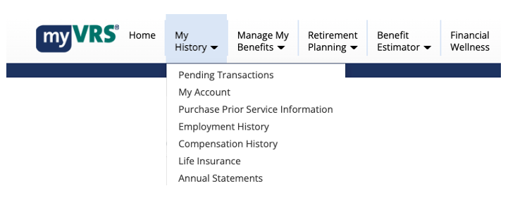
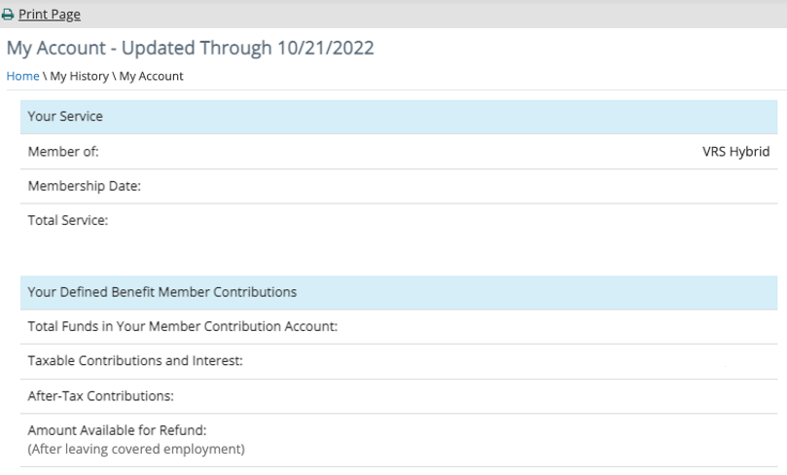

Slide 18
State Agency Transfers
Your service dates and accrued annual leave balance will not be accurately reflected in Banner until after receipt of your 2nd paycheck.

Slide 19
Retirement
VRS
Hybrid Plan
or
ORP
4% Voluntary Hybrid
Contributions
401(a)
Cash Match
$$$$$
5% Required
457(b)
and/or
403(b)
Highly Recommended
Optional

Slide 20
Retirement: Definitions
Defined Benefit – benefit you receive for the rest of your life following retirement as a “pension” or monthly benefit. Benefit is based on a formula.
Defined Contribution – benefit you receive in retirement is based on investment results of your contributions into a fund(s) and how your investment(s) performed.

Slide 21
Retirement: Hybrid Benefit Plan
Each pay, 5% of your gross pay (pre-tax) goes toward retirement:
4% to the “defined benefit” (DB) component
1% to the “defined contribution” (DC) component
Hybrid DB defined benefit at retirement is based on formula:
(Average of final compensation x 1% x years of service) /12
Hybrid DC defined contribution at retirement is based on investment results.

Slide 22
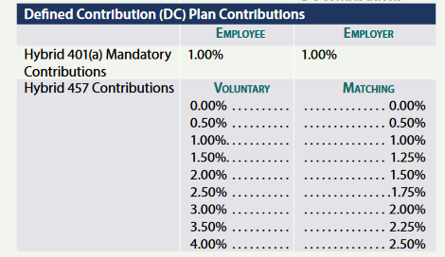
4% Voluntary Hybrid
Contributions

Slide 24
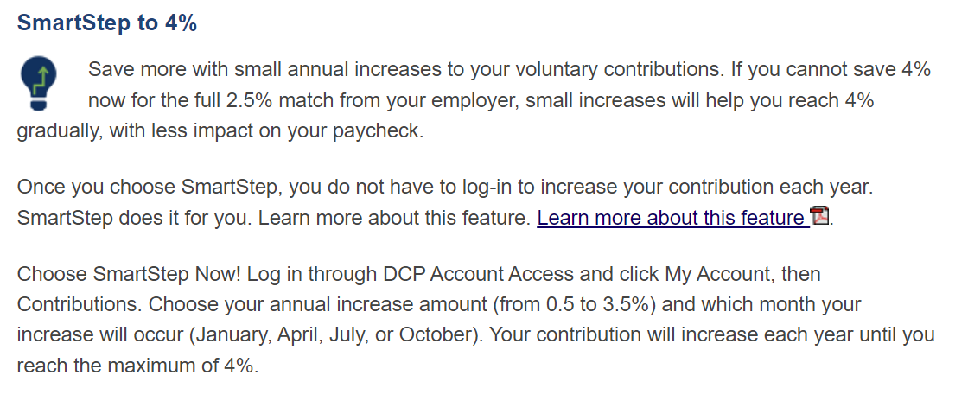

Slide 25
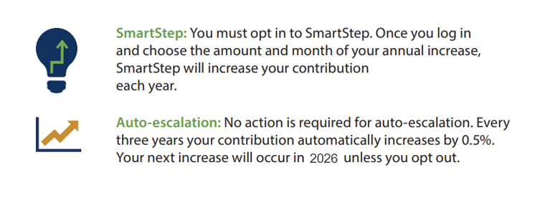

Slide 26
Retirement: Hybrid Benefit Plan Vesting
Years of Service | Defined Contribution | Defined Benefit
2 | 50% | -
3 | 75% | -
4 | 100% | -
5 |  | 100%

Slide 27
VRS Retirement: Hybrid Benefit Plan
Retire with Full Benefits
Social Security retirement age with 5 years’ service
Your age + Years of Service = 90
Earliest Reduced Retirement Eligibility
Age 60 + 5 or more years of service
Defined Contributions Distributions
Upon leaving employment

Slide 28
Tax Advantaged Savings Plans
457(b) | 457(b) Roth
403(b) | 403(b) Roth
Contributions Taken Pre-tax | Contributions Taken Post-tax
Deductions for your contributions to the retirement
plan are deducted from your paycheck before taxes
are calculated.
You pay taxes on the money in your retirement
account when you withdraw the funds from the
account.
Deductions for your contributions to the retirement
plan are deducted from your paycheck after taxes
are calculated. No tax savings right now.
You will not owe taxes on the money in your
retirement when you withdraw the money from your
account *if you meet the withdraw requirements*.

Slide 29
$ Cash Match $
If you contribute to the 457(b) or the 403(b), you will receive a cash match of 50%.
The minimum employee contribution required to receive a cash match is $10 per pay period.
The maximum employer cash match contribution is $20.
Contribute $40 each pay period & receive a $20 cash match!
You can enroll in both the 457(b) and 403(b) plans, you will receive ONLY ONE cash match for your contributions.
Hybrid plan participants must contribute 9%
to be eligible for the cash match programs with the 403(b)
or 457 (b) supplemental savings plans.
4% Mandatory DBP + 1% Mandatory DCP + 4% Voluntary Contributions To The Hybrid DCP Plan

Slide 30
Campus Police Officers/
Professional Employees Enrolled In The ORP Plan:
Automatically enrolled in the 457(b) plan after 90 days of employment.
$20 Will Be Deducted Per Pay Period w/ a $10 match
To opt-out, contact MissionSquare
1 (877) 327-5261 within 90 days of hire.

Slide 31
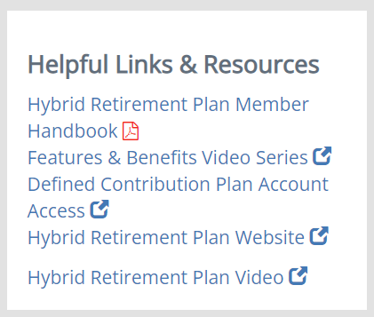
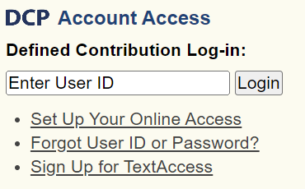
Retirement Account Access
VRS Defined Benefit + Group Life Insurance
https://myvrs.varetire.org/login/
VRS Hybrid Defined Contribution + Voluntary Hybrid + 457(b)
MissionSquare

Slide 32
Retirement Account Access
VRS Defined Benefit + Group Life Insurance
https://myvrs.varetire.org/login/
You will not have access to the VRS, Mission Square
or Retirement@Work websites at this time. It will take 1-2 two weeks after your first paycheck is received for your employee access to be setup in the VRS, Mission Square and Retirement@Work systems.
VRS Hybrid Defined Contribution + Voluntary Hybrid + 457(b)

Slide 33
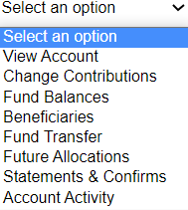
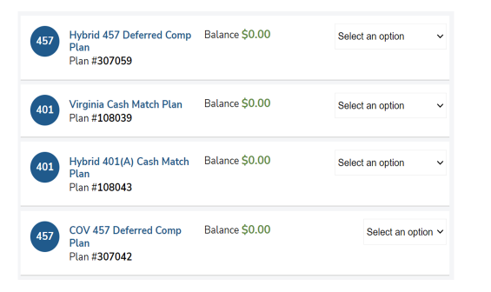

Slide 34
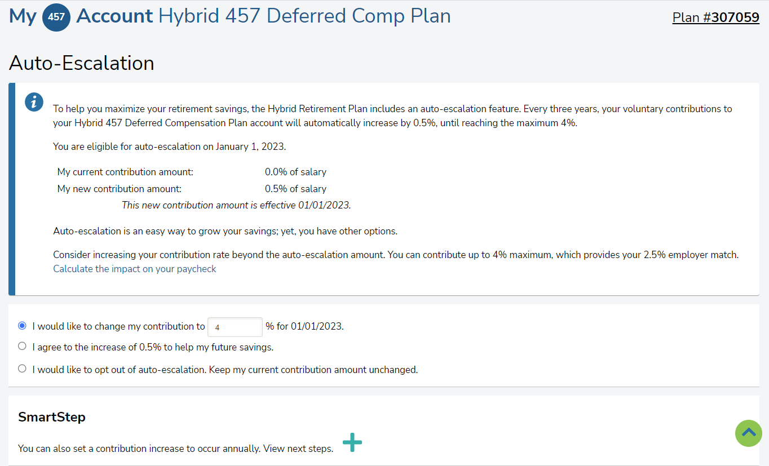

Slide 35
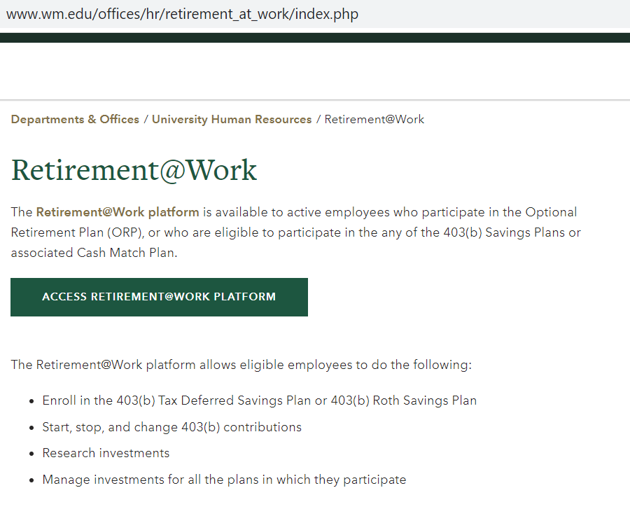
403(b)
Retirement Account Access
Enroll & Select Investments Here After Your First Check

Slide 36
Retirement: Optional Retirement Plan (ORP)
Is a retirement benefit based on contributions & fund performance administered by TIAA
5% employee contributions
8.5% employer contributions
Is a pre-tax deduction
Has no vesting schedule – If you leave you may take the total plan value. As vesting is immediate, the employee + employer contributions are yours.

Slide 37
Retirement: Plan Comparison
Topic | HYBRID | ORP
Vesting | Defined Benefit = 5 years Defined Contribution = 4 years | Immediate
Contribution | Employee = 5% Employer = Dependent on voluntary contributions. | Employee = 5% Employer = 8.5%
Retirement Benefit | Pension benefit income + contribution income | Based on investment account balance

Slide 38
403(b) + Optional Retirement Plan (ORP)
Retirement Account Access
Choose investments by accessing the Retirement@Work Platform after ORP contributions are deducted from your paycheck.

Slide 39
Retirement: Deferred Compensation (DC) 457b
ORP Plan Participants
Enrollment automatic after 90 days of employment.
Deducted amount = $20 with $10 match*
DCP is administered by MissionSquare.
To opt-out, you must contact MissionSquare 877-327-5261 within 90 days of hire

Slide 40
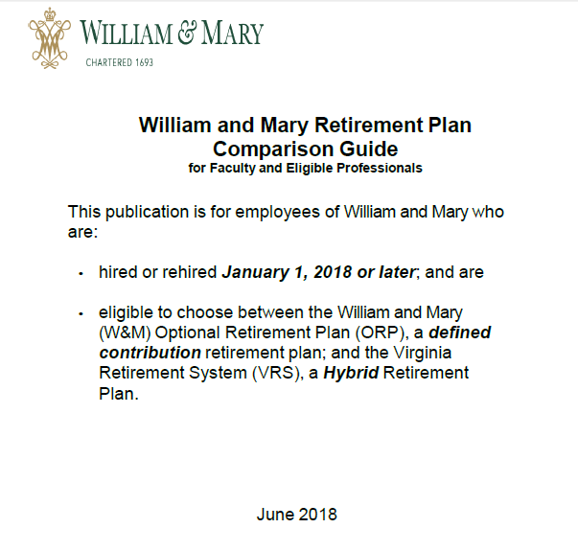
Retirement: Plan Elections
Selection of a Retirement Plan is IRREVOCABLE.
Read Comparison Guide for detailed information
**If you fail to select a retirement plan within 60 days of employment, VRS Hybrid Plan with VSDP disability will be selected for you.
Notes:
The W&M Comparison Guide provides a comprehensive overview of the VRS Hybrid and ORP retirement plans. The information can help you decide which plan you wish to elect to participate in.

Slide 41
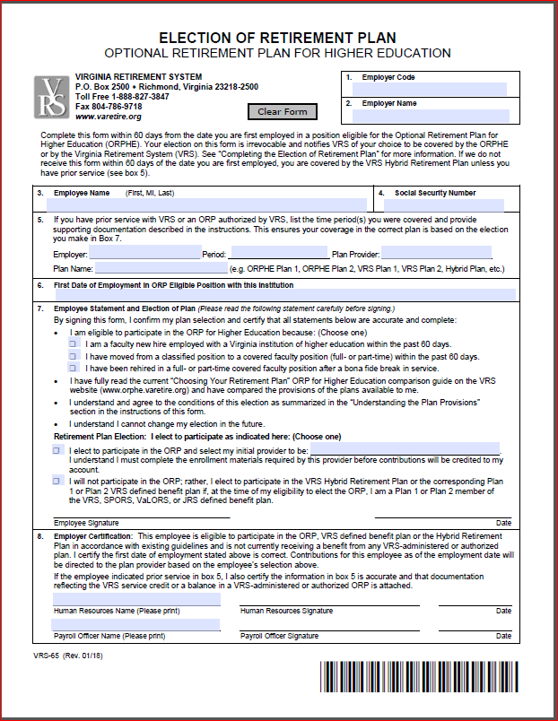
Retirement: Election Form
You have 60 days from hire date to complete the VRS-65 Form.
HR fax:
757 221 7724
Reminder: Selection of a Retirement Plan is IRREVOCABLE.

Slide 42
How PPF Retirement Choice Affects Sick and Disability Election:
Enroll in ORP | Enroll in VRS Hybrid, Plan 1 or Plan 2
Automatically placed in the University Sick and Disability Plan | Choice between University Sick and Disability Plan and the Commonwealth of Virginia Sickness and Disability Program (VSDP)
*New employees are only eligible for VRS Plan 1 or Plan 2 if previously enrolled with prior agency
Notes:
*Please refer to the Sick and Disability Comparison Chart provided prior to the orientation for a side-by-side comparison of the two plans

Slide 43
Sick/Disability Plan Comparison
Type of Leave | VSDP | University Sick & Disability
Sick Leave | 8 Days At Hire Increases With Years Of Service | 10 Days
Family/Personal | 4 Days | None

Slide 44
Sick/Disability Plan Comparisons
Type of Leave | VSDP | University Sick & Disability
Short-term Disability | Months 1-12 = None Months 13-59 = 125 at 60% of pay % increases with service | 120 days = 100% of pay with Provost Approval
Long-term Disability | Available after one year-180 day waiting period. Income 60%. State provided | Available after one year-180 day waiting period. Income 60%. Employee pays 40%.
Long-term Care | Up to $96/day. Maximum $7080 lifetime. State provided | None
Parental Leave | 8 weeks subject to policy rules & Provost approval | May use short-term disability leave.

Slide 45
Retirement & Related Plans - Checklist
Checklist Item | Location | Deadline
VRS 65 Election to Participate Form | Emailed | 60 days
VRS Beneficiary Designation Form | Online | After 1st paycheck deposited
VRS + Sick & Disability Election Form | Emailed | 60 days
VRS + Sick & University Disability Plan VSDP Opt Out Form (VSDP-2) | Emailed | 60 days
Optional Retirement Plan (ORP) Fund Selection | Online TIAA.com or R@W | After 1st paycheck deposited
Notes:
Options for faculty retirement:
1) Virginia Retirement Hybrid Plan (VRS); or
2) Optional Retirement Plan (ORP).

Slide 46
Group Life Insurance: Securian Financial
No cost to benefit eligible employees
No medical examination required
Effective first day of eligible employment
Term life insurance
Natural death coverage -
2 times salary rounded to next $1,000
Accidental death coverage -
4 times salary rounded to next $1,000
Notes:
Group Life Insurance
This benefit is at no cost other than the imputed tax on values greater than $50,000. This benefit continues through retirement subject to plan rules.
You received a document on optional life insurance benefits available in the emails sent prior to the orientation

Slide 47
Health Care Plans - Checklist
Checklist Item | Location | Deadline
Health Insurance Deadline Notice | Online Cornerstone | Today
Health Benefits Enrollment/ Waiver Form | In Folder | 30 Days
Notes:
Healthcare election is due within 30 days from your date of hire.

Slide 48
Medical Plans: Affordable Care Act & Health Insurance Marketplace
A Health Insurance Marketplace Notice is in Cornerstone
Since you are offered coverage under the Commonwealth’s health insurance plans, you are not eligible for a tax credit through the Marketplace
Notes:
The state offers a zero premium COVA HDHP plan, therefore, market place tax credit is not applicable.

Slide 49
Medical Plans: Choosing a Plan
Plan Provider | Health Plan Choices | Available
Anthem | COVA Care | Statewide and elsewhere
Anthem | COVA HDHP | Statewide and elsewhere
Aetna | COVA HealthAware | Statewide and elsewhere
OptimaHealth | Optima Health HMO (NEW!) | Regional, mostly in Hampton Roads
Kaiser | Kaiser Permanente HMO* | Regional, mostly N. Virginia
TRICARE | TRICARE Supplement* | Eligible Military Retirees
*Not covered in the rest of this presentation; Ask about these options if they pertain to you.
Notes:
DHRM Spotlight provides more details than will be covered in this presentation. We are providing some highlights.

Slide 50
Spotlight contains a plan summaries, monthly rates, information on earning premium rewards as well as Flexible Spending Account information and carrier contact information
Notes:
Review your DHRM Spotlight information. The Spotlight contains a plan summaries, monthly rates, information on earning premium rewards for COVA Care and COVA HealthAware medical plans as well as Flexible Spending Account information and carrier contact information. Each year, the state provides eligible healthcare participants with a new Spotlight during open enrollment.

Slide 51
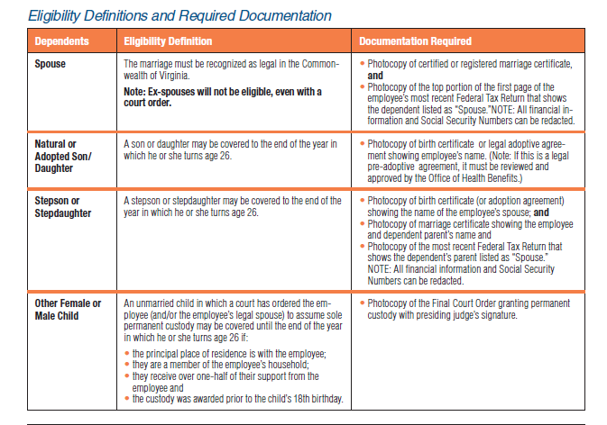
Health Insurance Eligibility
Notes:
If you will be adding dependents to your plan, please review page 2 of your enrollment form for the documentation required. Dependents will NOT be added to the plan until the documentation is received by HR. Do not wait to turn in your form until you have your dependent documentation or your 30 day window to enroll may close.

Slide 52
Medical Plans: Factors in Choosing a Plan
Frequently travel outside of coverage area
Travel Internationally
Tight Budget
Have experienced increase in out-of-pocket expenses
Confused on the plan that is right for you???
Seek help at: www.myalex.com/cova/2022.
Notes:
COVA Care has Blue Card and Global assistance when traveling. Aetna participants must go to an Aetna provider when traveling and Optima participants can only receive emergency care or use MDLive when traveling. These are all important factors to consider when you are electing the healthcare plan that is right for you. You can the Alex Benefits Counselor to assist you in finding the plan that can be the most beneficial to you and your family via the web at: www.myalex.com/cova/2021.

Slide 53
Medical Plans: All Basic Plans
Basic plans include:
Medical
Dental coverage - optional expanded plan
Prescription drug coverage
Behavioral Health
Employee Assistance Program (EAP)
Plan year is July 1 – June 30
Notes:
Medical Benefits: Anthem Blue Cross/Blue Shield administers the medical benefits under COVA Care and Cova HDHP. Aetna administers the medical benefits under Cova HealthAware. Optima HMO is a regional plan that includes expanded dental and vision.
Dental: Delta Dental of VA provides dental coverage for all the COVA plans.
Prescription Drug: Anthem IngenioRX administers the prescription drug program for all the COVA plans.
EAP – All medical plans have an EAP benefit through the plan provider that includes 4 free consultations for participants and their family member dependents.
Basic Dental – includes: Diagnostic and Preventative care at no cost; no deductible. Basic dental allows two teeth cleanings each year.
Expanded Dental (optional premium) – Pays 80% for certain procedures after a $50 deductible. Procedures include: fillings, tooth extractions, & root canals. Complex restorative – Pays 50% after the $50 deductible. Procedures include: inlays, on lays, crowns, dentures, & bridgework. Orthodontics – Pays 50%, with no deductible up to $2,000 lifetime maximum.

Slide 54
Employee Assistance Program
Contact your health insurance provider
Notes:
Contact the phone number on the back of your insurance card to find an EAP provider in your network. EAP assistance provides employees with support for situations that arise during the course of their lives. (Cancer support, financial money management, bereavement counseling, addiction, divorce, etc.) Counselors are available for you.

Slide 55
Medical Plans: Online Access
Anthem COVA Care → LiveHealth Online
Anthem COVA HDHP → LiveHealth Online
Aetna COVA HealthAware → Teladoc
Optima Health HMO → MDLive
Notes:
Log into your respective plan which provide links to the online access.
Anthem COVACare LiveHealth, Aetna Teladoc and Optima MDLive are free of charge with no co-pay.
Anthem COVA HDHP LiveHealth has a $59 co-pay.

Slide 56
Medical Plans: Wellness
Free Office Visits – Children up to age 6
Free Annual Check-ups – Children age 7 & older
Free Routine Screenings & Exams – Adults
Notes:
All plans offer wellness visits and screenings. Wellness and preventive visits consist of having your weight check, blood pressure, etc. You’ll end up paying a co-pay if the visit turns into a physical exam, i.e., if blood is drawn, urine sample is provided, etc. If not, it is free of charge. When making an appointment, let your physician be advised that you are making a “Wellness” visit appointment.
Free: routine gynecological exam, Pap test, mammography screening, prostate exam, and colorectal screening

Slide 57
CommonHealth
Quarterly programs – Variety of formats
Check Digest for on-site health & wellness programs
Program (Weight Watchers, Smoking cessation) available
Notes:
Commonwealth of Virginia employee benefit
CommonHealth offers quarterly programs cover a variety of health and
wellness subjects and are presented in a variety of formats - including
onsite programs and video presentations – that make it easy to participate.
CommonHealth offers these additional wellness programs:
On site health checks every two years
Future Moms - prenatal program, 1-800-828-5891
Tobacco cessation program including free patches and gum to
help you quit.
Quit for Life, 1-866-Quit 4 Life (1-866-784-8454)
Weight Watchers reimbursement
The monthly Compass newsletter
Employees across the state have improved the quality of their lives
through CommonHealth and you can too! See your agency CommonHealth
coordinator or visit www.commonhealth.virginia.gov for more information.

Slide 58
COVA Care
Primary Care | Specialty Care | In Patient Hospital | Emergency Room
$25 | $40 | $300 per stay | $150 facility PCP- $25 Specialist-$40
Notes:
COVACare is a PPO insurance that establishes set co-pays for a variety of services in the BlueCross/Blue Shield network.

Slide 59
Medical Plans: COVA Care Highlights
Vision Basic – Blue View Vision
Routine exam once per year
$15 co-pay
Vision & Hearing Options
Expanded vision
Routine hearing exams - $40 co-pay
Hearing aids and other services
Notes:
More detailed information is available in Spotlight or on the Anthem web site. With the hearing buy-up option, you are entitled to a maximum of $1200 each 48 month period for hearing equipment and services.

Slide 60
Medical Plans: COVA Care Highlights
Out-of-Network Option
Domestic Travel – BlueCard PPO Program
International Travel – Blue Cross Blue Shield Global Core
Notes:
Out of Network Option – Covered services received outside of the BlueCross/Blue Shield network are paid at the in-network level, less a 25% reduction in the amount paid by the plan. The 25% reduction does not count towards your Out-of-Pocket Expense limit. Payments are paid directly to you, not the health provider. Providers may charge more than the in-network negotiated rates and you will be responsible for the additional cost for services.

Slide 61
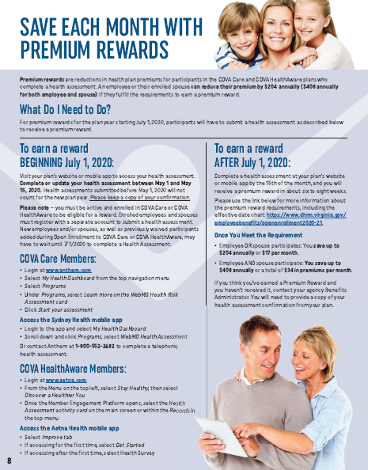
Medical Plans: COVA Care Premium Rewards
Save $17 a month in Premiums! Annual enrollment required
Notes:
Earn $17 off your monthly premiums ($34 for employee and spouse enrolled in Cova Care and Cova Health Aware plans)
Complete an online health assessment. Other screenings may be required depending on assessment
visit: the COVA care or COVA Healthaware plan website for premium reward information in the Spotlight.
Premium Reward program participation be completed each year during open enrollment for the new plan year (i.e. rewards are not a “once and done deal”. You must complete the assessment every year to earn Premium Rewards. If you miss completing the assessment during OE, you may complete it at any time. Rewards take approximately 2 months for state approval before you will see them in your paycheck dated the 16th of the month.)

Slide 62
COVA High Deductible Health Plan
Primary Care | Specialty Care | In Patient Hospital | Emergency Room
20% after deductible | 20% after deductible | 20% after deductible | 20% after deductible
Notes:
There is no premium cost for single coverage COVA HDHP with basic dental. The deductible must be met for all medical and prescription services. The state does not have a participating HSA (Health Savings Account), however, if you elect this plan you may set one up independently with a bank or financial institution offering these plans.
You pay 20% after deductible for:
Hospital services
Emergency Room visits
Outpatient diagnostic laboratory, tests, shots & x-rays
Infusion Services
Outpatient therapy visits
Occupational, Physical, and Speech Therapy
Chiropractic
Behavioral Health Visits
Medical or non-medical professional
Inpatient residential or intensive outpatient treatment
Applied Behavior Analysis (ABA) for autism spectrum
disorder (ages 2-6; $35,000 annual limit)

Slide 63
Medical Plans: COVA HDHP Highlight
You pay low premiums
Expanded Delta Dental Option
Blue View Vision routine eye exams = $15
No Hearing or Out-of-Network available
Notes:
The advantage to participating in the COVA HDHP is the no or low premium. Participants pay the deductible before coinsurance pays anything. You only pay or incur costs if you need service.

Slide 64
COVA HealthAware
Consumer-driven health plan
Includes a Health Reimbursement Arrangement (HRA)
Up to $600 for employee
Up to $1,200 for employee and spouse
Notes:
Aetna participants pay low premium costs each month and receive HRA funds to spend on medical and prescription drug costs before paying out of pocket up to the deductible amount. Once participants reach the deductible amount, the 20% coinsurance becomes effective until the out-of pocket maximum is reached. HRA funds are not used for dental expenses. HRA funds roll from plan year to plan year. Aetna negotiates physician and service charges. Typically, office visits range between $90 and $125. Specialist visits may be slightly higher. Aetna members can manage their HRA by choosing lower cost services and service providers.

Slide 65
Medical Plans: COVA HealthAware
Enrollment Date | Proration Percentage | HRA Adjustment
July 1 | 100% | $600.00
August 1 | 92% | $552.00
September 1 | 83% | $498.00
October 1 | 75% | $450.00
November 1 | 67% | $402.00
December 1 | 58% | $348.00
January 1 | 50% | $300.00
February 1 | 42% | $252.00
March 1 | 33% | $198.00
April 1 | 25% | $150.00
May 1 | 17% | $102.00
June 1 | 8% | $48.00
Notes:
The Aetna plan includes a Health Reimbursement Arrangement (HRA) fund. The chart shows the proration based on the participants date of entry into the plan. Participants entering the plan on July 1 receive $600 (prorated based on hire date) for an employee and $1,200 for an employee who enrolls his/her spouse (HRA funds are do not include dependent children participation in the plan). Dependent children are eligible to HRA funds for their medical expense needs. There is no limit to the amount you can roll from year to year as long as you stay in the Aetna plan. Funds end if you elect a different plan during the next open enrollment or when you have a life event. HRA funds are used before Flexible Spending Account Funds, if applicable.

Slide 66
COVA HealthAware
Primary Care | Specialty Care | In Patient Hospital | Emergency Room
20% after deductible | 20% after deductible | 20% after deductible | 20% after deductible
Notes:
Unlike the Anthem COVACare Plan, the Aetna plan uses the HRA funds first. The employee then pays out of pocket for medical services until the deductible is reached. The deductible applies to all medical and prescription drug services. Once the deductible is reached the 20% coinsurance is in effect until the out of pocket maximum is reached. No further charges for medical nor prescription drug costs are incurred for the rest of the plan year ending on June 30.

Slide 67
Medical Plans: COVA HealthAware Highlights
Pharmacy
HRA covers pharmacy expenses
Retail and Mail Order
Some free generic and preferred brands
Vision & Hearing – Basic & Expanded
Out-of-Network Coverage
Notes:
Out-of-Network Coverage for the Aetna Plan
Plan will pay 40% of allowable charges once deductible is met based on in-network allowable charges.
Provider may charge more than the allowable charge for which you will be responsible for paying.
Aetna offers expanded vision and dental plans as well as the out of network buy-up options like the Anthem COVACare Plan.

Slide 68
Medical Plans: COVA HealthAware
Earn HRA funds – Healthy Activities “Do Rights”
$150 maximum
Do Rights include:
Routine exams
Use MyActiveHealth Tracker
Flu Shot
Completing Coaching Module
Notes:
Unused HRA funds roll over to the next plan year as long as you work at the university. Aetna plan participants may also contribute to a Flexible Spending Account (FSA), however ,HRA funds are used first by the plan. Be conservative if you decide to open an FSA and you are enrolled in the Aetna plan as FSA funds are use or lose for funds remaining in the account after June 30.

Slide 69
Medical Plans: Optima Health HMO
Regional – Hampton Roads coverage area
26,000 providers
Sentara Quality Care, Riverside Health & TMPG Networks
Referral-less HMO/No Out-of-Network except Children
Notes:
Optima is one of the newest regional plans offered to state employees. This is a referral less HMO plan. Participants may elect to go to any physician in the Sentara, Riverside or TMPG Networks along with other providers.
Members may receive services with any participating provider in the Optima Health Vantage network throughout Virginia and northeastern North Carolina. The network includes 100% of major hospitals in Hampton Roads and over 32,500 participating providers. This plan includes lower copayments for primary and specialist care when members seek care through the Sentara Quality Care Network (SQCN) as well as credentialed, in-network doctors within Riverside Health System and Tidewater Physicians Multispecialty Group (TPMG).

Slide 70
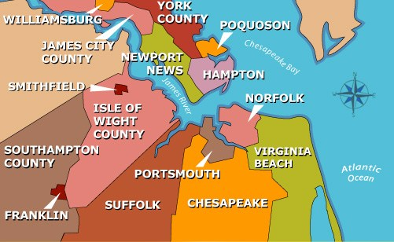
Medical Plans: Optima Health HMO
Notes:
The Optima coverage area includes 17 cities and counties: Hampton, James City, Mathews, Newport News, Poquoson, Williamsburg, York, Chesapeake, Franklin, Isle of Wight, Norfolk, Portsmouth, Southampton, Suffolk, Surry, Virginia Beach, Gloucester
If you are traveling 100 miles from area, pay for emergency care and submit for reimbursement. Otherwise there is no coverage out of the area except for covered children living out of the area.
If you have a non-emergency medical need, you should access MDLive for teledoc assistance.

Slide 71
Medical Plans: OPTIMA Health HMO
No out-of-network provided
Except emergencies over 100 miles from residence
Coverage only provided in 17 cities and counties
Out of Area Dependent Program provides coverage to dependent children who live outside of service area
Notes:
Access to a national network of providers outside of the Optima Health service area through PHCS/Multiplan at the in-network benefit level for eligible covered dependents away at college.

Slide 72
Medical Plans: OPTIMA HEALTH HMO
Includes Expanded Dental
Dominion National
Includes Vision
EyeMed
Notes:
Optima comprehensive benefits include expanded dental benefits through Dominion National and vision benefits through EyeMed Vision Services in one premium cost to participants.

Slide 73
Medical Plans: OPTIMA HEALTH HMO
Primary Care | Specialty Care | In Patient Hospital | Emergency Room
$5 – Tier 1 $25 – Tier 2 | $10 – Tier 1 $40 – Tier 2 | $300 per stay | $150 facility
Notes:
Tier 1: Sentara Quality Network (SQCN), Riverside affiliated physicians and Tidewater Physicians Multispecialty Group (TPMG) - refer to optimahealth.com/cova for full listing

Slide 74
Medical Plans: Health Benefits
Forms must be completed and returned to HR within 30 days of hire
the coverage is effective on the first of the month following the date of hire
failure to submit a form within 30 days of hire will result in an automatic waiver of coverage
Notes:
Failure to make an election within 30 days from your date of hire will result in waiving coverage until next open enrollment in May for a July 1 effective date.

Slide 75
Medical Plans: Making Changes
During Open Enrollment
Usually occurs May 1 to May 15; effective July 1st
With a Qualifying Mid-Year Event
Within 60 days of the event with appropriate documentation
Notes:
Qualifying Mid-year Events (QME) are Effective the 1st of month following application date, except for newborns/adoptions, they are effective first day of month of the birth/adoption.
List of QME listed on the middle of the enrollment form.
Birth/adoption need certificate of birth or adoption
Marriage or divorce need certificate
QME….your able to change your plan and/or membership
REMEMBER….you must make these changes within 31 days of the event
QUALIFYING STATUS CHANGES INCLUDE:
Marriage or Divorce (failure to remove a former spouse may result in your being terminated from the healthcare plan for up to 3 years and you will be invoiced for payments made for treatment from the date of the divorce)
Death of spouse or dependent
Birth or adoption of child
Loss of dependent eligibility
Employment begin/end for spouse
Employee or spouse change to/from part-time/full-time employment
Loss of other employer plan
Eligibility for or loss of government health care
Dept. of Social Services Health Care Coverage Order
on
Initial enrollments eligible during June – not eligible for health changes during Open Enrollment only FSA enrollment which requires completion of a second health enrollment form.

Slide 76
Workers’ Compensation
Report ALL on-the-job injuries or illnesses
Send HR within 24 hours:
First Report of Accident form
Physician Selection form
Doctor Notes
Photo of location
Incident Investigation form
Employee must respond to MCI investigations
Notes:
(Download forms from the HR web page, Forms, Workers’ Comp.)
***Once a panel doctor is chosen by the employee, all treatment must be with that doctor or from a referral from that doctor.***
All pages of the Accident Reporting Packet must be completed within 24 hours and faxed to HR at 757 221 7724 for entering into the state claims system. Do not jeopardize your claim. Complete the forms and fax them to HR for processing within 24 hours. Seek treatment at a panel physician unless emergency room services are required. Turn in all medical notes to HR and take a same day photo. A picture is worth a thousand words. The photo should show details of the unsafe workplace environment. Be sure that you bring forward the unsafe area as we do not want other employees suffering the same accident and want to make the workplace safe for everyone.

Slide 77
Voluntary Benefits Options
Checklist Item | Location | Deadline
Flexible Reimbursement Accounts | Health Enrollment form | 30 Days
Legal Resources | Online Enrollment | 31 Days
Optional Life Insurance | Paper Form | 31 Days
Legal Resources | Online Enrollment | 30 Days
Genworth Long-term care | Online Enrollment | 60 Days
Notes:
Remember that deadlines listed for enrollment are from your date of hire.

Slide 78
UHR IS HERE TO HELP. HOW CAN WE HELP YOU TODAY?
William & Mary
University Human Resources
Bell Hall, 109 Cary Street
Main UHR Phone Number:
(757) 221-3169
Main UHR Fax Number:
(757) 221-7724
HR Email: ASKHR@WM.EDU
WEB: https://www.wm.edu/offices/hr/index.php

