Slide 1












The Internationalization of Community College Education:
Moving Beyond Food, Flags, and Festivals
Stacy Korbelak, Assistant Professor - English
Howard Community College (Maryland)

Slide 2

Credit student population includes students from 106 different nations
About 14% of the student body are English Language Learners (ELL) (total enrollment is approx 10,000)
Faculty and staff with international backgrounds
Support for global objectives in GenEd curriculum
Notes:
Jean
2

Slide 3
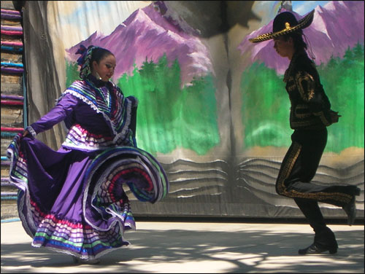

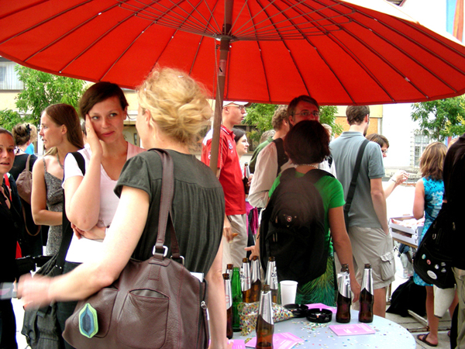
2005: Howard Community College was considered a “globalized” campus
Study Abroad programs
International campus events
Language programs
English Language Institute
We were great with the three F’s: Food, Flags, Festivals

Slide 4
However…
A globalized campus didn’t ensure global learning for all students
  Low numbers of students participating in global events and programs
  Very small percentage of student population in Study Abroad programs (120 per year max)
  Informal surveys revealed that global awareness and learning were not increasing

Slide 5

American Council for Education
Center for International & Global Engagement
“In order for the United States to have a truly world-class higher education system, colleges and universities must be globally engaged and prepare students to be citizens of a multicultural community both at home and in a globalized world. Institutions accomplish this by having a multi-dimensional, comprehensive strategy that includes internationalization at home and engagement with global issues and partners.”

Slide 6
Fall ‘07: HCC Global Curriculum Team formed
Whenever possible, general education course content should include material that allows students to examine issues and events from a global perspective so they can:
Demonstrate a greater global awareness of and appreciation for various cultures and societies throughout the world.
Demonstrate knowledge of historical and contemporary global events from economic, political, environmental, and/or social perspectives.

Slide 7
Examples of Course Outcomes
Describe cultural values and show how these values affect decision making;
Demonstrate an understanding of the effects of global trading on world economies;
Understand the impact and influence of media used throughout the world;
Apply critical writing skills to understanding the interconnections of world cultures;
Use mathematics to model population growth and resource depletion in the world.

Slide 8
Additional Examples
Describe global business practices in areas of finance, marketing, and management;
Identify sustainable environmental practices used in western Europe
Identify the ways higher education influences a nation’s development
Understand and convert from one international unit of measurement to another unit of measurement. Such measurements will include weight, distance, area and volume.

Slide 9
February 2009:
Faculty Began to Globalize Entire Core Courses
English Composition I
Introduction to Business
College Algebra

Slide 10
Freshman Composition Goes Global

Slide 11
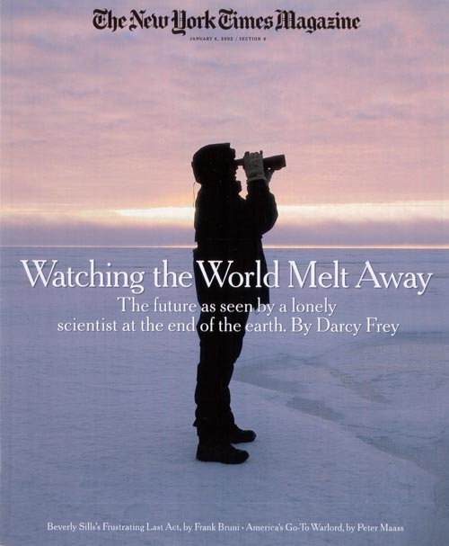
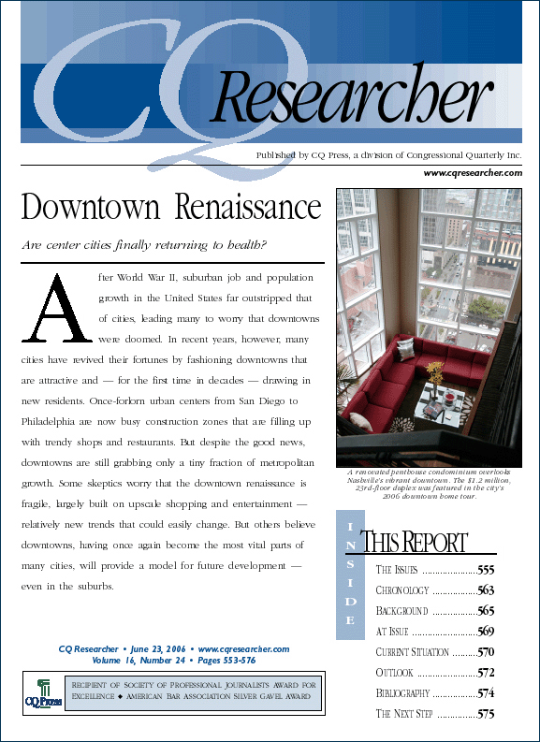
The Specifics …
10 In-Class Discussions

Slide 12

Group Magazine Project for Global Target Audiences

Slide 13
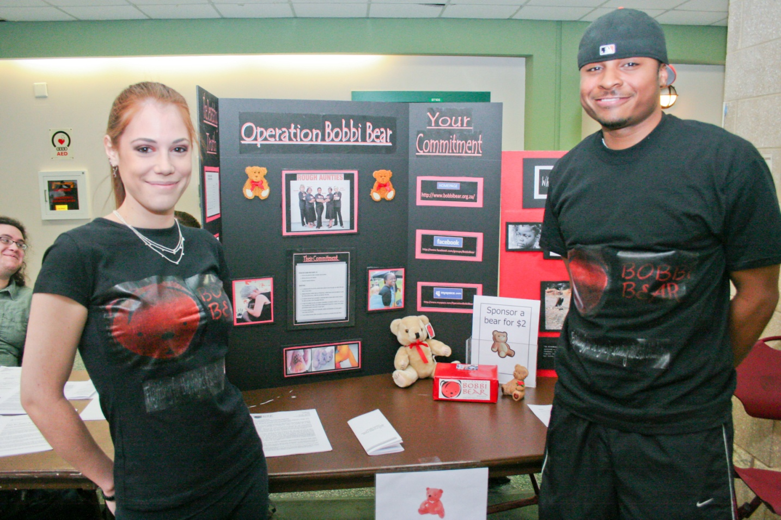
The Sundance Project & Windows to the World

Slide 14
WYPR MD Morning Show Essay & Presentation
http://www.wypr.org/MD_MORNING.html
Going Really Really Green (09:13)
Exhortations to "go green" are everywhere in this economy, but few cities seem to be taking "green" as much to heart as Annapolis. Maryland's capital has developed a plan to produce as much energy as it consumes, locally and sustainably. The man behind this plan is Bob Agee, acting Director of Public Works. We ask him just how he plans to do this.
External Links: City of Annapolis' website on the Renewable Energy Park

Slide 15
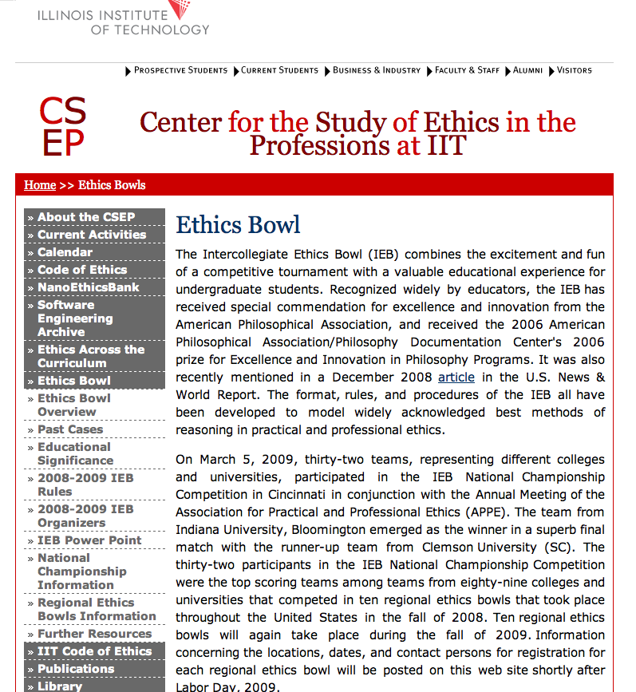
Intercollegiate Ethics Bowl Blog
http://ethics.iit.edu/eb/index.html

Slide 16

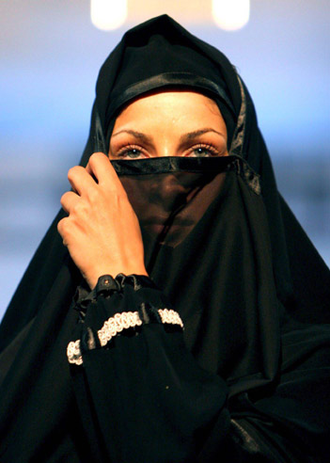
Final Research Essay
Blood Diamond Trading
Iranian government policies increase teen suicide among females

Slide 17
By asking students to choose global topics for the majority of their assignments, they were challenged to become better researchers and writers.

Slide 18
AAC&U: Employer Surveys
How should colleges prepare students to
succeed in today’s global economy?
Graduates need to be cross-culturally literate
Colleges should place more emphasis on the following areas:
  Global issues and developments and their implications for the future
  The role of the US in the world
  Cultural values and traditions in America and other countries
  The ability to collaborate with others in diverse group settings
Notes:
Based on surveys among Employers and Recent College Graduates, LEAP initiative
18

Slide 19
American Association of Colleges & Universities
Essential Learning Outcomes from the
College Learning for the New Global Century Report:
  Knowledge of human cultures through study in the sciences, mathematics, social sciences, humanities, histories, languages and the arts
  Personal and social responsibility to include intercultural knowledge and competence anchored through involvement with diverse communities
Notes:
Report from the National Leadership Council for Liberal Education and America’s Promise (LEAP)
19

Slide 20

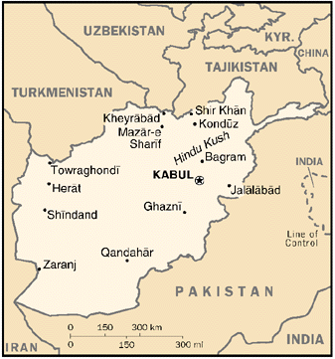

Slide 21
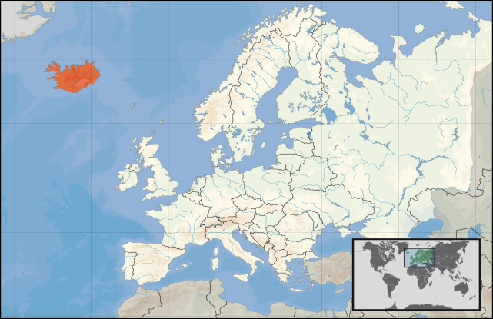

Slide 22

Global Topics Also Enhance
First Year Experience Objectives
Notes:
22
Need title

Slide 23
Students Became Independent Learners
Students will transition into active, independent, and self-aware learners through the exploration and identification of personal, academic and career goals

Slide 24
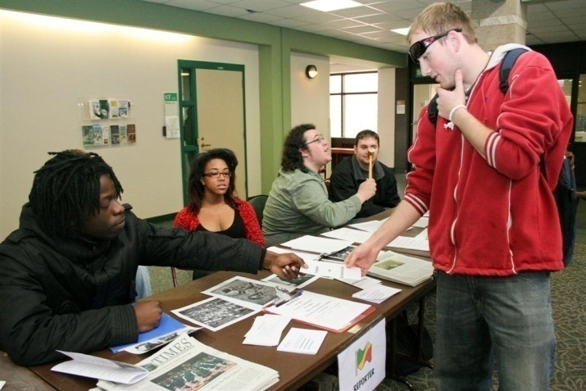
Students Collaborated
Students will assume responsibility for their learning and cultivate connections for success through interaction with faculty and fellow students as well as campus and community resources.

Slide 25
Students Displayed Critical Thinking Skills
Students will synthesize information from a variety of credible resources and make use of appropriate visual media to create an effective presentation.

Slide 26
Fall 2009:
A Joint Faculty Learning Community Formed
Howard Community College + Community College of Baltimore County
  CCBC had strengths in assessment and faculty development
  HCC had global students and international activities
Goals
  To share ideas
  To explore best practices
12 individuals – 6 meetings per year
Notes:
Thus, the FLC and the Program of Global Distinction was created
Jean
26

Slide 27
February 2010
The joint Faculty Learning Community proposes a more formal program based on FLC discussions throughout the fall.
The Global Distinction program is created.
Notes:
Thus, the FLC and the Program of Global Distinction was created
Jean
27

Slide 28
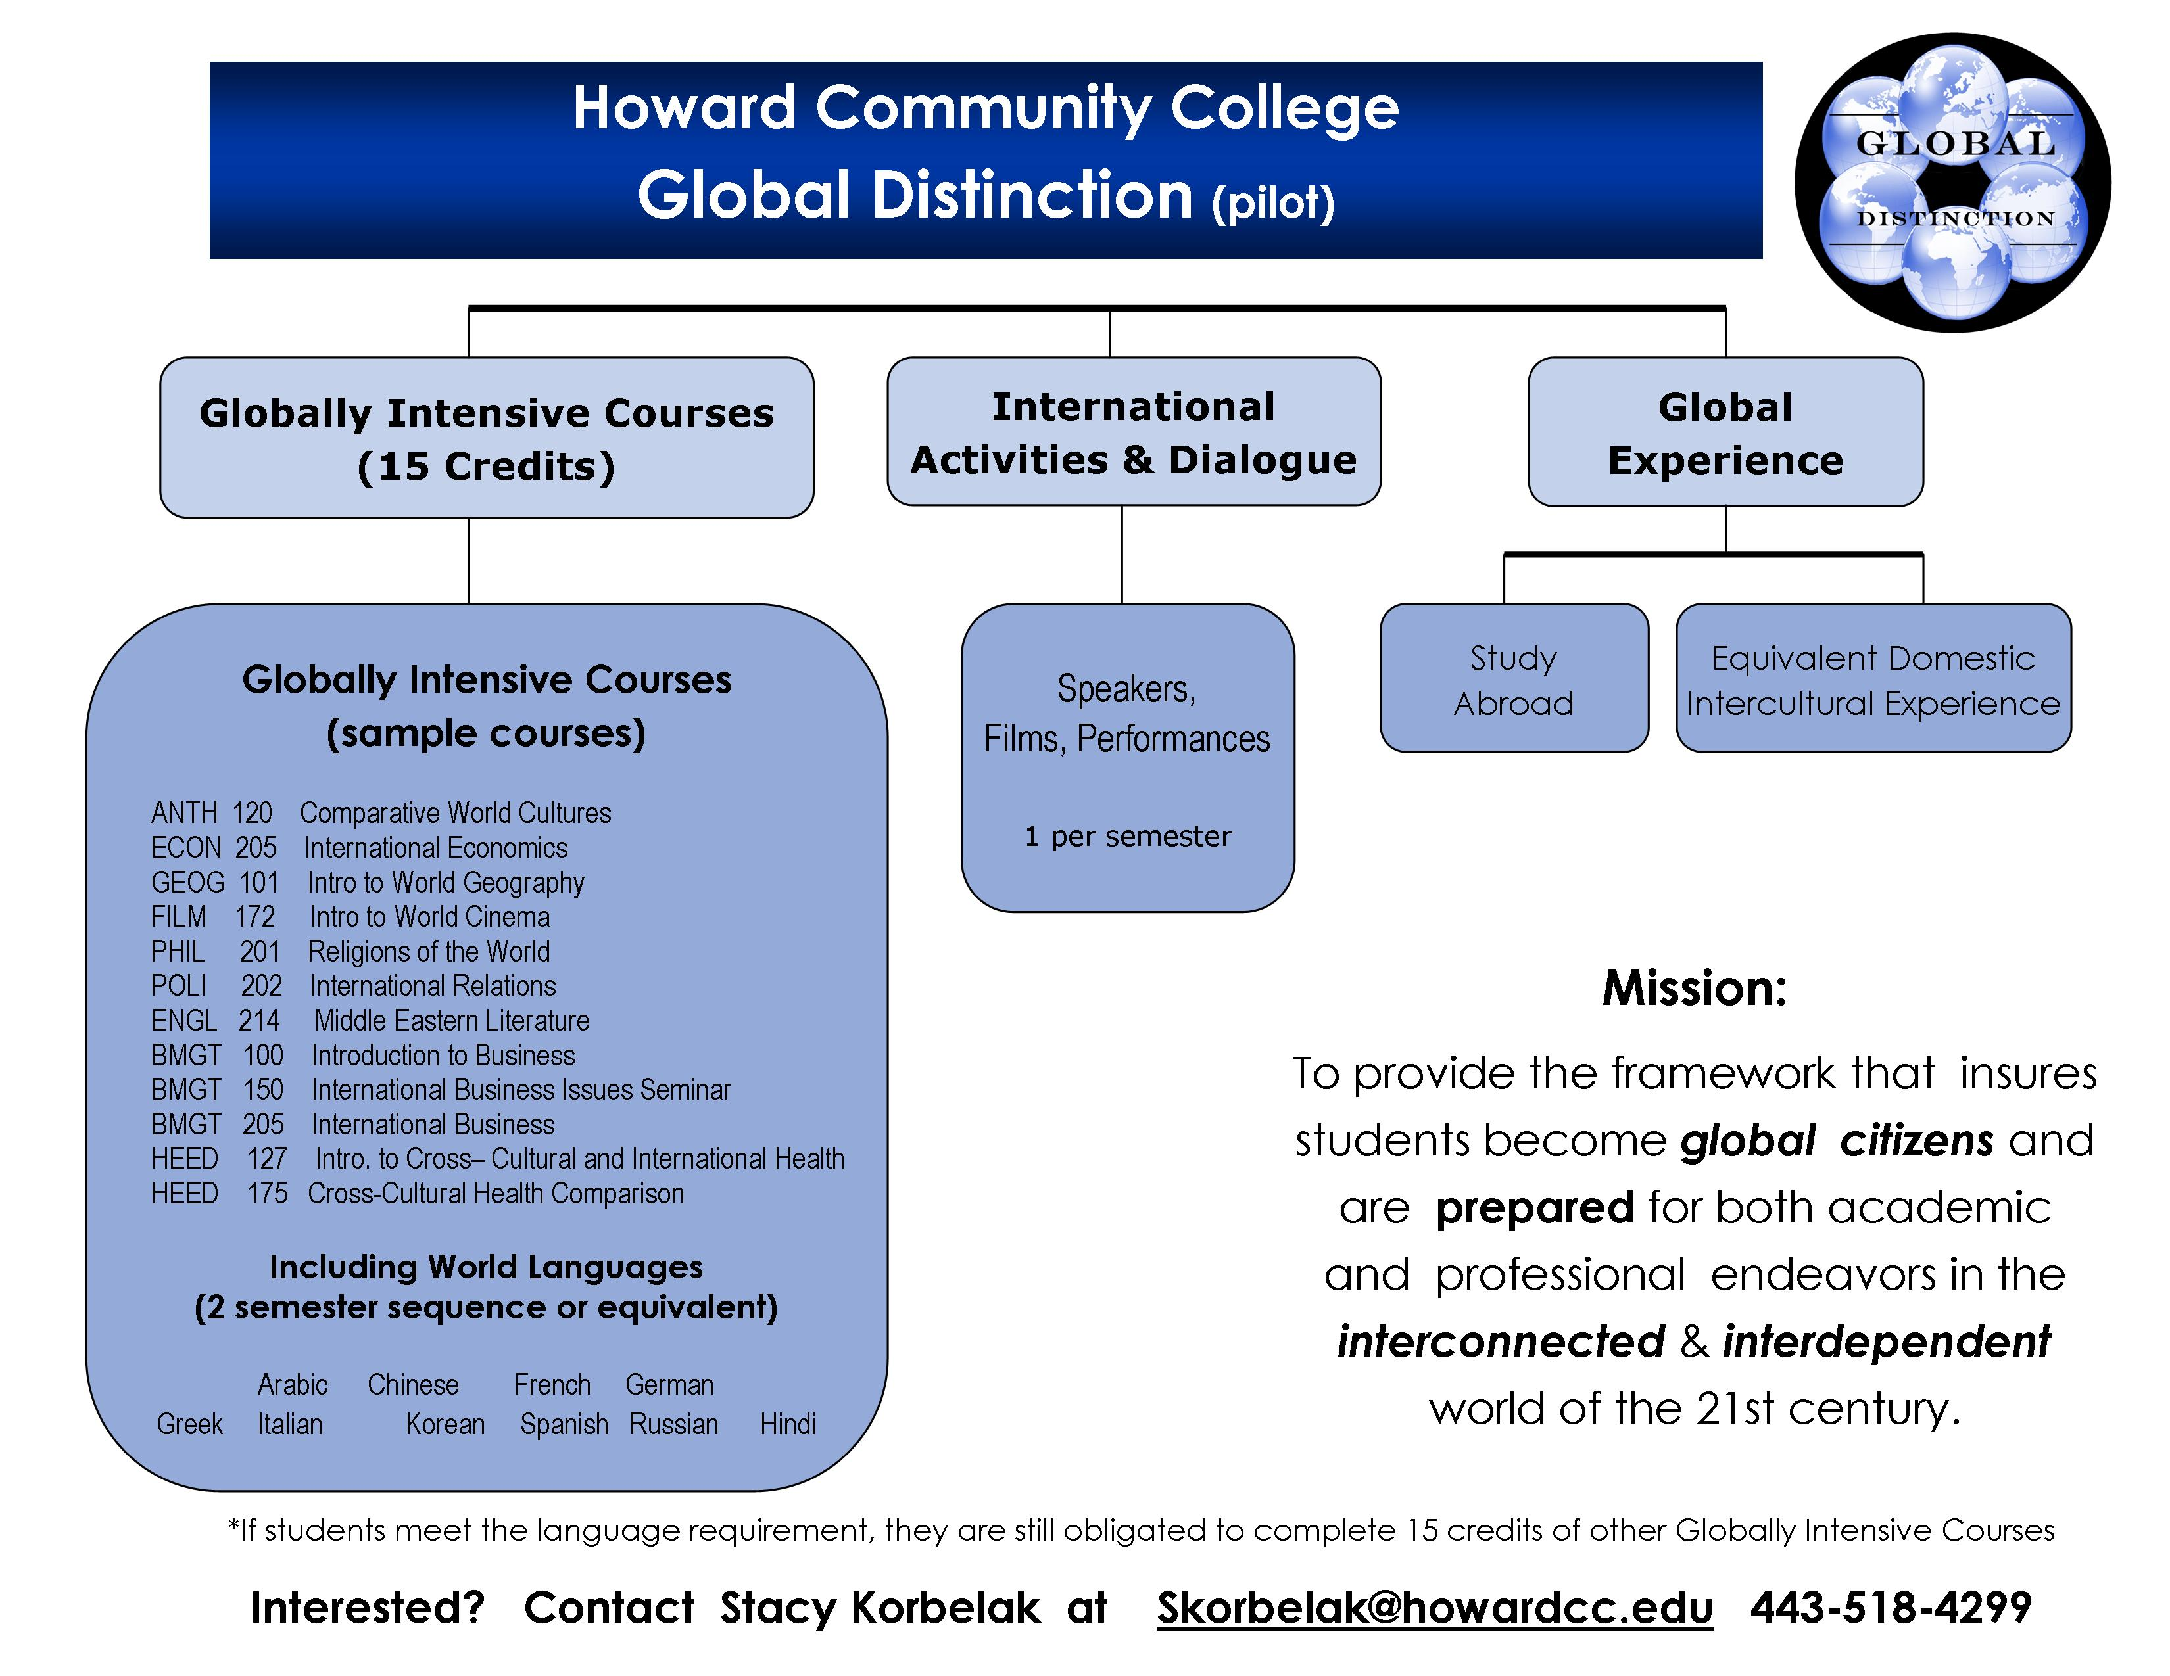

Footnote: sometimes the projects take on a life of their own – long past when the grades are in
Rough Aunties
Smith Theater
September 24, 2009

Slide 29
There was a lot of discussion on the foreign language requirement.
Lack of understanding of global cultures and foreign languages is a challenge that must be addressed, as it negatively affects competitiveness and security in an increasingly global economy. States should encourage the study of other languages and cultures.
(American Association of Community Colleges)

Slide 30
We also decided NOT to require study abroad
According to the IIE’s Open Door Report (2008), the number of American students studying abroad increased by 8% to a total of 241,791 in the 2006/07 academic year.
However…
Only 6,611 of those 241,791 students who studied abroad were community college students.
Only 18 CC’s nationwide sent 100 or more students abroad in 2006/2007.
Notes:
Open Doors report, published annually by the Institute of International Education with funding from the U.S. Department of State's Bureau of Educational and Cultural Affairs
30

Slide 31

Mission Statement
The Global Distinction program provides the framework to ensure that students become global citizens and are prepared for both academic and professional endeavors in the interconnected and interdependent world of the 21st century.
Notes:
mb
31

Slide 32
Awarding “Global Distinction” is a way to formally recognize students who are:
Better prepared to work and interact with individuals from other cultures
Sensitive to other cultures and languages
Ready to participate in a dynamic and changing world
Aware of personal cultural norms and how they shape one’s views & perspectives
Engaged in civic responsibility
Notes:
mb
32

Slide 33
Timeline
July 2010 - a two year pilot of the program began at Howard Community College and The Community College of Baltimore County
Fall 2010/Spring 2011 - Students were recruited through global classes; the CCBC-HCC Faculty Learning Community continues to meet monthly
Fall 2011 - The advising handbook was completed and assessment tools developed or selected.
Spring 2012 – The program received two national awards (Andrew Heiskell Award (iie.org) & the Diana Hacker Reaching Across Borders Award (TYCA)
Notes:
mb
33

Slide 34
Additional Recommendations
Institutions should consider providing incentives to encourage participation in the Global Distinction program, such as:
Special recognition at graduation
“Graduated with global distinction” noted on the official transcript
A private study lounge
Cohort seminars
Scholarships and/or easy transfers (pathways and articulation agreements) to 4-year institutions
Early registration
Dedicated advisor
Semester cohort socials/events
Notes:
mb
34

Slide 35
Future Plans
Expand the program to other community colleges around the nation
Recognition by 4 year schools and employers
Notes:
jean
35

Slide 36
What we’ve learned so far …
Bring key stakeholders to the table early
Admissions/Advising
Registrar
International Education/Study Abroad
Service Learning
Career Placement
Recruit from classes that “count” toward distinction
Interview students before acceptance into the program
Gather participants together once per semester to build community
Notes:
jean
36

Slide 37









QUESTIONS? COMMENTS?

Slide 38
Contact information
Stacy Korbelak
Assistant Professor
Coordinator, Global Distinction Program
Division of English and World Languages
Howard Community College – Columbia, MD
443.518.4299
skorbelak@howardcc.edu
Notes:
Jean
38

Slide 39
References
American Association of Community
Colleges (AACC). http://www.aacc.nche.edu
American Association of Colleges & Universities (AAC&U). College Learning for the New Global Century: A Report from the Council on Liberal Education and America’s Promise (LEAP). http://www.aacu.org/leap/documents/GlobalCentury_final.pdf
Institute of International Education. Open Doors 2008. Report on International Educational Exchange: Community College Data Resource.
http://opendoors.iienetwork.org/page/136343/

