Slide 1
Timesheet Review

Slide 2
Timesheet Requirements
Non-Exempt
Required to report all hours worked.
Must report a minimum of 40 hours per FLSA work week, which may include exceptional time, holiday or LWOP.
Must report additional hours worked.

Slide 3
Reporting Hours
Sunday through Saturday – W&M
Saturday through Friday – VIMS, Athletics
8 hours a day not including lunch
40 hours a week
Additional Hours Worked are recorded on different line, only after a total of 40 hours has been reported for the FLSA week.

Slide 4
Terms
Additional Hours
Total hours reported in a week in excess of 40 hours (Any combination of hours to include exceptional time.)
Overtime Hours
Total hours worked in a week in excess of 40 regular hours.
***Not all Additional Hours qualify to be paid as Overtime***

Slide 5
Completing the Timesheet
Timesheet Default Hours
Regular Hours
Holidays

Slide 6
Reporting Actual Hours Other Than Default
Example: Employee works 10 hours on Thursday, July 6
Employee will override the default 8 hours and enter 10 hours on the Regular Pay line.

Slide 7
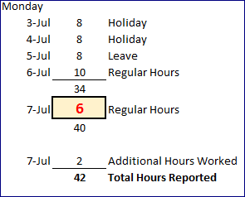
As the employee completes the timesheet and the 40 hour reporting requirement is met for that week, employee must commence reporting hours on the additional hours line (pay or leave).

Slide 8
Remember to look back to previous timesheet when reporting hours for FLSA work weeks that span pay periods – here the pay period begins on July 10, but the FLSA work week began on July 9

Slide 9
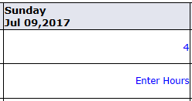
Hours worked on July 9 must be included in calculations to arrive at 40 hour total for the week ending July 15.

Slide 10
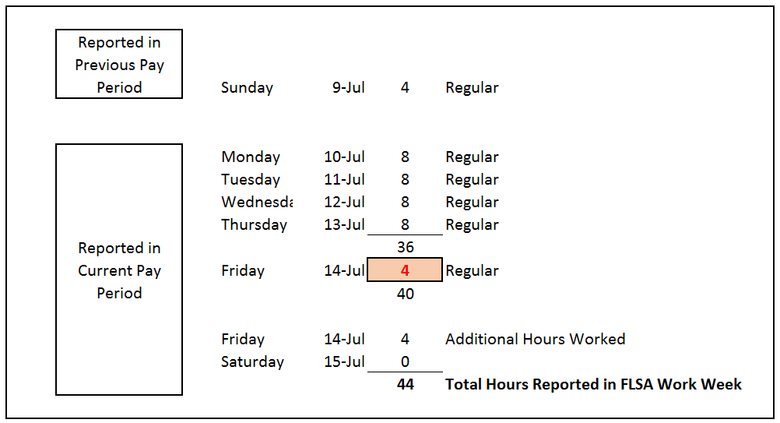
In this example, the employee worked their normal 8-hour work week (M-F) and must drop down 4 hours to Additional Hours Worked on Friday, July 14 to account for 4 regular hours reported in the previous pay period, for the current FLSA work week.

Slide 11
Walkaways
System Defaults 8 hours a day automatically.
Employee must record hours worked on the day the employee worked them.
Employee must report at a minimum, 40 hours per each FLSA week - any combination of regular and exceptional time.
After 40 hour requirement is met; employee must start recording hours worked as Additional Hours Worked (Pay or Leave).

