Slide 1
Payroll Basics for Salaried Employees
Presented by
Simonne Vance
Payroll Manager

Slide 2
Purpose
The purpose of this presentation is to introduce you to the basic principles of Payroll.

Slide 3
Agenda
Time Sheets
Self Service Access and Completing Your Time Sheet
Reporting Your Hours
Submission Deadlines
Manual Time Sheets
Employment Taxes
Federal and State Withholding
FICA
Pre-Tax Deductions
After-Tax Deductions
Direct Deposit / Electronic Form W-2

Slide 4
Time Sheets

Slide 5
Self Service Access
Employees of The College and VIMS are expected to submit their time sheets online using Banner’s Self Service module.
Employees use Self Service to complete time sheets, check benefits, leave balances, review paystubs, submit Withholding Certificates and access Form W-2.
Self Service Link

Slide 6
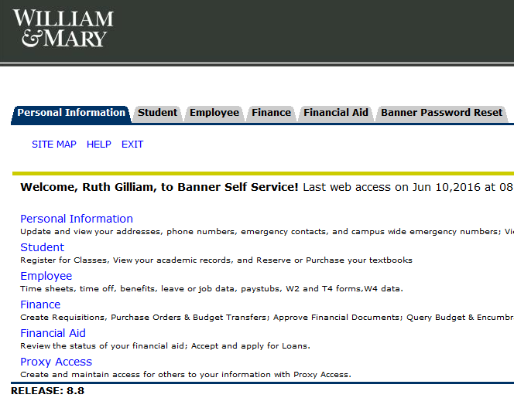
Logging into Self Service
Login with your ID and password
Click Here

Slide 7
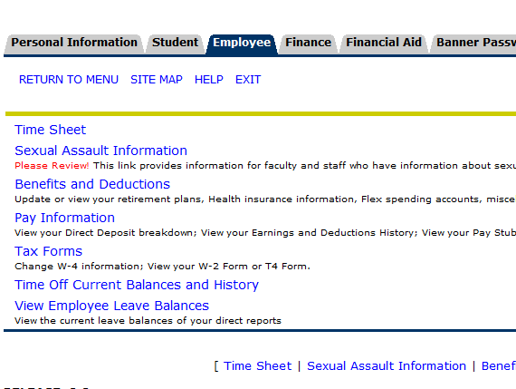
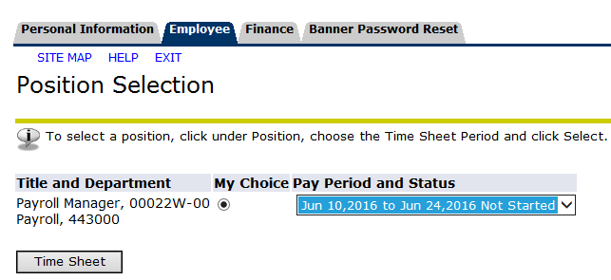
Accessing Your Time Sheet
Click Here
Access your time sheet
Select the pay period
Click to open time sheet

Slide 8
Enter hours here
Save
Submit for approval at end of pay period

Slide 9
Reporting Your Hours
W&M: Sunday to Saturday
Athletics/VIMS: Saturday to Friday
Hours in excess of 40 must be recorded as Additional Hours

Slide 10
Submission Deadlines/Pay Periods
Salaried Employees:
Pay periods:
10th - 24th, Paid 1st
25th - 9th, Paid 16th
Must be submitted no later than 6:00PM on the last day of the pay period, generally the 9th and 24th of each month*
Hourly and Student Employees:
Pay periods:
1st – 15th, Paid 1st
16th – 31st, Paid 16th
Submitted no later than 6:00PM on the 9th /24th of the month – We strongly recommend that student and hourly time sheets are submitted the last day of the pay period (the 15th and last day of each month)
* Dates subject to change - Please refer to the Commonwealth of Virginia Pay and Holiday Calendar found at Human Resources/Current Employees/ Pay Dates at www.wm.edu for published deadlines.

Slide 11
Manual Time Sheets
In the event that a time sheet was not submitted prior to the published deadline, a manual time sheet must be completed and forwarded to your supervisor for approval and submission to the Payroll Office
A PDF version of this time sheet can be found at Human Resources/Current Employees/ Web Time Entry by clicking the Manual Time Sheet Form link

Slide 12
Click here

Slide 13
Employee Type
Pay month, dates, year
Enter hours here
Reason for manual

Slide 14
Approvers will then sign the time sheet and submit it directly to the Payroll Office for processing in the next payroll
The Payroll Office cannot accept time sheets from the employee – all time sheets must be submitted by the approver

Slide 15
Employment Taxes

Slide 16
Federal and State Withholding
Generally, all employees are responsible to pay both Federal and State income taxes on their wages and other taxable earnings as outlined by the Internal Revenue Service
Tax withholdings are calculated based upon formulas provided by the taxing authorities, using filing status and personal exemptions as reported by the employee on Forms W-4 and VA-4

Slide 17
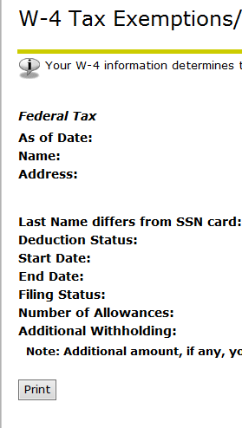
Completing Form W-4
Click Here
Click here
Select Update at bottom of next screen

Slide 18
Select filing status, and certify changes

Slide 19
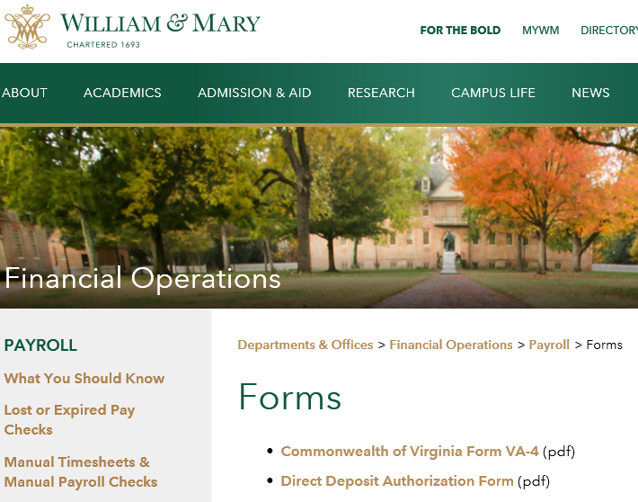
Completing Form VA-4
Click Here
Form VA-4 must be printed and submitted to the Payroll Office for processing
Complete highlighted boxes

Slide 20
FICA Taxes
Generally, all US citizens are subject to FICA taxes (Social Security and Medicare)*
2016 wage limit for Social Security is $118,500
There is no wage limit for Medicare, however, wages in excess of $200,000 per year are subject to an additional 0.9% withholding
* Exemptions do apply for some taxpayers – if you think you may qualify, please contact the Payroll Office for assistance

Slide 21
Pre-Tax Deductions

Slide 22
Pre-Tax Deductions
These deductions reduce your taxable wages, thereby reducing your income tax withholdings
Some examples are:
Parking Decal fees
Health Premiums
Flexible Spending for Medical/Dependent Care
Retirement Contributions
The Federal taxable wages shown in Box 1 of your W-2 have already been reduced by these pre-tax deductions – please note that your annual salary will not be the same as the amount shown in Box 1
Please see your Human Resources Team to discuss these employee benefits in greater detail

Slide 23
After-Tax Deductions

Slide 24
After-Tax Deductions
These are deductions that can be paid via payroll deduction, but are not considered tax deductible for payroll calculation purposes
Some examples are:
Charitable giving
Child Support
ROTH retirement contributions
Legal Services
Garnishments
Please see your Human Resources Team to discuss these employee deductions in greater detail

Slide 25
Direct Deposit Electronic Form W-2

Slide 26
Direct Deposit
The College and VIMS requires all employees to be paid via direct deposit to either a checking OR savings account
Benefits to the employee may include:
Waived banking fees
No lost or misdirected paychecks
Immediate availability to the funds on payday
Direct Deposit Authorization Form is available on the Payroll webpage via the Forms link

Slide 27
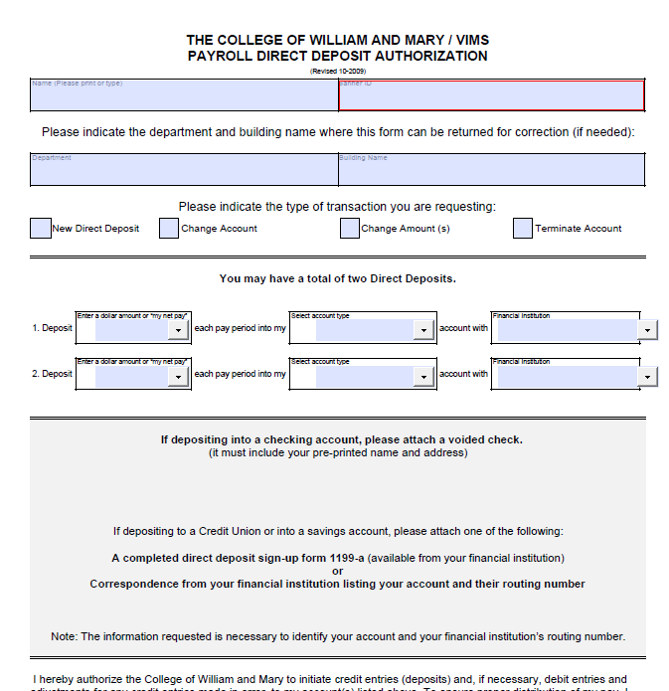
Click Here
Direct Deposit Authorizations must be printed and submitted to the Payroll Office for processing
Complete and attach void check or bank information

Slide 28
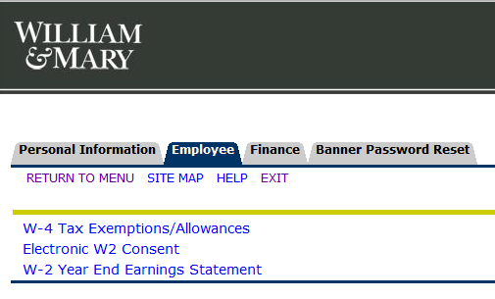
Electronic W-2
Select Tax Forms
Click Here
Consent and Submit

Slide 29
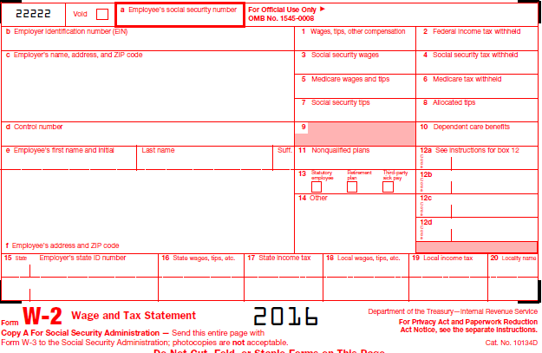
Printing your W-2
Select Tax Year
Click Here

Slide 30
Questions and Answers
Contact Information:
Simonne Vance
Payroll Manager
221-2844
smvance@wm.edu

